Slide 1
Greenwich CVD & Diabetes Resource Pack

Slide 2
Greenwich CVD & Diabetes Resource Pack Index (click the link to the relevant section)
Purpose of the Greenwich CVD & Diabetes Resource Pack
CVD: National Operating Plan Targets 23/24
Cardiology – General Information
Hypertension
CESEL Resources
Lipids Management
Diabetes
NHSE Outcome Improvement Programme
Opportunities for 8 CPs
Access to SEL BI Dashboard for 8CPs / 3TT
Non Diabetic Hyperglycaemia Project
Live Well Greenwich
Diabetes Prevention
Diabetes Education
Example of Call & Recall
Weight Management Programmes
Diabetes NHS Services
Injectables Therapies’ Initiation Service
Prevention Services and support for patients
  Healthy Eating
  Physical Activity
  Smoking Cessation
  Drug & Alcohol Services
  Talking Therapies
  Voluntary Sector
  Greenwich Supports

Slide 3
Purpose of the Greenwich CVD & Diabetes Resource Pack:
Overview of CVD & Diabetes Targets
Examples of improvements in hypertension and diabetes
Services and resources available to support patients and Practices

Slide 4
CVD:
National Operating Plan Targets 23/24:
Increase percentage of patients with hypertension treated to NICE guidance to 77% by March 2024
Increase the percentage of patients aged between 25 and 84 years with a CVD risk score greater than 20 percent on lipid lowering therapies to 60%

Slide 5
SEL ICS Joint Forward Plan-Cardiovascular disease (CVD)
CVD prevention and improvement
To develop and implement integrated Cardiovascular Pathways and Services within SEL which improve both the clinical and care outcomes for patients living with CVD and also the prevention of CVD within the broader population. We will also focus on actions which have a specific impact on preventing Coronary Heart Disease (CHD), with a focus on AF and HF detection/ management, support the full Elective Recovery of cardiac surgery position and reduce inequality of cardiac outcomes.
How we will secure delivery
Intended outcomes in 5 years time
We will undertake an end to end pathway review of patients suffering from Cardiovascular Disease, including:
Developing a coordinated and personalised prevention offer coordinated across multiple agencies
Improving identification of, and earlier intervention for, patients at risk of cardiovascular disease
Improving the effective management of blood pressure, lipids and stroke prevention
Reviewing demand and capacity at all points of the pathway (including diagnostics) and develop approaches to better manage demand through integrated care models
Understanding the impact of variations in clinical practice and move towards common standards and approaches.
Improve the current pathway and package of support for patients following a cardiac event
We will deliver against the 2 national 23/24 Operating Plan targets around Hypertension and Lipids
Reduce Under 75 mortality from Cardiovascular Disease
80% of the expected number of people with hypertension are diagnosed by 2029
80% of the total number of people diagnosed with hypertension are treated to target as per NICE guidelines by 2029
Increase the percentage of patients aged between 25 and 84 years with a CVD risk score greater than 20 percent on lipid lowering therapies to 60%
85% of the expected number of people with AF are diagnosed by 2029
90% of patients with AF who are known to be at high risk of a stroke to be adequately anticoagulated by 2029 – reducing stroke incidence across SEL
Increase referrals to cardiac surgery to align more with the London average
Improve Transcatheter Aortic Valve Implantation take-up across black and minority ethnic populations
Actions for 23/24
Undertake an equalities health review of CVD and identify priority actions to reduce health inequalities
Develop and test integrated out of hospital models of care for the management of heart failure which integrates workforce, processes and clinical management across primary, community and acute.
Undertake a review of stoke and neuro-rehabilitation.
Work with the Cardiac Network to improve timely access to electrophysiology and ablation
Embed the learning from SQUIRE funding pilot to improve stroke rehabilitation in SEL
people as key driver
Actions for 24/25

Slide 6
Cardiology –
General Information

Slide 7

Queen Elizabeth Hospital – Cardiology Services
Cardiology Services in Greenwich
The department provides a comprehensive cardiology service for adults, providing diagnosis and treatment for a range of heart conditions. Patients can be referred by their GP or the hospital's Emergency Department.
Contact details
Cardiology Department: 020 8836 4343 Monday to Friday between 9am – 5pm
The Cardiac Catheter Lab is open 9am – 5pm
The Department has a comprehensive nurse specialist service covering Arrhythmias, ACR, Cardiac Rehabilitation, Heart Failure and RACPC
What conditions does the department treat?
The department treats a wide variety of conditions in adults, including:
Acute coronary syndromes
Heart failure
Hypertension
Atrial fibrillation/flutter
Supra ventricular tachycardias
Ventricular arrhythmias
AV nodal disease
Syncope and pre syncope (fainting, lightheadedness)
Pericardial effusion/tamponades (collection of fluid around the heart)
Endocarditis ( a rare heart infection)
Myocarditis/pericarditis (inflammation of the heart muscle)
Cardiomyopathy (heart muscle disease)
Valvular heart disease
Services provided
Inpatient and outpatient cardiology
RACPC (rapid access chest pain clinic)
Atrial fibrillation (AF) clinic
DC Cardioversion
Hypertension clinic
Pacing
Acute coronary syndrome (ACS) inpatient and outpatient services
Heart failure inpatient and outpatient services
Inpatient and outpatient exercise treadmill testing (ETT)
Echocardiography (a painless study using ultrasonic waves to visualise structural and functional abnormalities of the heart),
24-hout ECG monitoring and blood pressure monitoring
Patient activated monitoring (PAM)
GP direct access echocardiography, 24-hour ECG monitoring, blood pressure monitoring and ECG
Transoesophageal echocardiography (TOE)
Cardiac CT
Myocardial perfusion scan
Stress echocardiography

Slide 8

Oxleas NHS Foundation Trust: Cardiac Service
We are a community based multidisciplinary team. We provide Heart Failure and Cardiac Rehabilitation adult community services for patients registered with GP surgeries across Bexley and Greenwich.
Our team compromises of administrators, cardiac nurses, psychologist, cardiologist for clinical supervision, dietician, health care assistance and exercise specialists.
Our Heart failure service
Oxleas Heart Failure service is a multidisciplinary team who provides education, support and clinical management, including drug titration to patients with a confirmed diagnosis of heart failure. The service is mostly delivered in a variety of community clinics with home visiting for those who are housebound. Virtual appointments are provided using telephone consultations or video technology as appropriate.
Our Cardiac Rehabilitation service.
The service is provided by specialist cardiac rehabilitation nurses and specialist exercise professionals. We aim to:
Restore the patient to their optimal level of health by addressing physical, psychological and social needs.
Enable the patient to make informed choices about health issues and improve their understanding of their cardiac rehabilitation.
Include patients’ families, carers and support networks in aspects of care and service provision.
The service is mostly delivered in community clinics. Home visits are available for patients who are housebound. Our exercise sessions are delivered in community-based gyms.
We run a weekly educational programme covering cardiac-related health topics. The aim is to empower our patients to self-manage their condition.

Slide 9
Greenwich Cardiac Service
Contact Details:
Base Address: 151-153 Lodge Hill, Goldie Leigh, Abbey Wood, SE2 0AS
Telephone: 02083197060
Cardiac generic email: oxl-tr.cardiac@nhs.net.
GP Referrals via: Single point of Access Email.
oxl-tr.greenwich-singlepointofaccess@nhs.net

Slide 10
Hypertension

Slide 11
Opportunities for Blood Pressure Readings
Opportunistic
Targeted Ordered Process
Pt has blood pressure taken at any Practice appointment they attend, regardless of condition complaint
Health checks
At community pharmacy (over 40s)
Using blood pressure machines at reception
Appointing a Blood Pressure Champion within each practice
Holding late or weekend clinics for patients who are working
Carry out blood pressure checks within vaccination clinics
Educating patients on how to take their own blood pressure at home. Using AccuRx to collect the readings.
Using support staff ie. Care coordinators and social prescribers to contact patients that are non responsive
Have a clear process within the practice to signpost patients with elevated BP reading to the appropriate clinicians
Reception staff to regularly check “pink” alert box on EMIS to ensure patients have had relevant reviews / checks
Pt asked to submit own reading
Pt asked to attend local community pharmacy with details of those nearby
Pt asked to pop into the Practice to use the blood pressure machine in the waiting room (where available)
Pt asked to make an appointment with the HCA to have blood pressure taken
Where no response, Care-coordinator calls patient to offer them the above options to provide their blood pressure

Slide 12

CESEL Resources
CESEL resources, including webinars for clinicians and administrators, the Greenwich hypertension & T2DM clinical guides can be found here.
CESEL offers practice/PCN visits, or informal conversations with any members of the Primary Care Team – administrators and clinicians likewise. The purpose of these sessions is to help your practice and PCN towards achieving its long-term conditions processes and targets. These sessions can include going through focus data packs, highlighting most important searches and education. CESEL will shape the visit/support session according to what suits your practice/PCN best
Access to CESEL’s Hypertension webinar for non-clinical staff
  https://seltraininghub.co.uk/2023/10/sel-hypertension-webinar-for-non-clinical-staff-with-atinuke-afanu-and-nupur-yogarajah/
To arrange a visit please contact Anu, your CESEL Greenwich Facilitator – Anu.singh@selondonics.nhs.uk

Slide 13
Lipids Management

Slide 14

Unmet CVD needs: lipid management
CVD Area | Gap
Lipid management: Primary prevention | Detection and optimised treatment of people with increased CV risk requiring lipid lowering therapy to reduce myocardial infarctions and strokes in SEL. In 1 borough: 16,366 people with a QRisk score > 10% are not on a statin (but most eligible patients have not had a QRisk score recorded in last 5 years). Initiating a statin in these patients would prevent 818 major CV events over 5 years NNT=20
Lipid management: Secondary prevention | Medicines optimisation with HI statins and second line therapies to reduce CV risk in populations with CVD in SEL. In 1 borough: 24% patients with CVD are not prescribed any statin; 55% patients with CVD are on a sub-optimal intensity or dose of statin. Initiating a statin in the 2,240 patients with CVD not on a statin would prevent 224 major CV events over 5 years (deaths / MIs / strokes) NNT = 10
Lipid management: FH familial hypercholesterolaemia | SEL acute trusts have capacity and resource limitations with current waiting times to first consultation now at 9 months. These clinics need to focus on FH genetic diagnosis and management, and are moving to cascade testing services, with current IIF incentives in primary care to identify patients that may have FH. Acute lipid clinics also accept referrals for patients with statin intolerance/not achieving targets after optimal interventions.
Lipid management: injectable therapies | Two PCSK9i therapies are very effective at reducing LDL-C and non-HDL-C. PCSK9i Mabs: started and reviewed in secondary care and the patient self-administers every 2 weeks. Inclisiran: started in primary or secondary care with follow ups at 3 months and then every 6 months- 70 patients initiated to date We currently do not have an agreed model for the administration and follow up for inclisiran in SEL
Lipid management: statin intolerance and hesitancy | QI project data: less than 50% of patients are willing to start or to keep taking statin therapy- we need to support these consultations and lifestyle interventions. Many other options are available for lipid lowering and reducing CV risk which should be consistently explored in SEL populations. Adding in second line medications to 694 patients with maximal statin therapy but not at target would prevent up to 22 major CV events over 5 years NNT = 32-45 Virtual clinic models and upskilled PCN staff will support this process in primary care and reduce CV risk in SEL populations

Slide 15

Action Plan for Lipid Management
Lipid management | Action plan
Primary prevention | Incentivised by the CVD DES IIF –improvements seen 2022/23 as some PCNs have capacity to review high priority groups and check QRisk at every opportunity
Secondary prevention | No national incentives but some SEL boroughs have local MO schemes around statin optimisation- restarting or initiating high intensity statins in high CV risk populations. There are 23,000 patients in SEL with CVD with TC >5mmol/L- our aim is to prevent them having an MI or stroke
Familial Hypercholesterolaemia | Incentivised by the CVD DES IIF- identification and diagnosis of patients with FH: however increased number of referrals to secondary care- working with primary care supporting patient searches/ flowcharts for patient reviews and review of referral forms to eliminate unnecessary referrals and reduce waiting times for clinic appointments
Medicines optimisation | Lipid management webinars across SEL and PCNs have supported HCPs with SEL and national lipid management guidance and escalation of therapy beyond statins in patients not achieving sufficient cholesterol lowering. We want this to happen consistently and routinely across SEL with equitable access to all therapy options for all patients in SEL.
Second line therapies | Ezetimibe is available in primary care but is under-utilised. Bempedoic acid is amber listed but should also be available in primary care to manage patients with statin intolerance and those not achieving targets on ezetimibe – there is no capacity in secondary care to manage all statin intolerant patients. There is a secondary care pathway for PCSK9i (MAbs) – but the hospitals may move some eligible patients onto inclisiran instead. NICE figures predict 1,250 eligible patients in SEL for PCSK9i MAb and 14,700 eligible patients in SEL for inclisiran. There is no agreed plan for on-going administration of inclisiran 6 monthly; but the acute team do expect that there will be a primary care pathway in place for these patients in the near future.
Community settings | We currently have a pathway that stalls after initiation of a statin, often at a suboptimal intensity or dose, and we are addressing this through education and training support to all HCPs. However, we need to increase capacity within primary care to review all patients in SEL in community settings with support from CVD and lipid specialists to maximise lipid management through medicines and lifestyle optimisation and associated CV risk reduction for SEL populations.

Slide 16
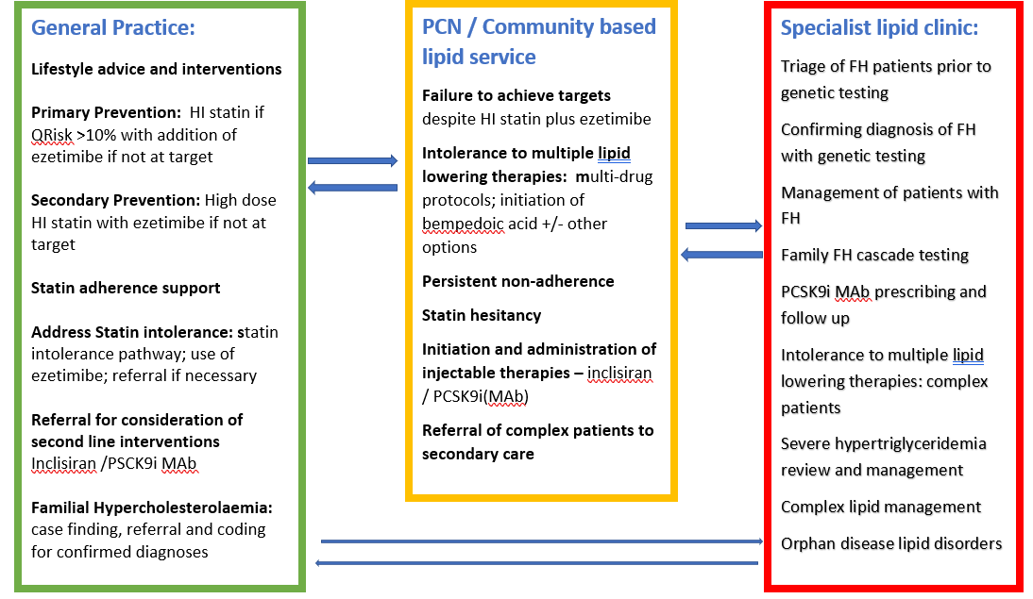
Lipid management priorities and clinical settings proposal

Slide 17

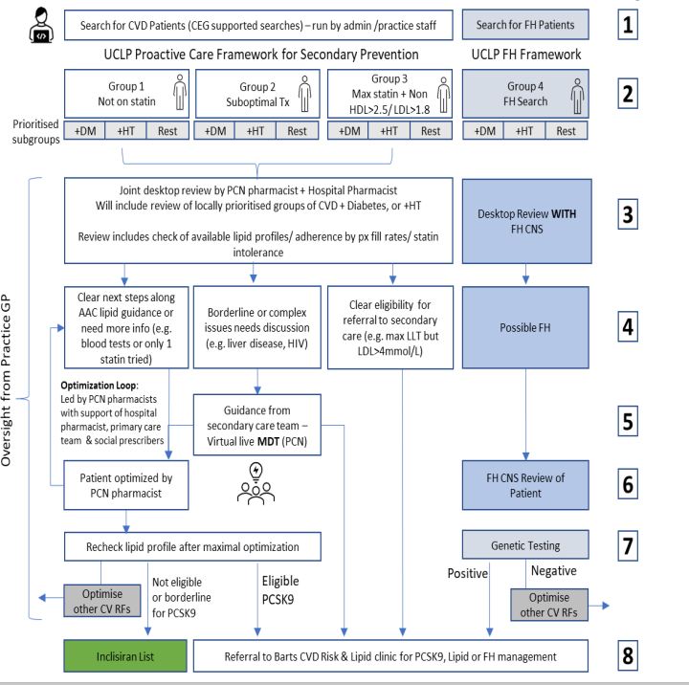
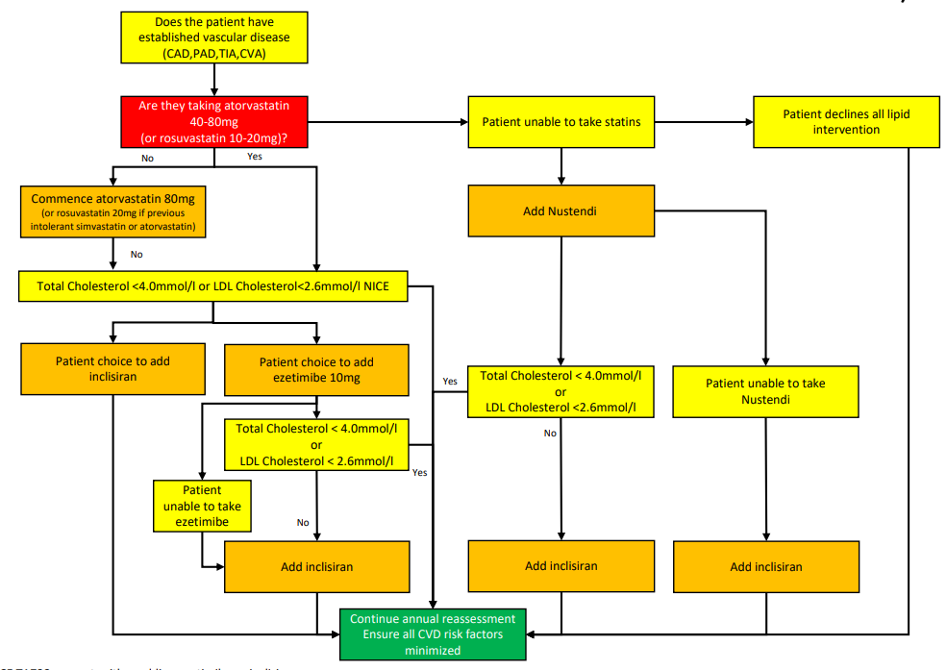
Examples of successful lipid transformation pilots
Barts/Brompton: FH outreach hubs
Carol Hayes and Sotiris Antoniou
Affinity Care: pharmacist-led inclisiran clinic in primary care
Dr Matthew Fay– Cardiovascular lead GP, Affinity Care
Mahmoud Khodadi– Lead Pharmacist, Affinity Care

Slide 18
Diabetes

Slide 19
NHSE Diabetes Outcomes & Improvement Programme
This is a SE London scheme, launched in March 2023. The aim of this programme is to provide financial support to PCNs to make improvements in 8 Care Processes & 3 Treatment Targets and reduce variation within their PCN
Funding covers the years from 2022/23 to 2024/25
PCNs have been able to decide how to best utilise the funding to make improvements in patients’ outcomes
For 22/23, there were no targets associated with the payment
For 23/24, PCNs will receive 75% of the payment on a block basis, the other 25% will be based upon PCNs achieving their 2019/20 level of 8 Care Processes (or more), together with reducing the variation of achievement to less than 20% between the highest and lowest performing practices
2023/24 will focus on 8 Care Processes Improvements only
2024/25 will focus on 3 Treatment Targets improvements (achieving same level as in 2019/20 or more), together with a stretch target to make further improvements in 8 Care Processes. Again, reducing the variation of achievement to less than 20% between the highest and lowest performing practices.

Slide 20
SIGN UP TO ACCESS THE SELICB BUSINESS INTELLIGENCE DASHBOARD TO MONITOR YOUR DIABETES 8 CPs / 3TTs
.
Please be advised that anyone in your practice can now sign up to gain access to the BI SEL Dashboard and review data on 3 Treatment Targets (3TTs) and 8 Care Processes (8CPs) for your individual practice / PCN or review other practices data as a comparison across South East London.
The Access Request form for South East London Analytics Resources is now live, this is the link:
SEL Analytics Resources Access Form
This link can be shared with practices and anyone else looking to get access to dashboards.
To get access to the Diabetes Dashboard specifically, people need to tick on Page 4 of the form that they require access to the 'Long Term Conditions' report category. Access will be automatically granted to SEL practice staff within 1 day.
There are various other dashboards which might be especially interesting to primary care staff. In the New Year, the BI Team will aim to share guidance on how practices can request access to a selection of dashboards you’re most likely to want access to. The form can be filled in an unlimited number of times, so it's fine if somebody initially fills it in for the diabetes dashboard and later realises, they also want access to other reports.
If you have any questions, please do not hesitate to get in touch with me on email joanne.hare@selondonic.nhs.uk

Slide 21
Opportunities for 8 CPs
Opportunistic
Health checks – code appropriate information
Using blood pressure machines at reception
Have a clear process within the practice to signpost patients to the appropriate clinician
Collecting random urine samples (these do not need to be early morning samples)
Combine collecting urine sample with foot checks
Use AccuRx to collect information such as smoking status, BP reading, height and weight
Appoint a Diabetes Champion within your practice
Add CESEL 8CPs video link : -A short film to support patients to understand diabetes care processes (youtube.com) to text messages and display on TV screen within waiting area
When requesting bloods ensure kidney function, lipids and HbA1c are requested together
Ensure patients who are booked in for foot check have had all other 8CPs carried out
Reception staff to regularly check “pink” alert box on EMIS to ensure patients have had relevant reviews / checks
Admin team to run regular searches for call / recall

Slide 22
Non-Diabetic Hyperglycaemia Project

Slide 23
Non-Diabetic Hyperglycaemia Health Innovation Project
Unity (Greenwich) PCN

Slide 24
Project Overview
Unity PCN started Non-Diabetic Hyperglycaemia project in January
Project team was constituted, and tasks divided among the team members to be completed in agreed timeframe
Regular review meetings within the team and with Clinical director to monitor the progress of the project.
Basic aim of the project was to find prevalence and registration for patients aged 30+ who are at higher risk of developing type 2 diabetes and referring them to NDPP
Timely updates provided to the NDH project team on monthly basis

Slide 25
Project Aim
Prevalence and registration for patients aged 30+ who are at higher risk of developing type 2 diabetes. HBA1c levels - (42mmol/mol (6%) – 47mmol/mol (6.4%)
Identify patients with increased risk factors such as
BAME background
BMI >24.9
cardiovascular disease, hypertension, obesity, stroke, polycystic ovary syndrome, a history of gestational diabetes and mental health problems.
Learning disabilities
Those attending accident and emergency, vascular and renal surgery units and ophthalmology departments
Support the restoration of NHS Health Checks
Support community engagement with Pharmacists to identify patients who do not routinely engage with their general practice.
Reduce Health Inequalities

Slide 26






Project Model
Patient Identification
Contacting & Inviting Patients for Blood Test
Setup Clinics for the patient
Discussion with patients on different treatment options
Referring them to NDPP program
Keeping track of the referred patient

Slide 27
Operational Model
First phase of the project involves patient identification. Stratification of the patients was done and EMIS searches run to find patients . We started with patients aged 30+ and BMI > 24.5, who are at higher risk of developing type 2 diabetes. HBA1c levels - (42mmol/mol (6%) – 47mmol/mol (6.4%).
Once a patient was referred , practice will receive an email from the NDPP confirming patient attend their program. Practice will collate these responses from NDPP and prepare a list of the patient who didn’t attend the program. This list will then be separately dealt with.
Subsequent Reviews of the patients should be held on yearly basis on basis of improved QOF coding hereby preventing DM in targeted population and subsequently tackling health inequalities
Following phase involved inviting (NDH) patients to attend the clinics. Clinical staff explain the patients regarding their blood test and need for them to be referred to NDPP program. If patient agrees, then he/she referred to the NDPP program. Some patients were reluctant and refuse to be referred to the NDPP program, then they will be further referred to the social prescribers, live well coaches.
Once patient lists gets ready, next phase involves contacting the patients. This was the most challenging phase. We need to ensure maximum participation from the patients to get their blood test done to identify the HBA1c levels.

Slide 28
New Cases of NDH Identified Against HBA1C Done

Slide 29
Demographic Data For New Cases of NDH Identified

Slide 30
Patients Referred to NDPP Against New Cases of NDH Identified

Slide 31
NDH Program Challenges
Risk identification
Establishing at risk cohort and creating searches
Coding issues
Started with pre-diabetes code but got few complaints as feedback from patients; reverted to NDH
Despite filtering information about the project, the new Hba1c between 42-47 were still coded as ‘no action’ by the clinicians - have to revisit it again and again via group information and one to one
Patients on-boarding
Major challenge was to get healthy people to do bloods - various tactics employed including(repeated texts followed by phone calls by SPLW and Care co-ordinators)
Once diagnosed as NDH, getting person to see nurse to discuss the diagnosis, lifestyle and onward NDPP referral
Certain people were picked up who were eligible and above 80 yrs and got NDH diagnosis- challenging conversations
NDPP Referral Declined
To improve lifestyle and advice people who have declined NDPP, were referred to live well (social prescribers)
Project Pace
Project inertia was noticed between March/April period due to regular updates within project team and SEL NDH project monitoring. We dedicated more resources to the practices where the number was high for eligible cohort
Service Improvement
Phlebotomy services can be improved

Slide 32
NDH Project- Working On The Innovation Ideas
Extend appointment times
Use of clinical Judgment when patient required longer appointment, during that appointment other clinical domains where reviewed like, Blood pressure reviews, Height &weight measurements, smoking status and alcohol intake as part of an overall review
Walking clinics to allow opportunistic reviews
Major challenge was to get healthy patients to do bloods test so we decided to offer walking clinics with HCA and opportunistically offer for blood test to be done in house /Practice at the first point of contact with patients
Walking away from diabetes /Live well referral
Patient who did not take on the offer to be referred to NDPP programme where offered alternative options like Walking Away from diabetes, healthy leaving referral via the live well coaches
Nominated clinician reviewed and monitored clinics regularly and worked closely with the wider team, provided regular training when required, and made sure to be reachable to provide overall support
Creating self booking option
Create self booking clinics via Accurx in order to release pressure for the admin /Reception at the same time to offer easy access to patient
Overviewing monitoring

Slide 33
Live Well
Greenwich

Slide 34
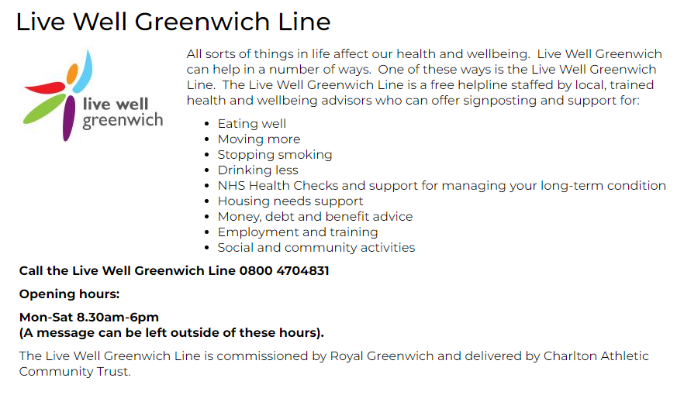
Live Well Greenwich | Healthy living activities around Greenwich, London

Slide 35
Diabetes Prevention

Slide 36

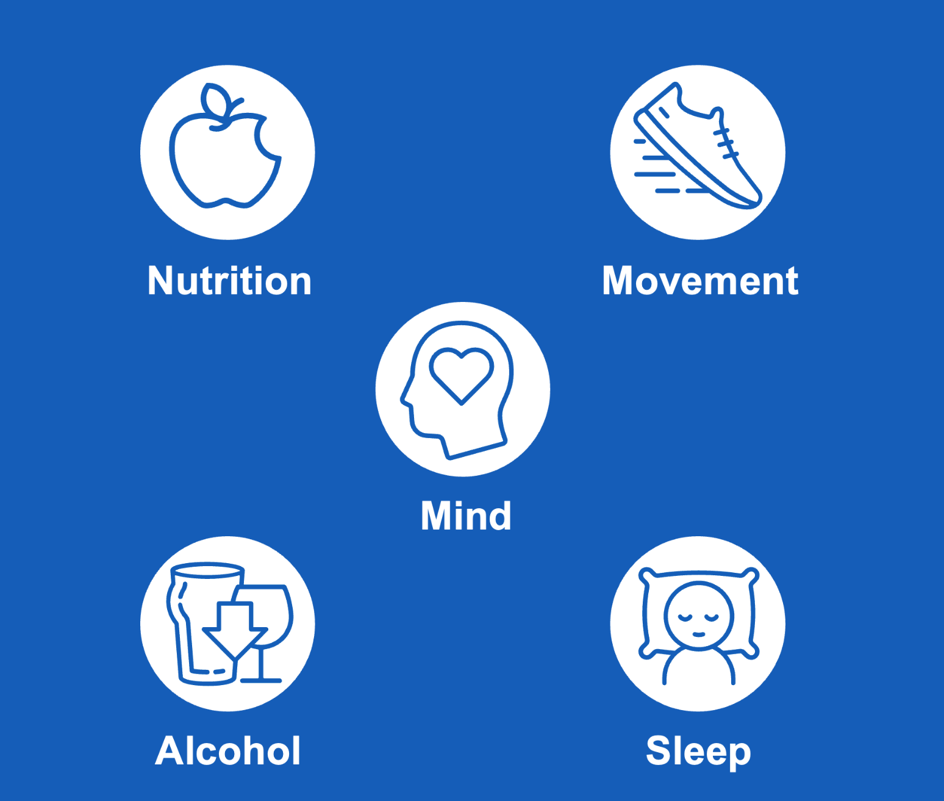
Our Programme
Notes:
Heather

Slide 37
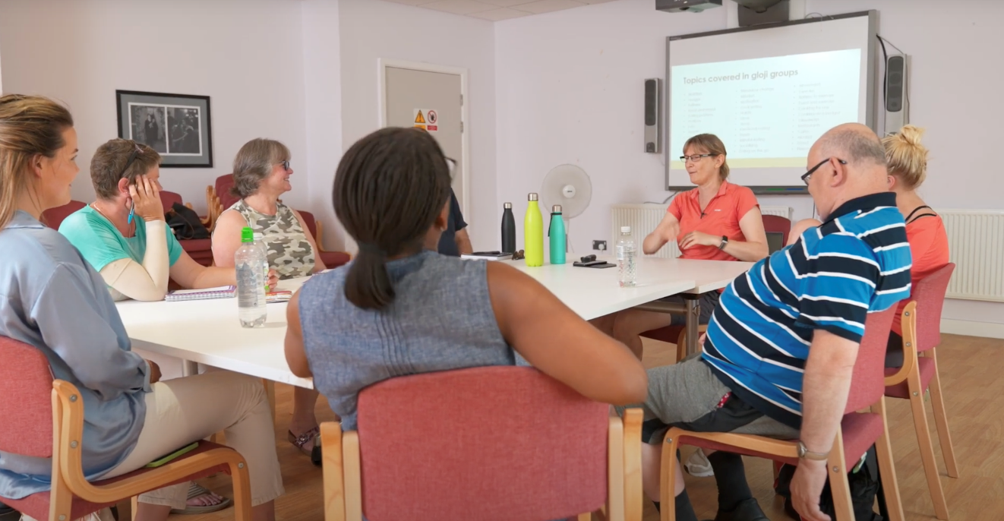

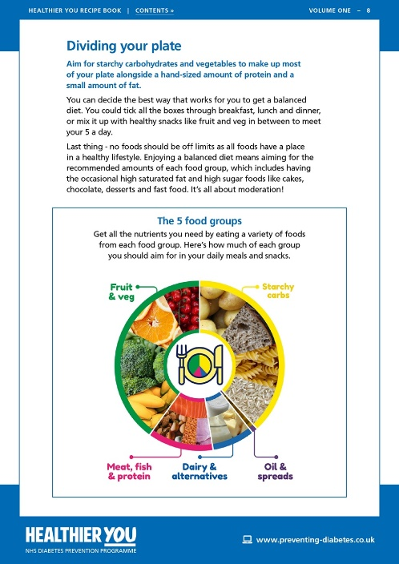
Our Programmes
Our group programme has
the highest retention rates
in the country, currently.
Face to Face group programme
Notes:
Heather

Slide 38
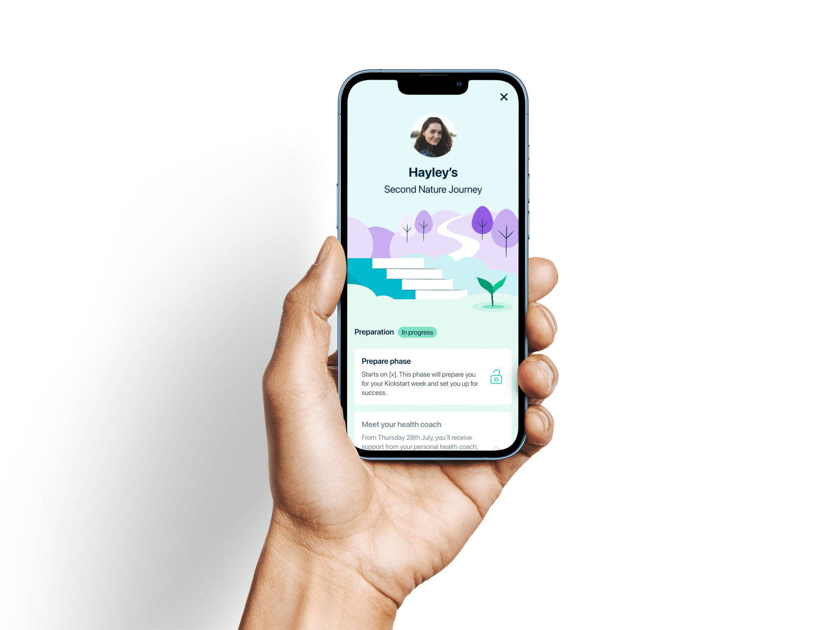
Our Programmes
Face to Face group programme
Digital – provided by Second Nature
Notes:
Heather

Slide 39
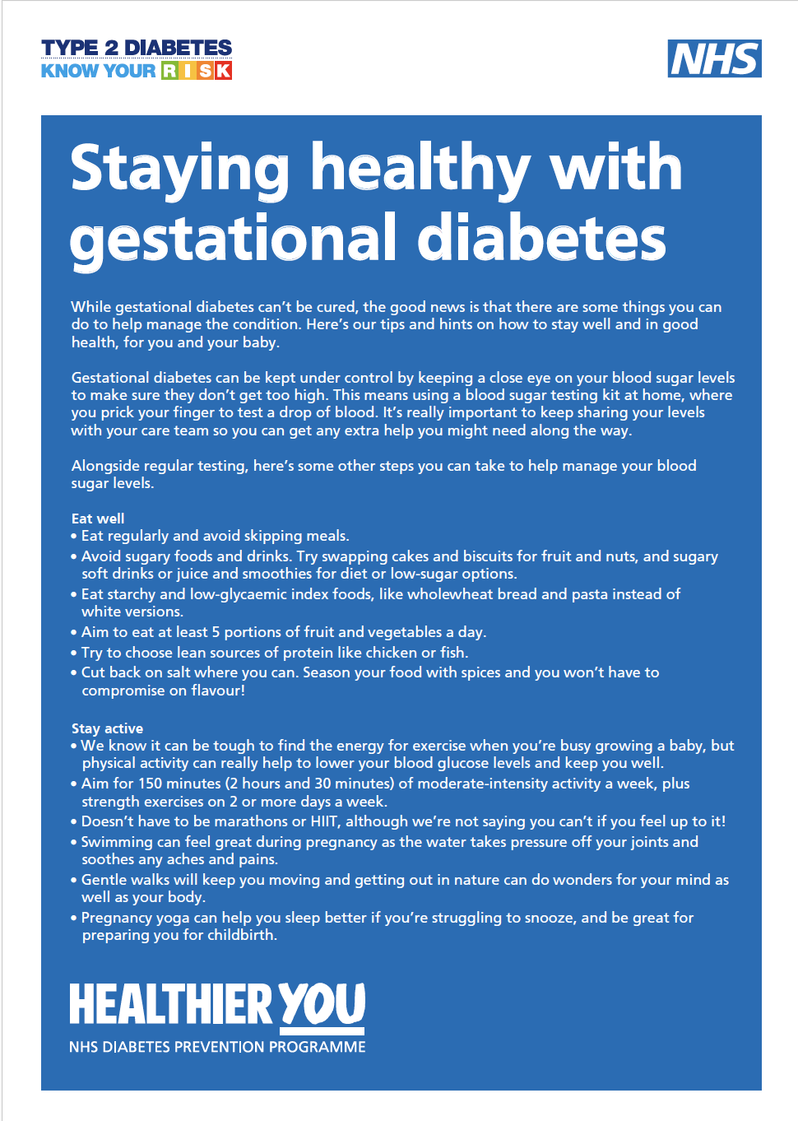
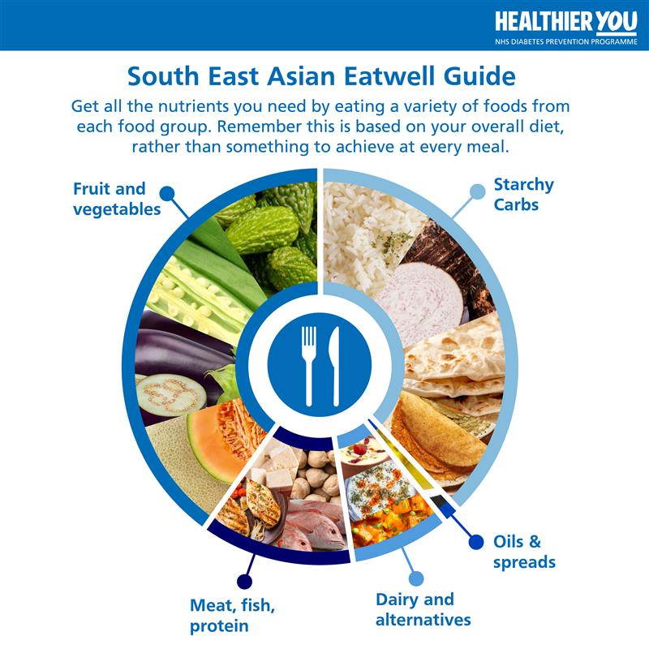
Our Programmes
Face to Face group programme
Digital – provided by Second Nature
Tailored Remote – adapted courses designed for specific cohorts of patients.
Notes:
Heather
Delivered online / Remote
Clients with visual / audio impairments.
Women with a history of GDM
Non - english speakers / clients who speak English as a second language.

Slide 40
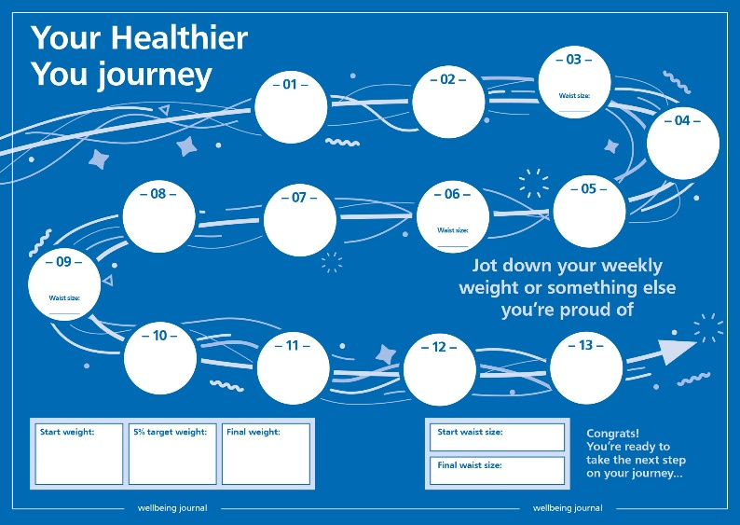
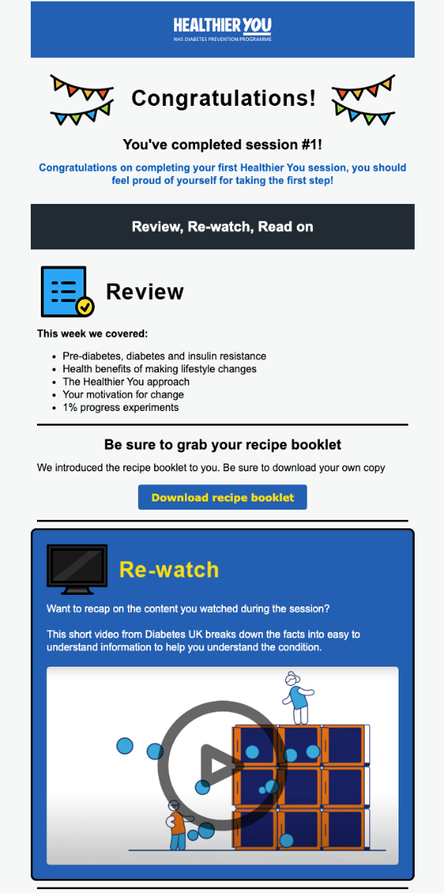
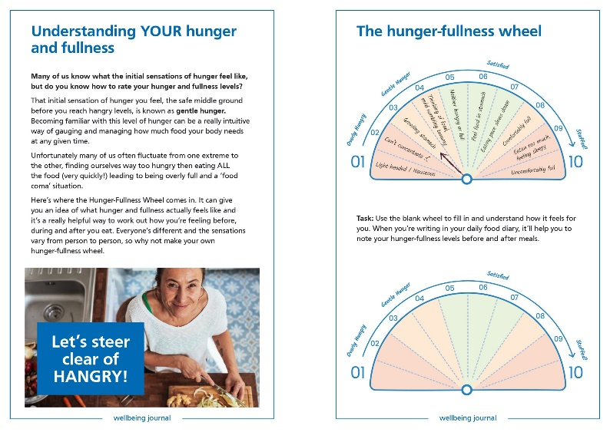
Our Programme – Group Programme
Founded on the principles
of behaviour change​
1% experiments
9-month programme
Group sessions in person
Initial 'getting to know you' session
Support for clients between group sessions
Aims to address all aspects of lifestyle
The main aim is for clients to reduce their body weight by 5%
High quality resources to go alongside programme
Interactive videos and activities
to support learning
Long term sustainable changes​
Up to date course content, based on most recent evidence
Notes:
Heather
Notes - group sessions spread across the county
Images show:
(Top & Bottom) Screenshots from the healthier you journal
(Right) Regular email communication received after each session

Slide 41
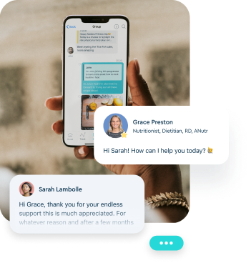

Our Programme – Digital Programme
9-month programme
10 -15minutes a day via a mobile app
1-1 support from a registered nutritionist
Online group support
Handbook, recipe book & digital weighing scales
Notes:
Heather
Second Nature is a 9-month programme developed to help you lower your blood sugar levels and prevent type 2 diabetes.
The programme is delivered completely online, which means you’ll participate on the app on your mobile phone. You don’t need to go anywhere in person, the programme comes to you and is available any time. You will receive lifetime access to the app and your account.
Before your official start date, Second Nature will send a package to your address that includes a digital weighing scale, our printed handbook and recipe book. You’ll have access to over 300 Second Nature recipes.
In the app, you’ll be in a group with other members, and you’ll have a health coach (one of their qualified dietitians or nutritionists) that will support one-to-one through the programme. You can chat with your health coach and group in the Chat section of the app.
Each day there will be a short article for you to read in the Learn section of the app. The articles are about nutrition, exercise, sleep, mental wellbeing, and positive thinking.
You’ll be able to track your progress in terms of your weight and daily step count, by connecting your wireless weighing scales and Apple Health/Google fit on your mobile phone. You can also manually enter your data onto your weight and steps dashboards.

Slide 42


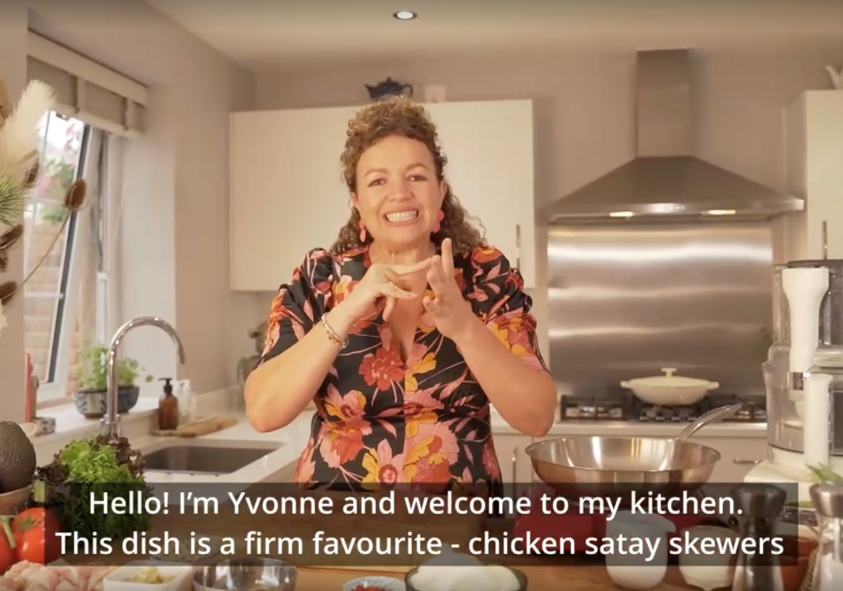
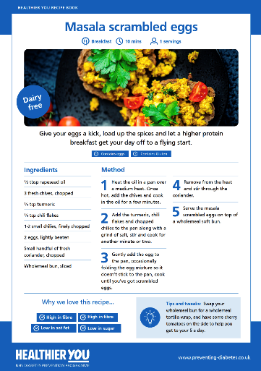
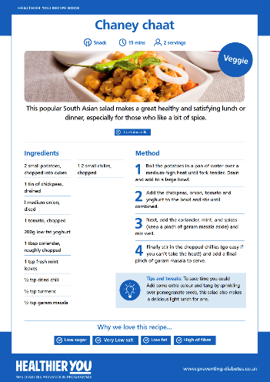
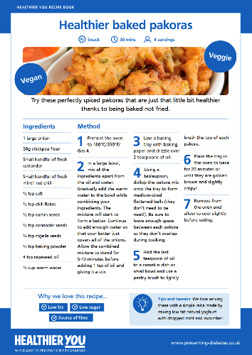
Our Programme – Specialist Remote
Building tailored programmes in collaboration with RNIB, Faheera Jay & Yvonne Cobb.
Tailored resources specifically for South Asian, African & Caribbean populations.
Notes:
Heather
Elaborate on the specialist remote programmes

Slide 43

Thank you​
Get in touch anytime at:​
www.healthieryou.org.uk​
0333 047 9999
hello@healthieryou.org.uk​
Notes:
Area Lead

Slide 44
Diabetes Education

Slide 45
Diabetes Book & Learn
For patients newly diagnosed with Type 2 diabetes, they should be referred to Diabetes Book & Learn where they can choose from attending a diabetes education course www.diabetesbooking.co.uk :
  Face to face
  Online live course
  Digital programme
  Some courses are culturally specific or available in different languages

Slide 46

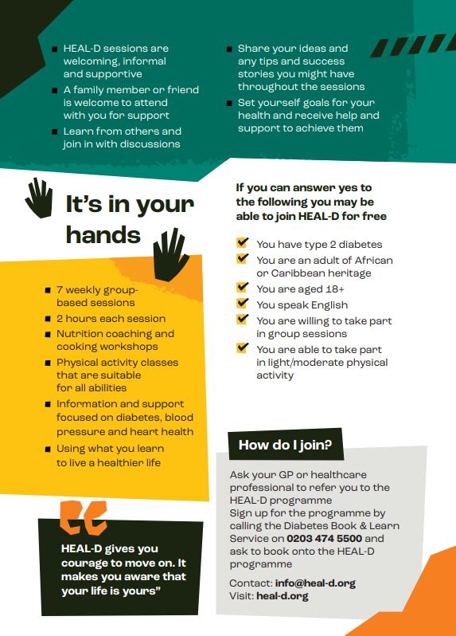
HEAL-D

Slide 47
Example of Call & Recall – Increased Patient Engagement

Slide 48
Patient Call & Recall Example – with excellent results
Eradicating Health Inequalities : AT Medics Lambeth Hypertension Case Study – Dr Tarek Radwan
Dr Tarek Radwan explains how AT Medics in Lambeth closed their health inequality gap in Hypertension and achieved the best PCN outcomes ever seen in South East London for overall hypertension control.
Ambition: To achieve this without any additional investment to prove that inequalities can be tackled sustainably and at scale
Commitment: To narrow the inequality gap between black and white patients
Data- driven: In house data analytics platform EZ Analytics
Team: Led by a senior GP and PCN Manager with centralised recall and pharmacist teams working alongside practice-based pharmacists and HCAs
Please see video presentation: Medicines & Prescribing Network – 15th May 2023:
https://youtu.be/HtP48rQs2zU

Slide 49
Weight Management Programmes

Slide 50
Greenwich Adult weight management pathway (18 years +)
Calculate BMI by measuring height and weight BMI calculator | Check your BMI - NHS | Please fill in your details (www.nhs.uk)
UNIVERSAL Support / Tier 1
Provide information about the benefits of healthy eating and physical activity, share details of Give it a Go and Cookery clubs
Provide contact details of Livewell Greenwich: and social prescribers for when they are ready to change / take action
Review at the next point of contact
Tier 2 weight management services
Tier 3 weight management service
Non-Condition specific
Condition specific
4Healthy Weight Greenwich: Specialist Tier 3 Weight Management Programme
Patients who meet referral criteria and enter treatment are offered the following:
Motivational interview, Multi-disciplinary assessment,
Intensive treatment phase either in groups, one to one or e-learning
Maintenance treatments which lasts up to 9 months
Discharge plan
Tier 4 assessment and referral
Eligibility criteria: GP referral ONLY
BMI>30 with recent onset Type 2 diabetes
BMI > 35 with 2 recognised co morbidities
BMI >40 with no related co morbidities
Individuals who have experienced a weight problem for at least 5 years
Individuals who have complied with Tier 1 and 2 services for at least 6 months and have failed to achieve or maintain weight loss goals
Undergone bariatric surgery and require specific post operative support after 2 years
Individuals who may be referred to Tier 4 and therefore require assessment and preparation
Weight Loss with Better
12 week FREE multi-component weight management programme. Weekly 2 hour sessions, nutrition workshop and physical activity session.
Contact: Healthwise Team M-F 8am – 5pm
Tel. 020 3795 0715
Borough wide
Eligibility criteria:
Adults ≥ 18 years
BMI ≥ 30kg or 27.5 for those from Black, Asian and ethnic minority backgrounds*.
BMI ≥ 25 or 23.5 BAME with risk factors for Type 2 diabetes or CVD
GP or self referral
* The BMI threshold will be lower at 27.5 for people from Black, Asian and ethnic minority backgrounds, as we know people from these ethnic backgrounds are at an increased risk of conditions such as Type 2 diabetes at a lower BMI.
Healthier You : National Diabetes Prevention Programme (NDPP) (Pre diabetes)
9 Month behavioural change Programme aimed to support long term behaviour change for weight loss to prevent onset of diabetes. This is a Tier 2 weight management programme, run over 9 months with reducing intensity of contact. Offering face to face group sessions available in a range of community languages. A digital programme is also available run over the same 9 month period. Receive 1:1 support from a registered dietitian or nutritionist and peer support group. Track positive changes in activity, habits and weight loss.
Patients can self-refer as long as they have their HbA1c result, the date it was taken (last 12 months) and their NHS number. https://healthieryou.org.uk/gp/
Eligibility Criteria:
Aged 18-79
Not Pregnant
Do not have diabetes currently
HbA1c 42-47.9 (6.0-6.4%) or Fasting Plasma Glucose between 5.5-6.9mmol/within last 12 months
If patient has a history of Gestational Diabetes (GDM) then patient is eligible with HbA1c <42 mmol/mol or FPG < 5.5mmol/l
HSE Digital Weight Management Programme
12 week programme offers free, online access to weight management services. 3 levels of support available incl. a combination of digital and human coaching
You will only be able to access this programme if you have a smartphone or computer with internet access.
Eligibility criteria:
18 years and over
BMI ≥ 30 (adjusted to >27.5 for BAME participants)
Has a diagnosis of diabetes (T1 or T2) or hypertension or both
e-RS Referral by GP Practice to the NHS Digital Weight Management Programme – Clinical templates available from SystemOne, Aardens, EMIS or Vision IT Systems.
Patient will be contacted via text message or email within 2 working days. This message, from “NHS WMP” will contain a link to a website from which patients can access the list of available programmes eg Digital only offer, 50mins coaching, 100mins coaching. For those patients who are unable to receive text messages or access the internet, they will receive a phone call directly to landline or mobile including alternative language options.

Slide 51
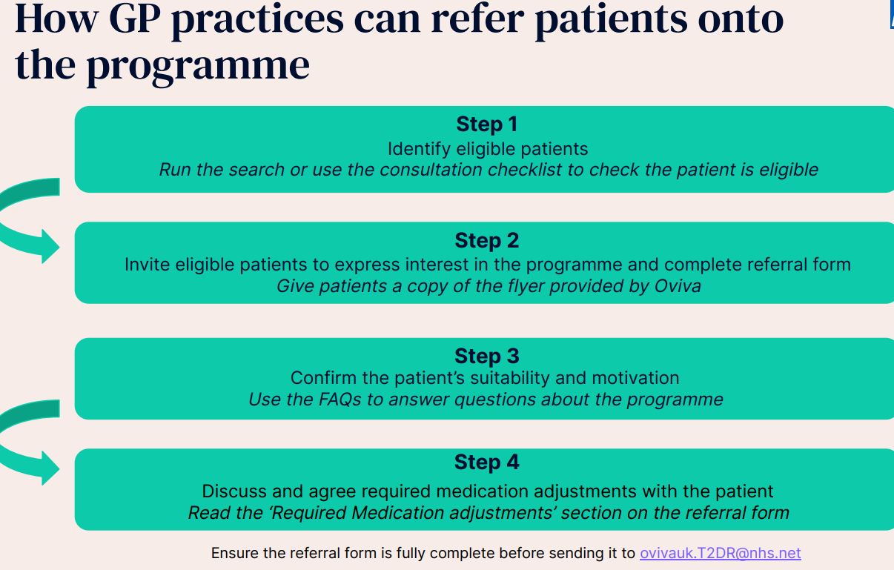
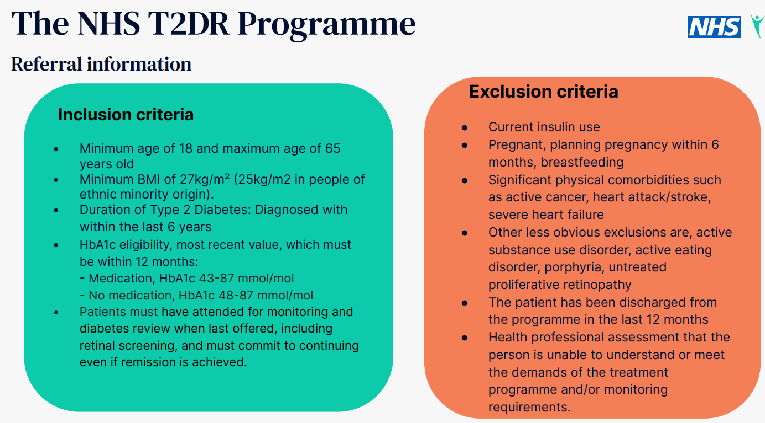
Greenwich Adult weight management pathway (18 years +)
Calculate BMI by measuring height and weight BMI calculator | Check your BMI - NHS | Please fill in your details (www.nhs.uk)
UNIVERSAL Support / Tier 1
Provide information about the benefits of healthy eating and physical activity, share details of Give it a Go and Cookery clubs
Provide contact details of Livewell Greenwich: and social prescribers for when they are ready to change / take action
Review at the next point of contact
Tier 2 weight management services/continued
Contact Details
Condition specific
Eligibility
Please contact ovivauk.T2DR@nhs.net if you have any question
Click on the link to find training videos, mediation guidance, patient leaflets etc
NHS Type 2 Diabetes Pathway to Remission Programme for primary care | Oviva UK
Type 2 Diabetes Pathway to Remission formally known as Low Calorie Diet
Provider Oviva
The NHS Type 2 Diabetes Pathway to Remission Medications Guidance Video – YouTube
NHS Type 2 Diabetes Pathway to Remission
Formally known as Low Calorie Diet
How is works?
The NHS is delivering a new programme which provides a specially formulated diet for 3 months followed by healthy lifestyle support, for people who are living with type 2 diabetes and obesity, or overweight.
Eligible participants will be offered low calorie, total diet replacement products including soups and shakes consisting of 800 to 900 kilocalories a day for up to 12 weeks. During this time participants will be expected to replace all normal meals with these products
Alongside this, participants will receive support for 12 months including help to re-introduce food after the initial 12- week period.
This support will provide participants with the help and advice they need throughout every stage of the programme.
GP practices will be kept informed of patient progress and if any medication changes might be needed.
People with a confirmed Type 2 diabetes diagnosis within the last 6 years, obesity, or overweight, and are committed to lose weight, improve their blood sugar levels, reduce diabetes-related medication and, in almost half of participants, put their type 2 diabetes into remission
GP role in supporting patients
The Oviva Medications and Monitoring protocol outlines the role, responsibilities and guidance for Oviva delivery staff and primary care colleagues.
Primary care responsibilities are as follows:
To ensure all relevant staff at the practice have read and understood the protocol before referring patients
To ensure patients who are referred are eligible (as per criteria) and informed (T2DR is not for everyone)
Carry out 6 and 12 month reviews to measure HbA1c and review medications, and share the results with Oviva
To make telephone calls/appointments available within 2 weeks of request to review patient case and change medications in case of an adverse event
Establish a clear channel of communication via NHSmail

Slide 52



Other Greenwich Weight Management Services
Community Services
Online Resources and Apps
These services are not incentive linked
Football Fans in Training
Adults 35-64 years
BMI ≥ 28 BMI
Waist circumference:
Men / 38” Women 31”
Self-referral
Diabetes UK
Diabetes NHS
Livewell Greenwich
Greenwich Get Active: online platform for all physical activity in Royal Greenwich
Good Food in Greenwich: Cookery clubs, food growing and a lot more
Couch to 5k
NHS LiveWell : Healthy Weight & Exercise
NHS Better Health
Know Diabetes
Low Carb Programme App available via Diabetes Book and Learn Service
Active Addicks
Adults 18+
BMI ≥ 28 BMI
Self-referral
Self –referral
Commercial companies
Weight Watchers
Slimming world
January 2024

Slide 53
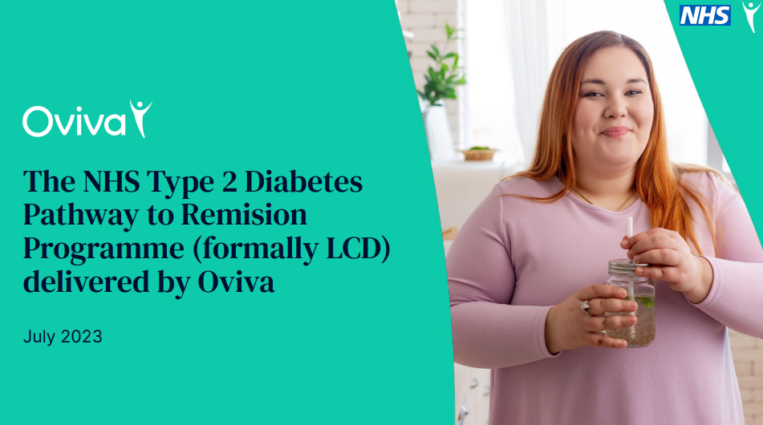

Slide 54
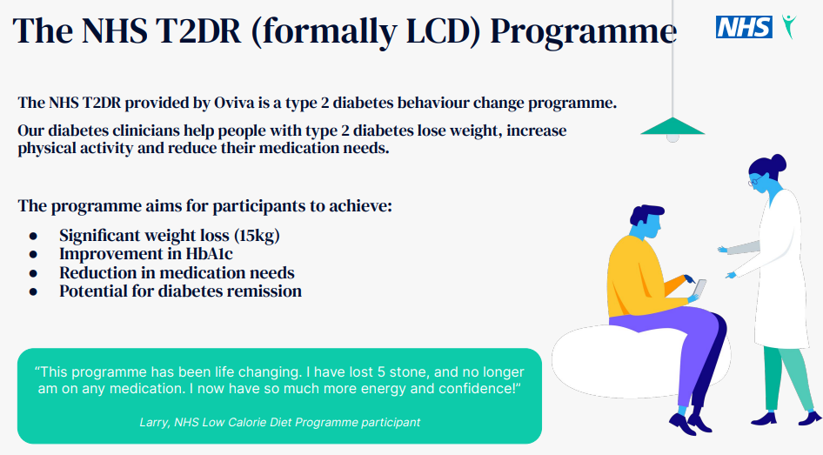

Slide 55
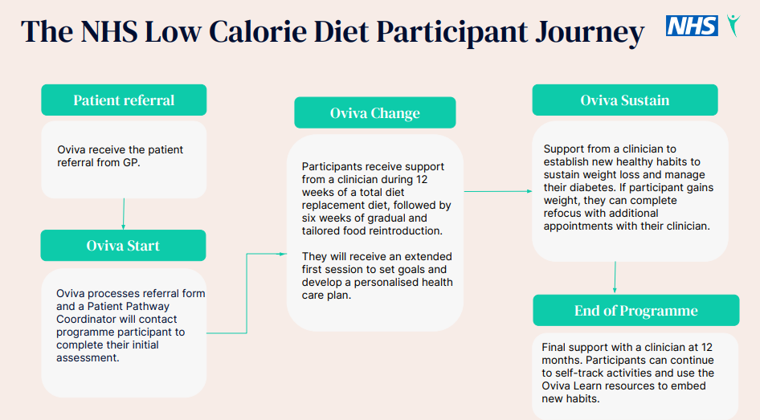

Slide 56
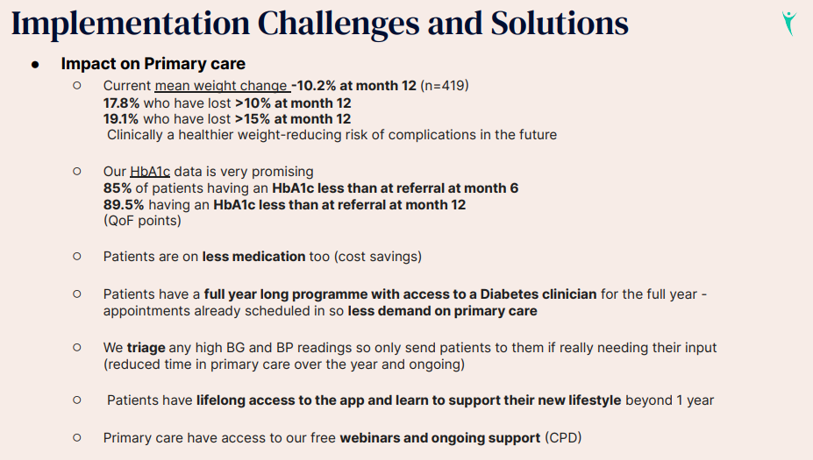

Slide 57
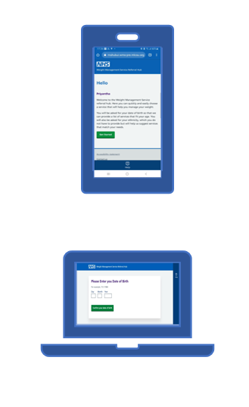
NHSE Digital Weight Management Programme
The NHS Digital Weight Management Programme supports the delivery of the NHS Long Term Plan commitments relating to obesity, focusing on weight management to support people living with obesity who also have a diagnosis of diabetes, hypertension or both. Obesity is a serious health concern that increases the risks of many other health conditions, including Type 2 diabetes, cardiovascular disease, joint problems, mental health problems and some cancers.
The NHS Digital Weight Management Programme provides weight management services flexibly, without the need for people to travel. Evidence from the NHS Digital Diabetes Prevention Programme shows that digital and remote weight management services are more likely to be accessed by younger (working age) people whilst maintaining comparable results to face-to-face weight management services.
The programme has been designed to offer service users a personalised level of intervention to support them manage their weight, improve quality of life and improve longer term health outcomes. It works alongside and does not replace existing weight management services funded by local authorities.

Slide 58
NHSE Digital Weight Management Programme
Who can be referred?
Referrals to the programme are only for people that meet the following criteria:
are over the age of 18
have a body mass index (BMI) of 30 or more (adjusted to ≥27.5 for people from black, Asian and ethnic minority backgrounds)
have a diagnosis of diabetes (type 1 or type 2), hypertension or both.
Who cannot be referred?
Any person that meets any of the following exclusion criteria should not be referred to the programme:
recorded as having moderate or severe frailty
is pregnant
has an active eating disorder
has had bariatric surgery in the last two years
people for whom a weight management programme is considered to pose greater risk of harm than benefit.
For people aged over 80 years old, the referrer will need to confirm on the referral form that a weight management programme is considered likely to pose greater benefit than harm.

Slide 59
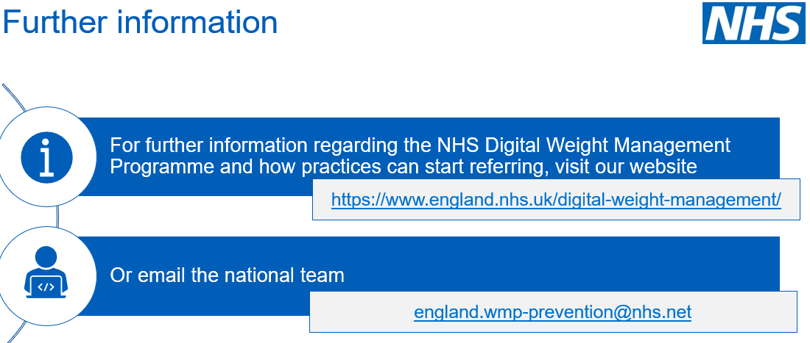
NHSE Digital Weight Management Programme

Slide 60

Greenwich Children and Young People weight management pathway (4-17 years)
Calculate CYP BMI centile by measuring height (m) and weight (kg) BMI calculator | Check your BMI - NHS | Please fill in your details (www.nhs.uk)
UNIVERSAL Support / Tier 1
Provide information about the benefits of healthy eating and physical activity, share details of Greenwich Get Active and Cookery clubs
Provide contact details of Young Greenwich school nursing team and Livewell Greenwich: when they are ready to change / take action
Review at the next point of contact
Tier 2 weight management services
Tier 3 weight management services
XPLORE for CYP aged between 4-17 years.
8 week FREE family based weight management programme. Focussing on healthy eating, physical activity and behaviour change.
Borough wide
Eligibility criteria:
CYP who either:
  live in the Royal Borough of Greenwich
  Registered with a Royal Borough of Greenwich GP;
  Attend a Royal Borough of Greenwich school, sixth form college or institutes of further education
AND
Have a BMI≥ 91st centile (calculate this using the NHS BMI calculator here)
Have no complex needs
Professional or self referral
The service does accept children and young people outside of the eligibility criteria, however this is processed on a case by case basis
PROFESSIONAL REFERRAL ONLY
Tier 3 specialist family based service
The service is targeted at children & young people and their families living in the London Borough of Greenwich. It offers a multidisciplinary programme to specialist weight management.
Inclusion criteria:
Must be a Greenwich resident
Should have a BMI above 98 Centile
Must be between the ages 4-17 years old
Be available to commit to a one-year programme
Exclusion criteria:
Children or young people with a complex comorbidity i.e., Hypertension, diabetes, sleep apnoea, other underlying medical cause of obesity (referred by GP)
Children or young people actively suicidal
Children or young people with moderate to severe active self-harm
Children or young people with a diagnosed eating disorder (DSM 5 B>E>D scale), Anorexia or Bulimia
Children or young people actively engaged with substance misuse
Children or young people where the related medical problems may be best treated in an alternative service i.e., Tier 4 medical management
CEW clinic (CYP with complications due to Excess Weight)
Inclusion criteria:
2 to 18 years
Obesity
Significant obesity related medical co-morbidities that has not responded to treatment with a specialist team
Exclusion criteria:
Disengaged family and/ or significant mental health problems
Referral form:
Complications of Excess Weight (CEW) Clinic referral form | King's College Hospital NHS Foundation Trust (kch.nhs.uk)

Slide 61
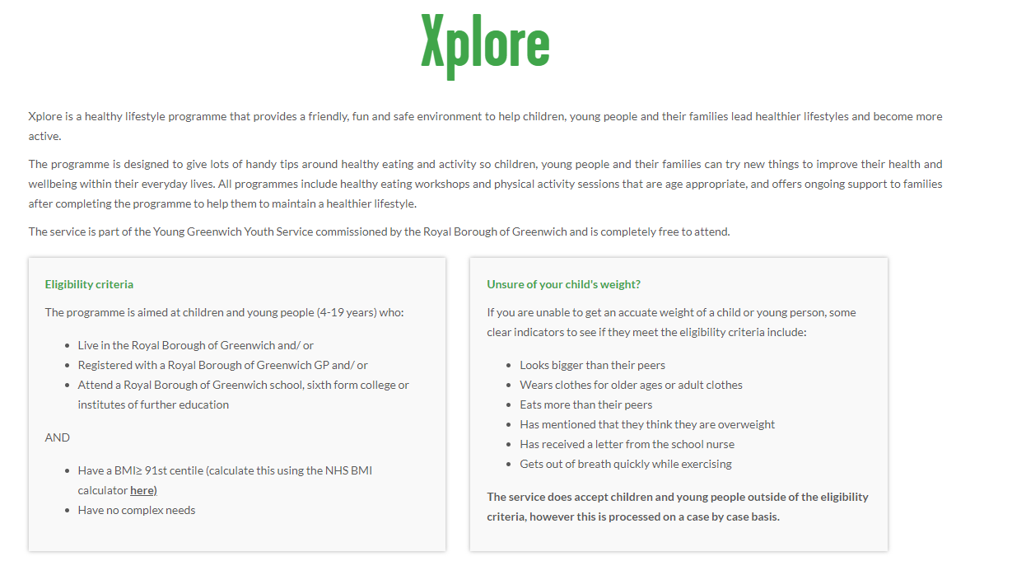
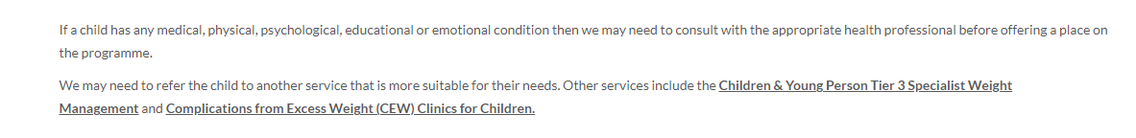
Xplore | Healthy Lifestyle Programme in Greenwich | Better

Slide 62
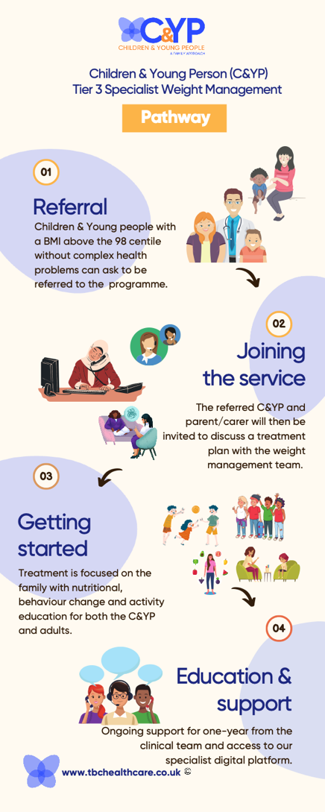
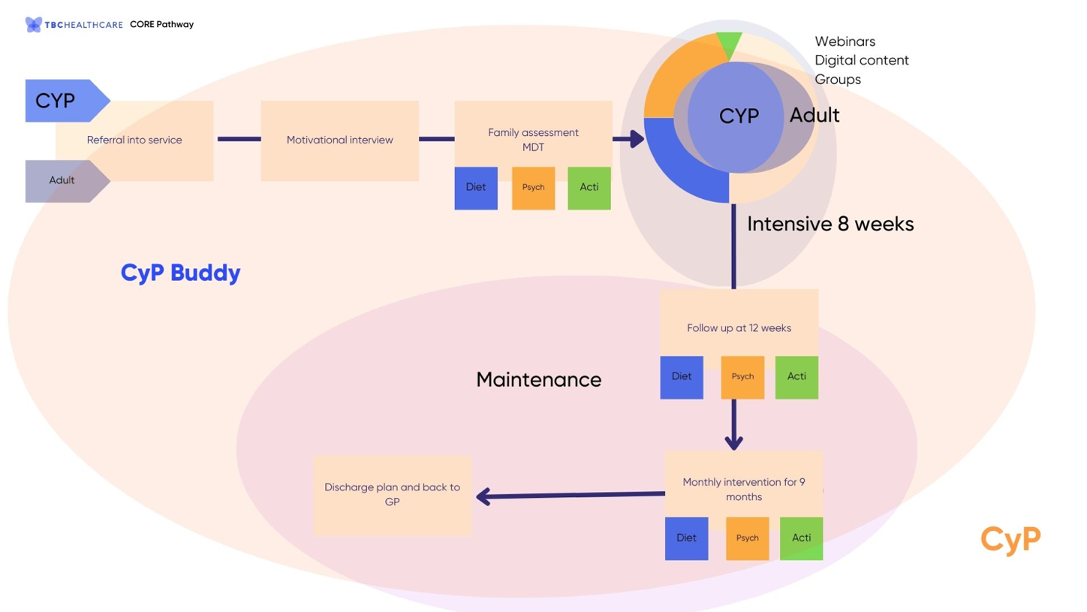
Tier 3 CYP specialist service pathway

Slide 63
Diabetes NHS Services

Slide 64

Diabetes Information Pack - Greenwich
Primary Care
Community
Acute
Healthier You National Diabetes Prevention Programme (NDPP) (pre diabetes)
Contact: Provider: Thrive Tribe
Regional Lead: Mike Power
Email: mike.power@thrivetribe.org.uk
Engagement Lead: Malsa Ibrahim
Email: malsa.ibrahim@healthieryou.org.uk.
Telephone No: 07375 398142
GP Referral via DXS / Self registration
Referral criteria
Not pregnant
18 years and over
HbA1c 42-47.9 (6.0-6.4%) or Fasting Plasma Glucose between 5.5-6.9mmol/within last 12 months
If patient has a history of Gestational Diabetes (GDM) then patient is eligible with HbA1c <42 mmol/mol or FPG < 5.5mmol/l
Able to take part in light/moderate physical activity
Adult Community Podiatry Service
Provider: Oxleas NHS Foundation Trust
Service Lead: Catherine Edmeades – Principal Podiatrist, Head of Podiatry
Email: Catherine.edmeades@nhs.net
Telephone No: 020 8320 3550
Advanced Podiatrists (Band 7)
Emma Pearce, Arifa Hafez, Arthur Okoye, Susanne Olsen
Refer via Email: oxl-tr.podiatry@nhs.net
Hours of Service – Monday to Friday
9am – 5pm
Contact point for all clinics: Tel 020 8320 3550
Referral Criteria:
Patients registered with a Greenwich GP including those living in nursing/ residential care homes
Aged 18 years and over
All new patients will be assessed and if have a clinical need for podiatry will be offered a follow up appointment
Routine nail care is not offered by the service unless patients are assessed as moderate or high risk in line with NICE guidance (NG19 - www.nice.org.uk/guidance/ng19)
---------------------------------------------------------------
FOR INFORMATION ONLY – Do not make direct contact
Diabetology: Dr Chika-Ezerioha
Email: i.chika-ezerioha@nhs.net
Dr Debbie Ann Charles
Email: Debbie-anncharles@nhs.net
Microbiology: Martina Dallantonia
Email: mdallantonia@nhs.net
Sarah Starkey
Email: sarah.starkey@nhs.net
Greenwich Intermediate Diabetes Service (via Oxleas Community Service)
Provider: Oxleas
DSN Team Lead: - Amitha George
Senior Diabetes Specialist Nurses: Ifeyinwa Maduka, Chinasa Uzor, Sara Fisk
Referral address: oxl-tr.greenwich-singlepointofaccess@nhs.net
General Enquiry: oxl-tr.diabetes@nhs.net
Telephone No. 0208 3197078
Home Visits are offered to T1/T2 housebound patients
Patients can be seen at various sites across the borough by DSNs who carry out full assessments, explain treatment options and working with patients to agree a care plan
Diabetes Podiatrists provide specialist foot assessments and screening and psychologists can help to improve motivation to maintain a healthy lifestyle
Patients with HbA1c >58mmol/mol (>7.5%) and on maximum oral therapy
Support to GHL/practices to help patients meet 3TT target/Provide training for HCPs
Working with MH sector to provide support for those with diabetes
Provide insulin & GLP1 initiation
Active Foot Service & MDFT at QEH
Provider – GSTT
Telephone No: 0208 836 4008
Service Leads: Kate Gilbert - Podiatrist
Prakash Saha – Vascular Consultant
Dr Jennifer Tremble – Diabetologist
Email: Lg.qeh-acutefootservice@nhs.net
Email: Lh.acutefootservices@nhs.net
MDFT Clinics: Thursday, 11am – 1pm
Podiatry led ambulatory clinic: Monday & Friday 9am – 12noon
Referral via GPs to QEW MDFT Clinic eRS Referral
Advice/Guidance
Patients with current active foot damage:
Any foot ulceration
Acute Charcot Foot (Hot / swollen / painful foot
Any foot infection
The SEL Diabetic Foot Network has appointed a Diabetic Foot Navigator to ensure patients with "Active" diabetic foot disease is seen by a multidisciplinary team (within 24 hrs - Monday - Friday). There is a single point of access across the SEL network for primary care staff and community health staff needing to refer patients. The Navigator has access to all appointment slots across the SEL Network of 7 (MDFT) clinics
Patients with current active foot damage referred to MDFT team within 24 hours
Referral via GP/Community Diabetes Team/Community Podiatry Team/All other HCPs
to the Greenwich Health Diabetes 3TT services.
Weight Management Services
Please see the Weight Management Infographic document for a full list of weight management services available in Greenwich.
ADD LINK ON DXS TO WEIGHT MANAGEMENT INFOGRAPHIC DOCUMENT
Type 2 Diabetes Pathway to Remission Programme (formerly called the NHS Low Calorie Diet
The NHS T2DR Provided by Oviva is a Type 2 Diabetes 12 month behaviour change programme
Diabetes clinicians help people with Type 2 diabetes lose weight, increase physical activity and reduce their medication needs.
Please contact ovivauk.T2DR@nhs.net if you have any questions. NHS Type 2 Diabetes Pathway to Remission Programme for primary care | Oviva UK
Greenwich Time to Talk
Provider: Oxleas
Email: oxl-tr.greenwichtimetotalk@nhs.net
Telephone No: 020 3260 1100
Greenwich Time to Talk offers free psychological treatment as recommended by the National Institute for Health and Clinical Excellence (NICE) guidelines for anxiety and depression. This is mainly cognitive behaviour therapy (CBT) and counselling.
Support for people over 16 who are either registered with a Greenwich GP or live in the Greenwich Borough.
Specific services are provided for 16 and 17 year olds, 65 year old and above and people suffering from long term conditions.
Tier 3 Specialist Weight Management Programme (Bariatric Consultancy Ltd
Provider: The Bariatric Consultancy London
Telephone No. 01322 220299@nhs.net
Website: https://tbchealthcare.co.uk/
Referrals via GP
Individuals who have experienced a weight problem for over 5 yrs/completed T2&T3 services for at least 6 mths and failed to achieve weight loss
Undergone bariatric surgery and require specific post operative support after 2 yrs
BMI >30 with recent onset T2 Diabetes
BMI > 35 with 2 recognised co morbidities
BMI >40 with no related co morbidities
Structured Education
Education courses for patients with T2 accessed through GP practice via Book and Learn Platform – Hosted by Bexley Health Neighbourhood Care – Priority Digital Health Platform
Referrals can be made using the Diabetes Book and Learn referral form with DXS/EMIS and Vision. Once fully completed please email the form to diabetes.booking@nhs.net or Via the webform at www.diabetesbooking.co.uk/refer
January 2024 – Version 1

Slide 65
Diabetes Information Pack - Greenwich
Primary Care
Community
Acute
HEAL-D – Healthy Eating & Active Lifestyles for Diabetes in African & Caribbean communities – T2
Hosted by : Bexley Health Neighbourhood Care – Priority Digital Health Platform
Email: diabetes.booking@nhs.net
Telephone: 0203 474 5500
Referrals can be made using the Diabetes Book & Learn referral form within DXS/EMIS and Vision. Please use the free text box to mention that the referral is for HEAL-D. Once fully completed please email the form to diabetes.booking@nhs.net or Via the webform at www.diabetesbooking.co.uk/refer
Patients can also self refer by calling 0203 474 5500 and asking to be self referred to a HEAL-D course (it is not possible to book online at this time)
Annual-Report-and-Annual-Accounts-2021-22.pdf (selondonccg.nhs.uk)
Retinopathy Service
Provider: Guy’s and St Thomas’ (GSTT)
Email: gst-tr.seldesp.admin@nhs.net
Telephone No: 020 7188 1979
Diabetic eye screening clinics are held six days a week and evening appointments are available on request.
Appointments can be booked at other SE London sites if more convenient for the patient. Full list of clinics can be found here: Diabetic eye screening clinics | Guy's and St Thomas' NHS Foundation Trust (guysandstthomas.nhs.uk)
Appointments to be booked via the above contact details.
Screening clinics take place in the following locations:
Guy’s Hospital, Diabetes and endocrine department
3rd floor, Southwark Wing, Great Maze Pond, London SE1 9RT
Garland Road Heath Centre – Plumstead, First floor, 2 Garland Road, Plumstead, SE18 2AE
Royal Arsenal Medical – Woolwich, 21 Arsenal Way, Woolwich Riverside, London, SE18 6TE
Secondary Care Diabetes Service – QEH
Provider : LGT
Service Leads: Dr Tremble
Email: Jennifer.tremble@nhs.net
Dr Prakash Saha - Vascular
Email: Prakash.saha@kcl.ac.uk
Viapath - Microbiology
Christopher Wood – Antibiotic Pharmacist
Email: Christopher.wood5@nhs.net
Referral via GP, PN, HCA, to Lewisham Podiatry Service
The hospital diabetes service is delivered by diabetes specialist nurses, dietitian, 3 diabetologists and a receptionist based in the QEH diabetes centre.
Main focus is Type 1 diabetes:
Diagnosis, education (Dose Adjustment For Normal Eating - DAFNE course), advice on diet (carbohydrate counting courses), insulin regimes/titration, supporting the use of technology for glucose testing and insulin delivery. Annual reviews and management of complications.
Pre-pregnancy counselling for patients with Type 1 & 2 diabetes.
Management of patients with gestational diabetes requiring oral or insulin treatment and those with type 1 and 2 diabetes during pregnancy.
Advice on glycaemic control and diabetes related complications for patients admitted into hospital or seen in the emergency dept.
Patients with type 2 diabetes for diagnosis and initial management where this occurs in the hospital or on request, e.g. with challenging glycaemic control problems (e.g. during chemotherapy), requiring rapid achievement of glycaemic control (e.g. perioperatively) and with complications.
Monthly virtual MDTs with GP Practices (on request)
Community High Risk Podiatry Team
Provider: Oxleas NHS Foundation Trust
Sites – Community
Greenwich Square Health Centre
2nd Floor, 12 Lambarde Square, SE10 9GB
Wensley Close, 4 Wensley Close
Eltham SE9 5AB
Manor Brook Medical Centre
117 Brook Lane, Blackheath, SE3 OEN
Garland Road Clinic
2 Garland Road, SE18 2SB
Gallions Reach Health Centre
Bentham Rd, SE28 8BE
Fairfield Medical Centre
Fairfield Grove, SE7 8TX
Garland Road Health Centre
2 Garland Rd, SE18 2AE
Advice & Guidance
Consultant Connect
Telephone No: 0208 016 3004
Please go to the following website to access the service directory: https://consultantconnect.org.uk/service/directory/SCNmFhKSHbTl
All Podiatry queries and referrals:
Email address: oxl-tr.podiatry@nhs.net
Telephone No: Tel 020 8320 3550
The podiatry services assess, diagnose and treatment conditions affecting the feet.
Patients with current active foot damage:
Any foot ulceration
Acute Charcot foot (hot/swollen/painful foot) require an URGENT referral ** see Foot Navigator on page one under Acute Section
Kings Renal Unit
Provider: Kings College Hospital
Email: kch-tr.renal@nhs.net
Telephone No: 020 3299 6233
Kings Renal Unit provides a full range of care for those with kidney disease. The range of treatment and specialist services they provide includes general and specialist outpatient clinics for people with diabetes and renal disease.
Treatment is provided at King's College Hospital as well as at satellite dialysis units in Bromley, Dartford, Sydenham, Thamesmead and Woolwich.
Referrals via e-RS wherever possible.
Prevention
Free Greenwich Cookery Clubs - Healthy eating on a small budget. (gcda.coop)
Healthwise exercise on GP referral. Provider Better
DXS referral
Greenwich Get Active www.greenwichgetactive.com
Live Well Greenwich | Healthy living activities around Greenwich, London and DXS referral

Slide 66
Diabetes Information Pack - Greenwich
Specialist Services / Oxleas
Useful Contacts & Websites
Information Sources
Specialist dietetic service to support patients with diabetes. Patients will be offered a 1:1 appointment with tailored diet and lifestyle advice to support optimisation of glycaemic control
Patient must meet all the following essential criteria:
Adult > 18yrs
Registered with Bexley GP
HbA1c ≥58mmol/mol (≥7.5%)
On maximum tolerated oral medications or on insulin
Patient must meet at least one of the below criteria, along with all essential criteria:
BMI ≥30kg/m² (or BMI ≥27.5kg/m² for individuals of BAME background) requiring weight loss due to impact on glycaemic control
BMI ≤18.5kg/m² or MUST ≥2 requiring weight gain
Poor glycaemic control (recurrent hyperglycaemia, uncontrolled hypoglycaemia due to suspected poor dietary management and/or medication not matching food intake)
Centre of Obesity, diabetes and endocrine
Telephone No. 020 7188 1912
Email. gst-tr.diabetesandendocrine@nhs.net
Contact: Dr Piya Sen Gupta, Consultant in diabetes and
endocrinology
Diabetes UK
Careline National Office 0845 120 2960
London Office 020 7423 1000
www.diabetes.org.uk
King’s College Hospital NHS Foundation Trust
Telephone No. 0203 299 8571
St Thomas’ Hospital
Telephone No. 0207 188 1988
Guy’s Hospital
Telephone No. 0207 188 1916
Patient.co.uk www.patient.co.uk
London Diabetes https://londondiabetes.com/
Diabetes Peer Support www.diabetes.org.uk/How_we_help
/Peer-support/
SEL Joint Formulary Website
www.selondonjointmedicinesformulary.nhs.uk/
Greenwich Meds Optimisation Team
Email: greenwich.pharmacy@selondonics.nhs.uk
ThriveTribe
Weight Management (thrivetribe.org.uk)
Email: hello@healthieryou.org.uk
Tel. 0333 047 9999
Diabetes NHS
NHS Live Well
Livewell Greenwich
Know Diabetes
PITstop Diabetes Training Courses
NHS England » The NHS Digital Weight Management Programme
Apps & Programmes
Greenwich Get Active: online platform for all physical activity in Greenwich
Good Food in Greenwich: online platform for cookery clubs, food growing and sustainable in Greenwich
Couch to 5k
Know Diabetes
Low Carb Programme App
NHS Better Health Apps and programmes
Diabetes UK – Know Your Risk of Type 2 diabetes

Slide 67
Healthy io
Fully funded home ACR testing for people with diabetes now available for all SEL GP practices - get set-up in less than one hour
Last year, SEL ICS commissioned Healthy.io (an established health care company offering remote clinical testing and services enabled by smartphone technology South-East-London-GP-Practices - Healthy) to help increase adherence to ACR (urine) testing in patients with diabetes in South East London.
Patients use Healthy.io’s “Minuteful Kidney home testing kits” to collect and test their urine sample, registering the reading using a smartphone device that enables analysis of the test strip colour to determine the ACR ratio. The results are then coded as ‘normal’, ‘abnormal’ or high abnormal’ and sent back to the patient’s GP practice for relevant follow up or recording.
The pilot initiative was launched in a few PCNs, whose patients had the lowest adherence to ACR testing in SEL (in accordance with the National Diabetes Audit programme data), to improve uptake of ACR testing and reduce variation. The easy access home testing format creates increased patient uptake, enabling earlier identification of chronic kidney disease (CKD disease is more common in people with diabetes) and medical optimisation and to support recovery of primary care backlogs.
To date, 60 practices in SEL have launched the service with positive feedback from practice staff and patients alike and I am pleased to confirm that following the success of the first year, the service has been commissioned for a second year, enabling all remaining practices in SEL the option of signing up to access the home testing kits at no cost to the practice.
If you have any questions, please do contact Sheila Taylor on mobile 07999101382 or Sheila.taylor@royalgreenwich.co.uk in the first instance or joanne.hare@selondonics.nhs.uk who is supporting the project for Greenwich and Bexley.
.

Slide 68
Healthy io
Key information: Improve ACR testing in patients with diabetes in your practice
Sign-up now online with no cost to your practice - it’s free to all GP practices in South East London.
Quick and easy to implement - takes just one hour to set up, then the service is fulfilled by the Minuteful Kidney team. 87% of practices surveyed in South East London said they found the setup process ‘easy’ or ‘very easy’.
Fully outsourced service - no manual processing of urine samples or chasing-up missed tests - results are delivered straight to your EPR.
60 out of 194 SEL practices already participating – nearly 15,000 patients, without an ACR test in the last 12 months, referred since October 2022.
94% of patients tested find the test ‘easy’ or ‘very easy’ - over 7,000 patients have already tested at home, with an average age of 62.
.

Slide 69
Eating Well and T2 Diabetes Training
This training was co-produced with primary care colleagues in response to needs identified in patient focus groups. The training content is as follows:
Eating well and T2D training
A 1-hour, face-to-face, interactive training session for all practice staff on Eating Well and T2D.
The main aim of the training is to explore a set of resources that can help patients make healthier food choices, including recently published African and Caribbean and South Asian Eatwell Guides and Diabetes UK guidance. Touching on key aspects of evidence-based healthy eating guidance for the prevention and management of type 2 diabetes.
If you would like to book this training for your practice, please contact Nicola Nzuza nicola.nzuza@royalgreenwich.gov.uk tel. 07843 978716 or alternatively, email joanne.hare@selondonics.nhs.uk who will liaise with Nicola and your practice to set up a mutually convenient date.

Slide 70
Delivery of an Injectables Therapies’ Initiation Service in Primary Care for Patients with Type 2 Diabetes (Greenwich funded programme)
There is a payment scheme available to Practices who initiate injectables (insulin / GLP1) in primary care for patients with diabetes - £255 per initiation. This payment reflects the number of appointments (approx. 4 – 6) that Practices will need to have with patients. This includes the option of providing the service to patients from another practice / PCN if this has been agreed in advance.
Each Practice must have a nominated, named Diabetes Lead in their Practice.
Staff who initiate injectables must have a suitable qualification to do so such as Warwick, Merit or PITstop and provide a copy of this as part of the sign up process.
For all newly trained staff in PITstop Injectables Initiation – there is peer support available through the Diabetes Specialist Nurse at Greenwich Health who can also sign off competencies (please email greenwichhealth.diabetes@nhs.net)
On Ardens there is a step by step process for initiating patients onto injectable therapies, based on the PITstop model.
Please code new injectable initiation patients on EMIS as either:
  Insulin treatment initiated
  Incretin (GLP-1) mimetic therapy started
  If using the Ardens template for initiation this will go directly on patients’ records
If your Practice/PCN is intending to deliver injectables initiations, please email joanne.hare@selondonics.nhs.uk to request registration details. Payments will not be made unless Practices/PCNs have signed up to the scheme.

Slide 71
Prevention Services & support for patients
Healthy Eating
Physical Activity
Smoking Cessation
Drug and Alcohol services
Talking Therapies
Voluntary Sector
Greenwich Supports

Slide 72
Healthy Eating

Slide 73
Community cookery clubs
Community cookery clubs
Supports patients to make small changes such as reducing fat, salt and sugar
Label reading and cooking from scratch
Cooking | Good Food in Greenwich
Cooking skills training
Cooking Skills | GCDA Learning

Slide 74
Roots4Life
Charity focussed on activities which aim to tackle the problems of obesity, malnutrition and loneliness
Cooking clubs
Green social prescribing
Community fridge
Yoga
Warm hubs

Slide 75
Physical activity

Slide 76
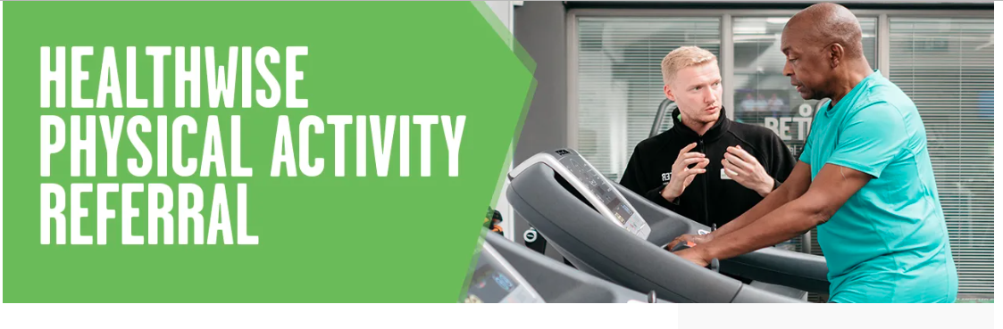
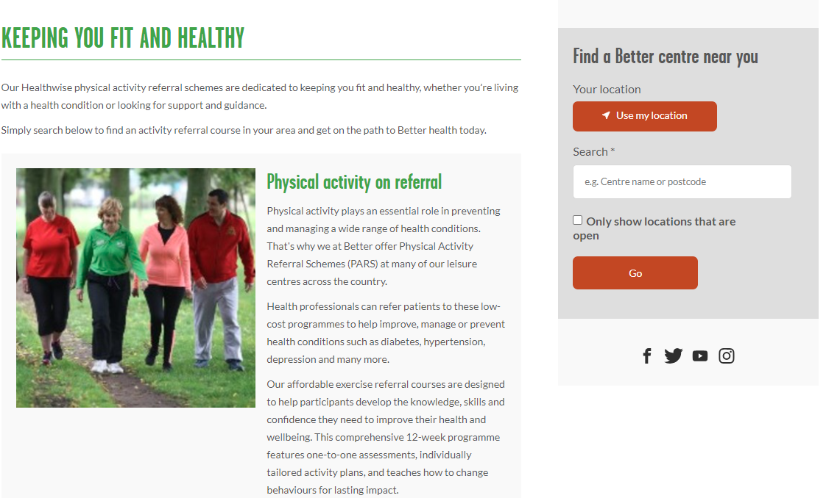
Healthwise Physical Activity Referral | Better UK

Slide 77
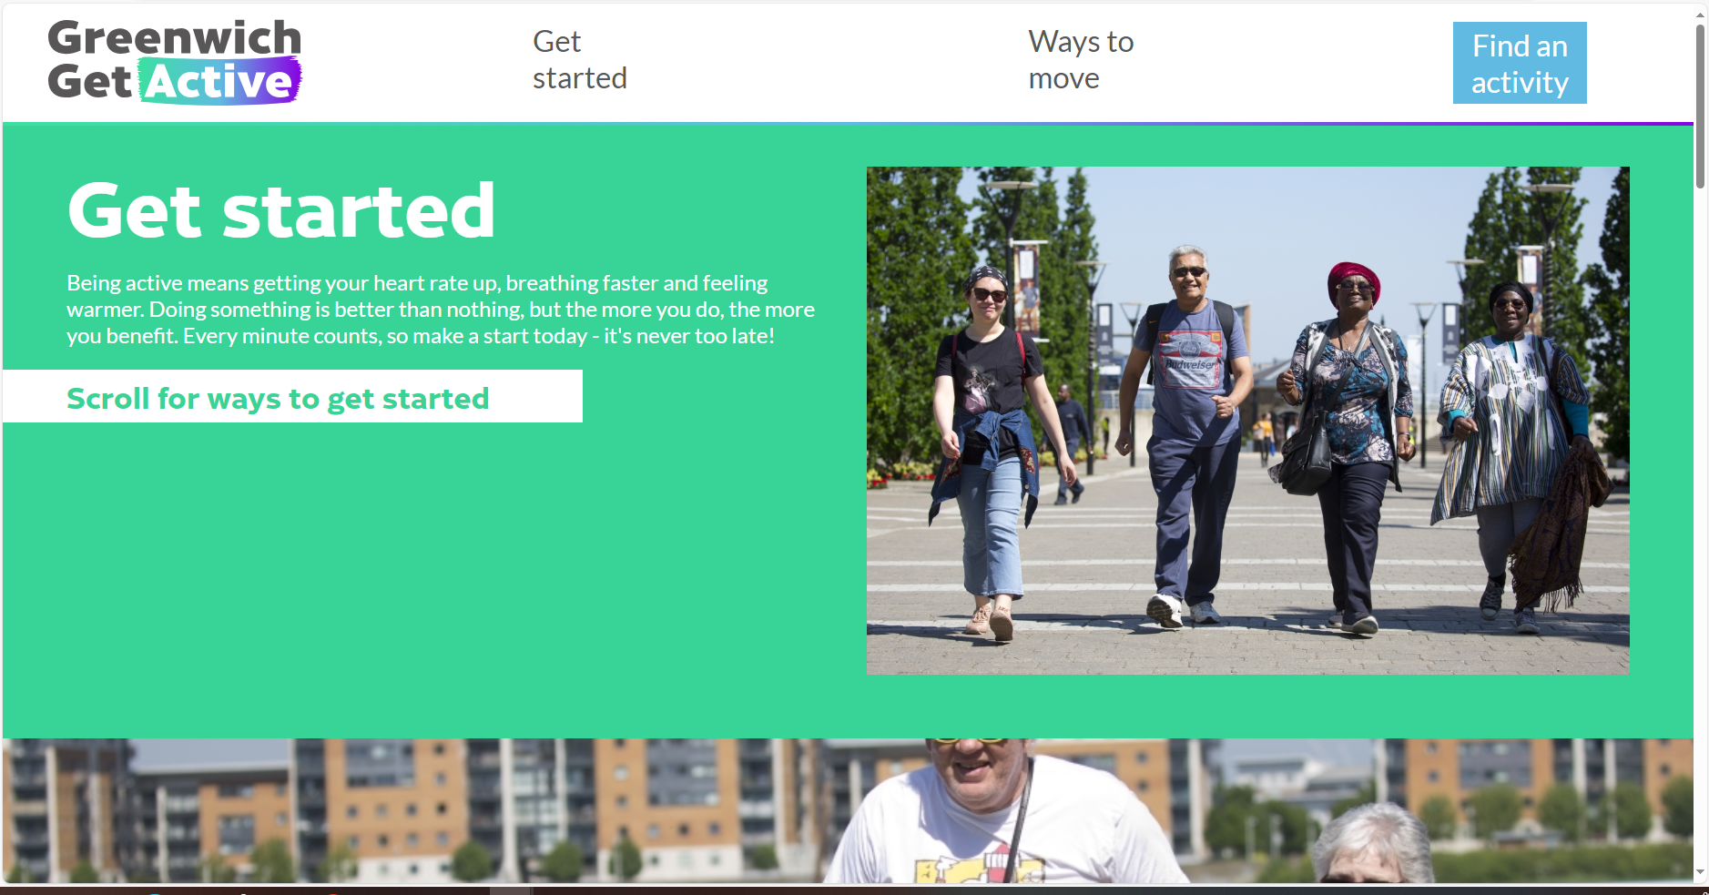
Greenwich Get Active
Being active means getting your heart rate up, breathing faster and feeling warmer. Doing something is better than nothing.
Find tips and ideas to get started:
Small steps
Build it into your routine
Taking up something again
Find something you love

Slide 78
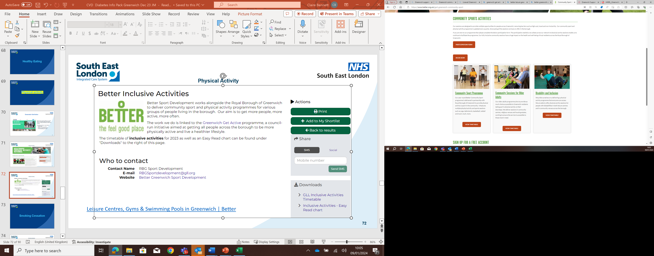
Community Sport Activities | Greenwich Sport Development | Better
Better Sports Development works alongside Royal Borough of Greenwich to deliver community sport and physical activity programmes. Our aim is to get more people, more active, more often.
Timetable for inclusive activities
For more information, please email: RBGSportsdevelopment@gll.org
Leisure Centres, Gyms & Swimming Pools in Greenwich | Better

Slide 79
Smoking Cessation

Slide 80

Smoking Cessation
Quit Smoking | Greenwich Health (greenwich-health.com)

Slide 81
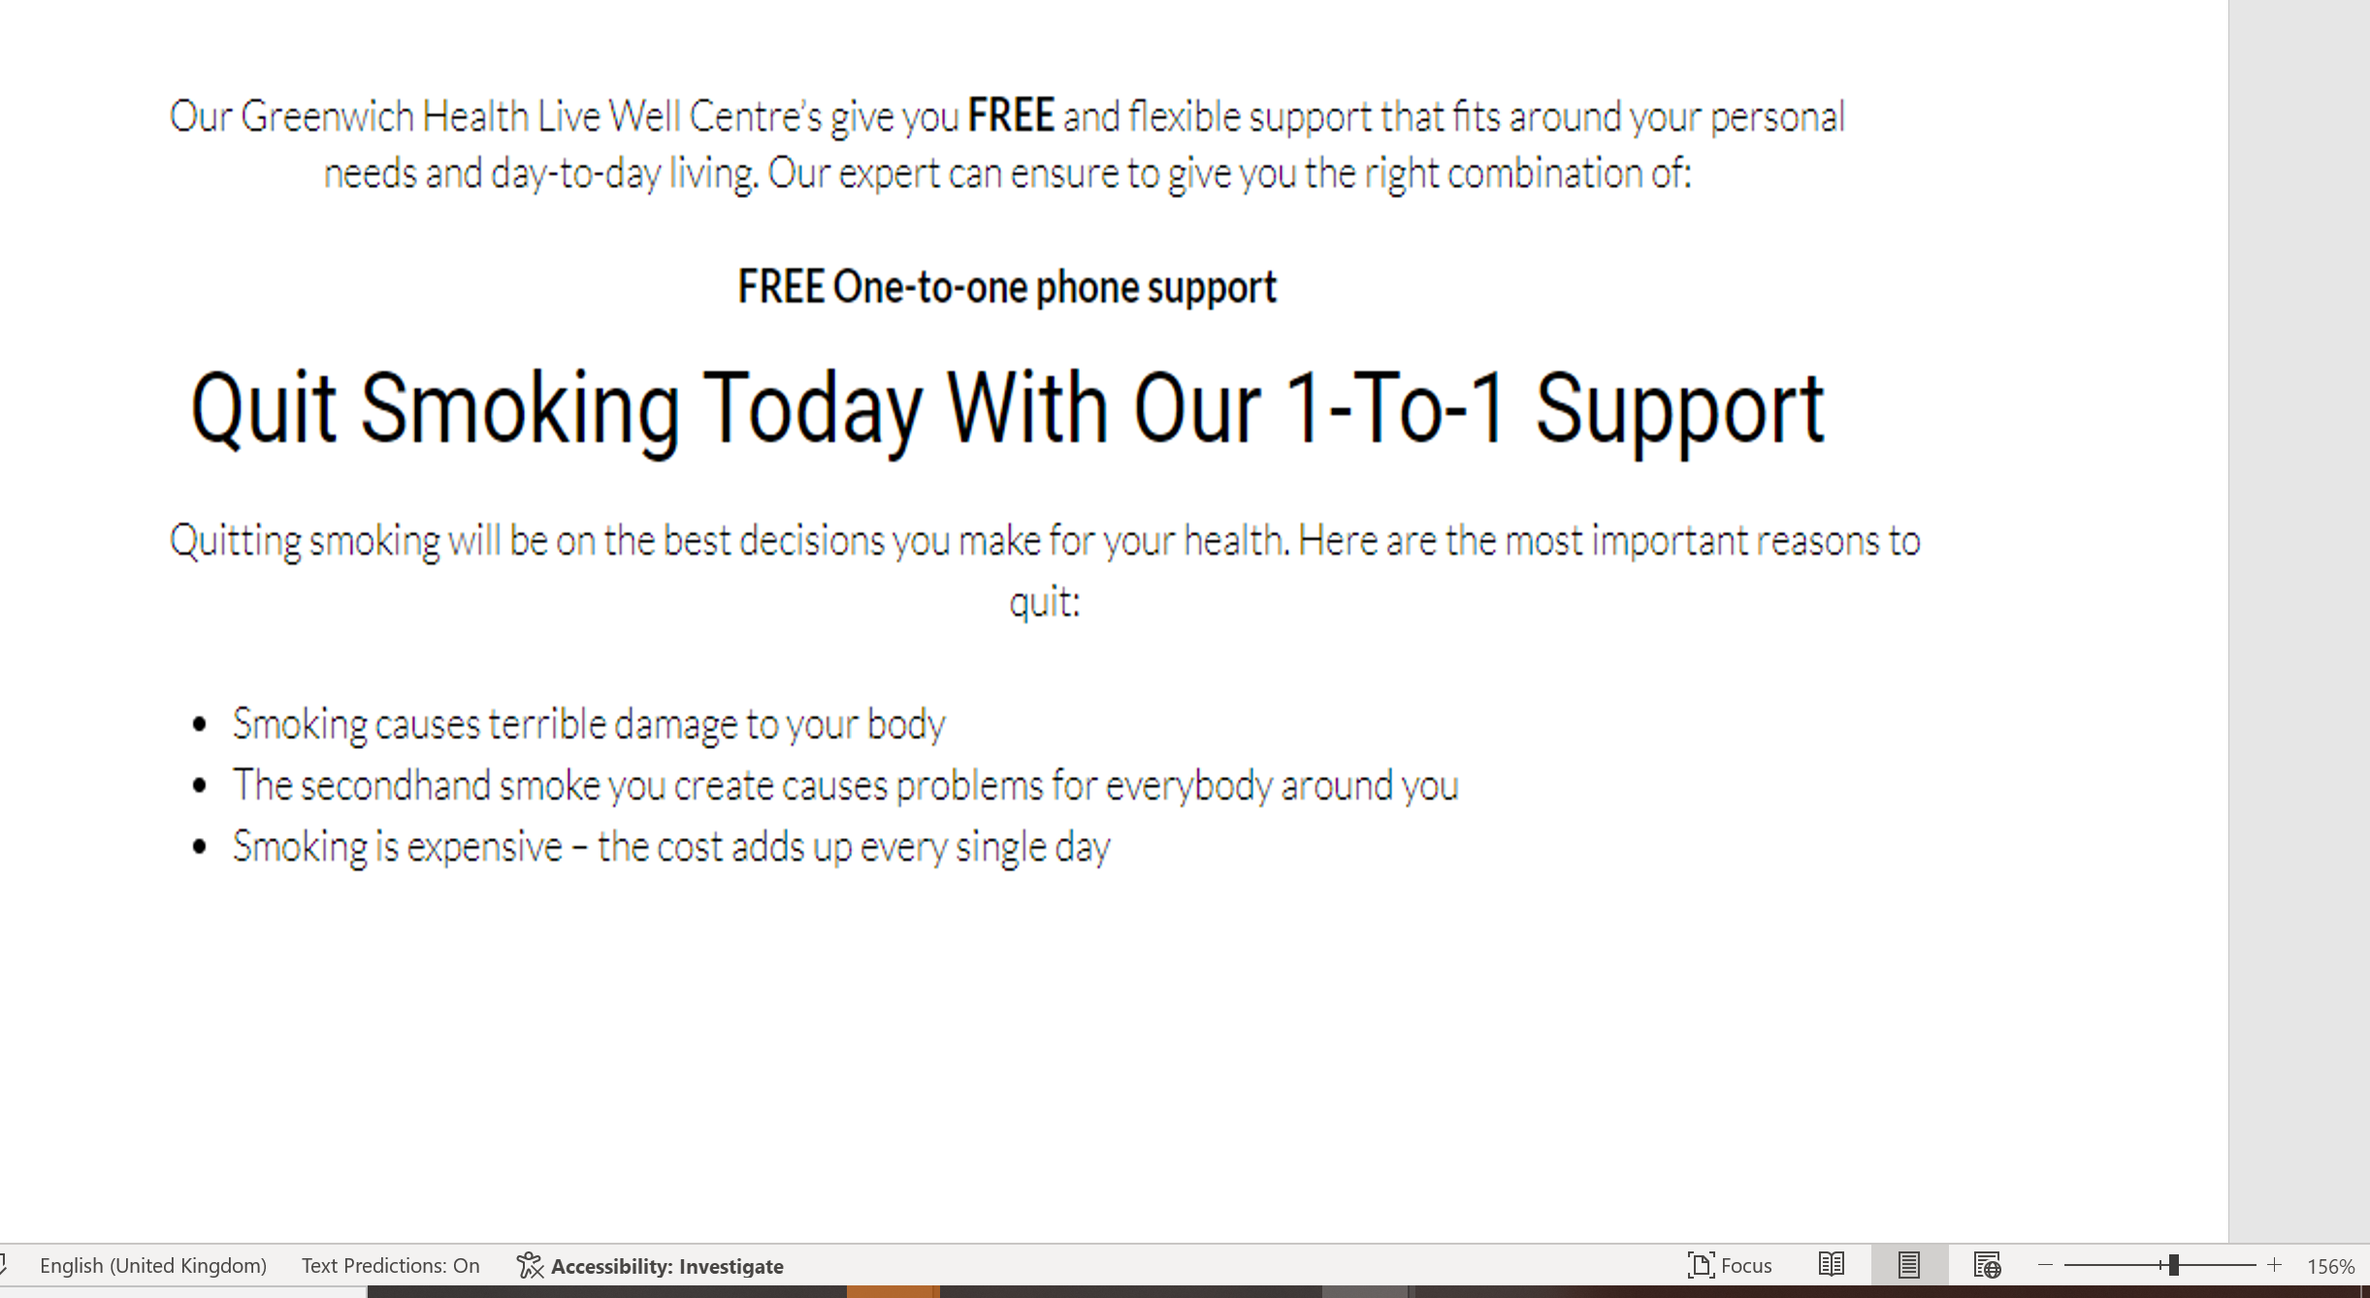
Smoking Cessation
Quit Smoking | Greenwich Health (greenwich-health.com)

Slide 82
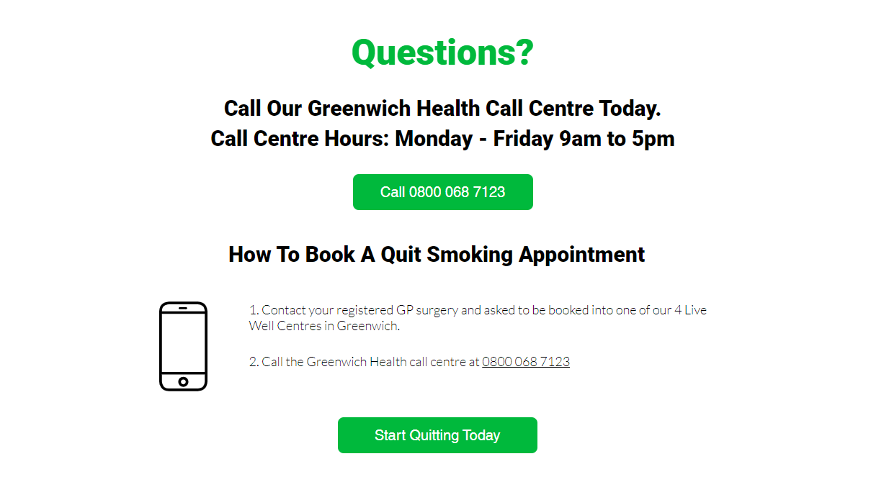
Smoking Cessation
Quit Smoking | Greenwich Health (greenwich-health.com)

Slide 83
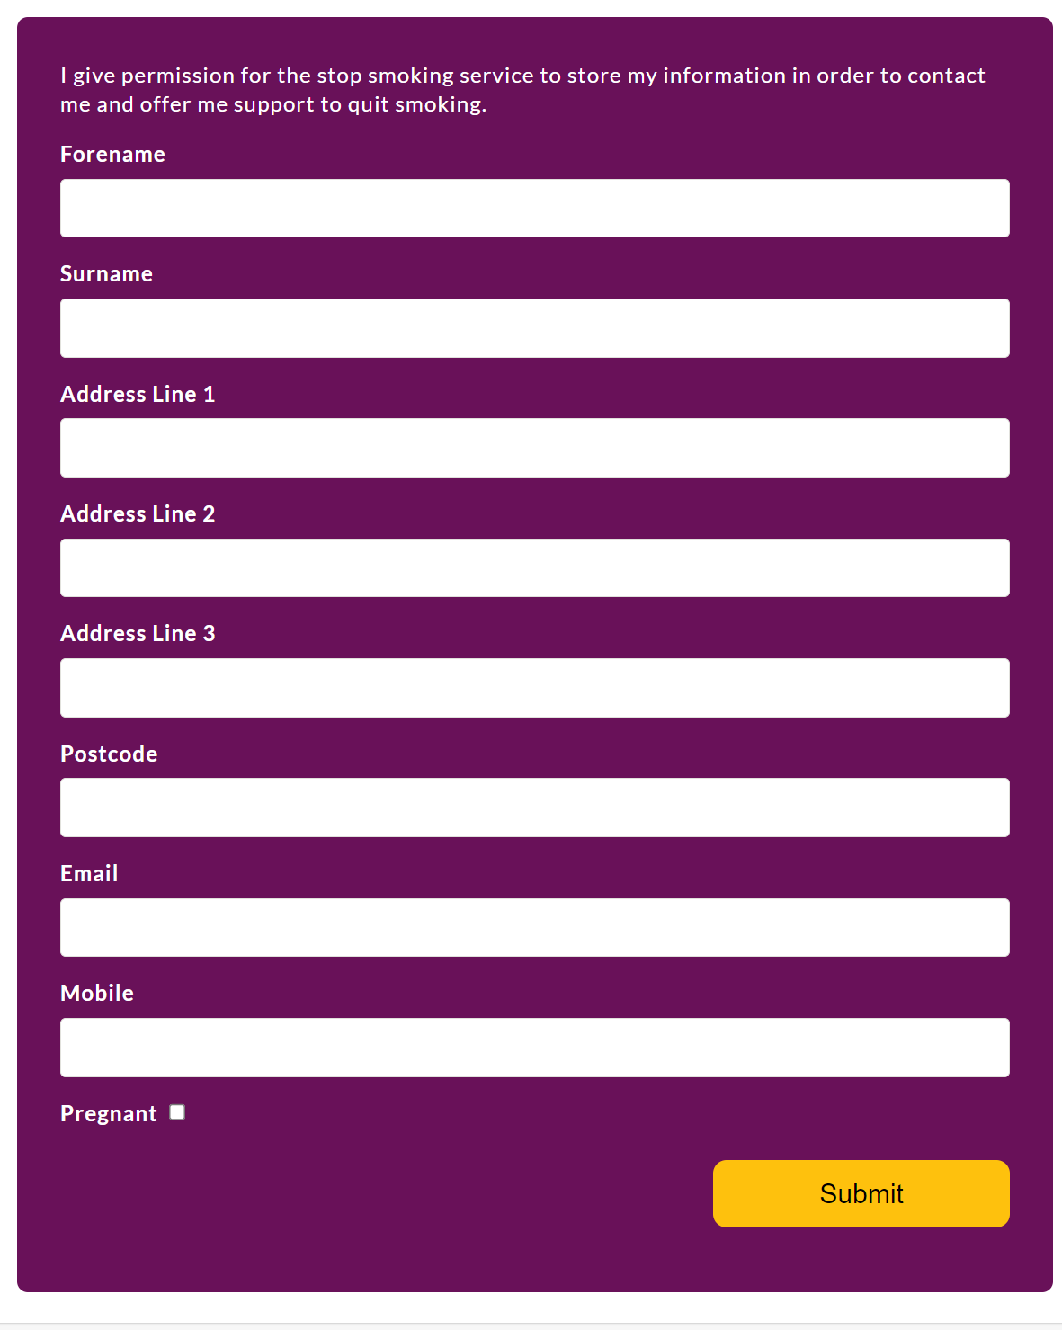
Smoking Cessation Get in touch on line
Text – ‘QUIT’ to 60060
Email – send your name and phone number to lg.smokefreegreenwich2030@nhs.net
Fill in the form
Stop Smoking - Live Well Greenwich
Complete and submit the simple form below and a friendly Stop Smoking Specialist will get back to you shortly.

Slide 84

Acute and Mental Health - Supports NHS Trusts to have Tobacco Dependence Advisors within Lewisham and Greenwich NHS Trust and Oxleas, which patients are treated in house, with behaviouaral support and NRT and on discharge are referred into community specialist services to continue care
Maternity - are supported to have Smoke Free Midwives to work strategically, undertake interventions and channel those smoking in pregnancy into community specialist services.

Slide 85
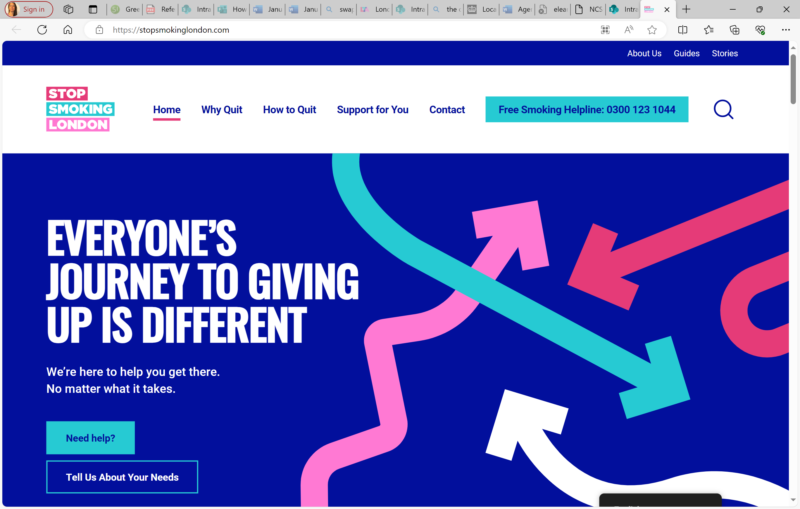
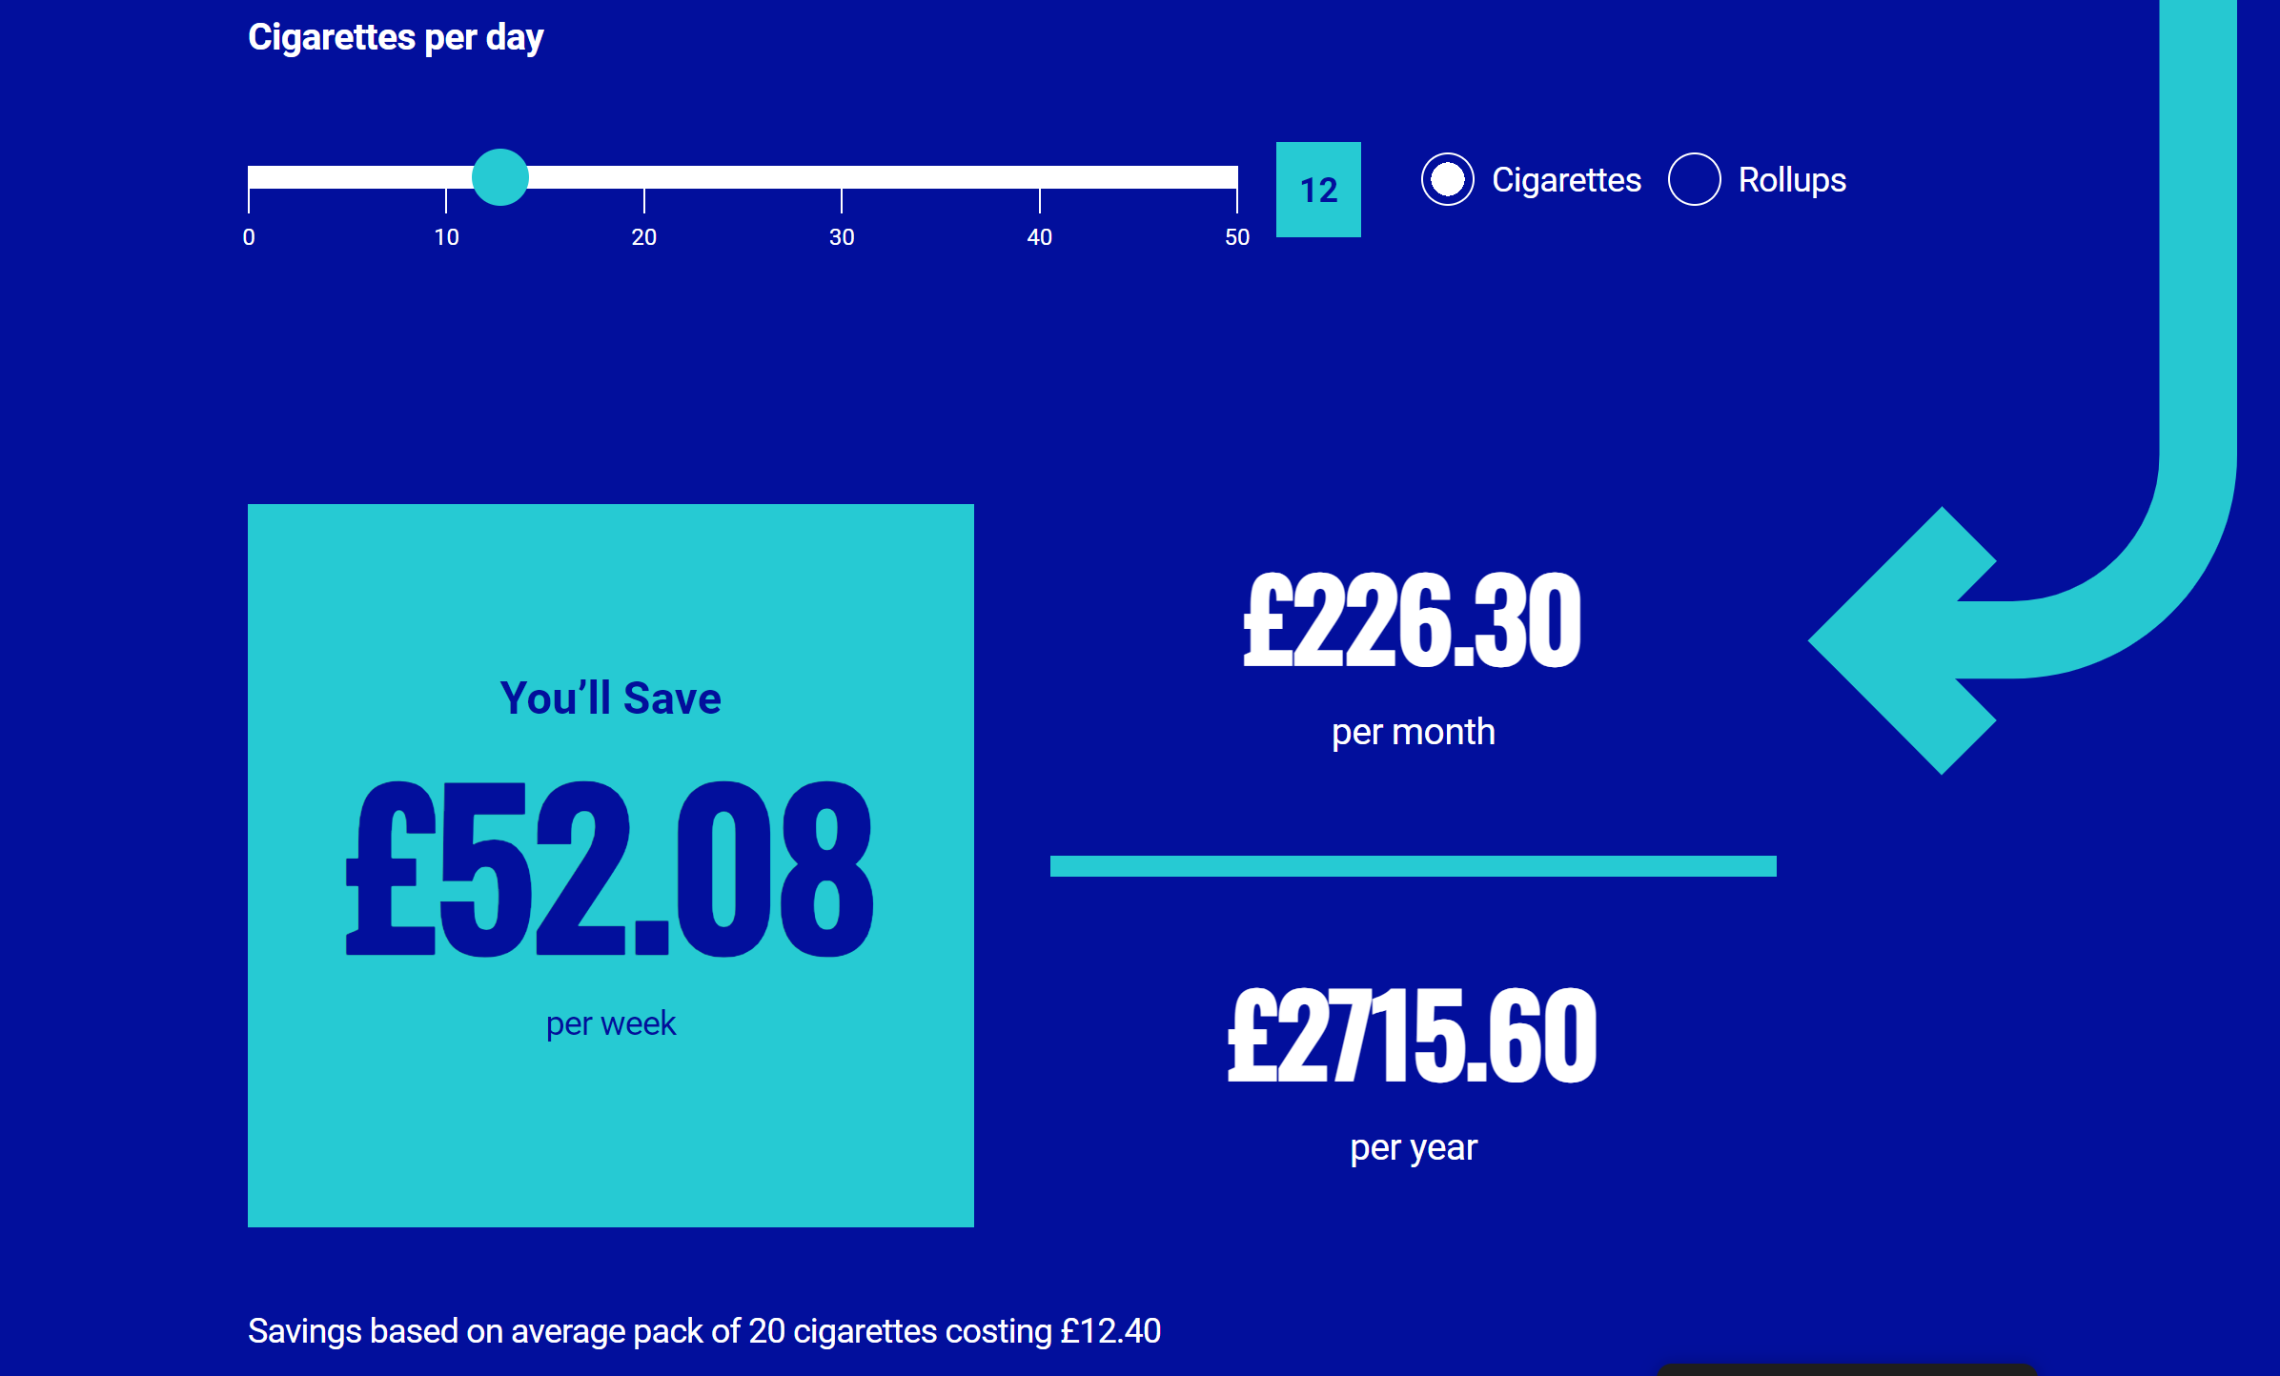
Online tools available from Stop Smoking London
Stop Smoking London - We're Here to Help You Quit Smoking
Calculator for Saving of Stopping Smoking

Slide 86
Drug and Alcohol Services

Slide 87

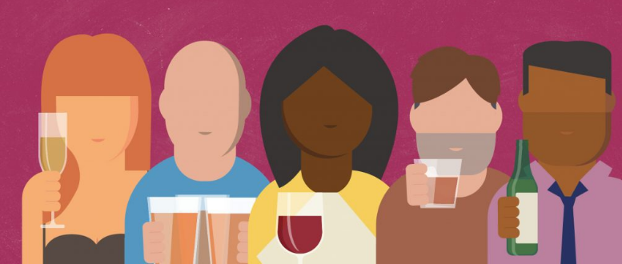
Alcohol interventions (prevention and signposting)
Online resource for anyone concerned about their or others drinking.
Do you know when to stop
Online identification tool (Audit C)
10 questions – 2 minutes
Assessment of risk
Provides tailored advice based on individuals audit score
Self referral option for support and treatment
Linked to borough treatment provider
(VIA Greenwich) )

Slide 88
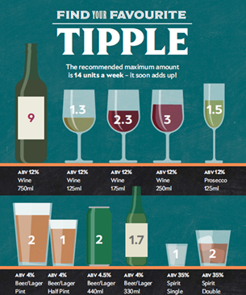
Alcohol interventions (prevention and signposting)
Do you know when to stop
Audit score thresholds:
0 – 5 Low risk - mindful drinking means low risk
6 – 15 Increasing risk – brief advice on how to cut down
16- 19 High risk - referral for support (up to 12 sessions)
20+ Possible dependency
Full assessment of needs and one-to-one support through VIA Greenwich drug and alcohol service. Access community detox or residential support.
Self-referral option within the online tool.
Can be completed confidentially on your phone.

Slide 89
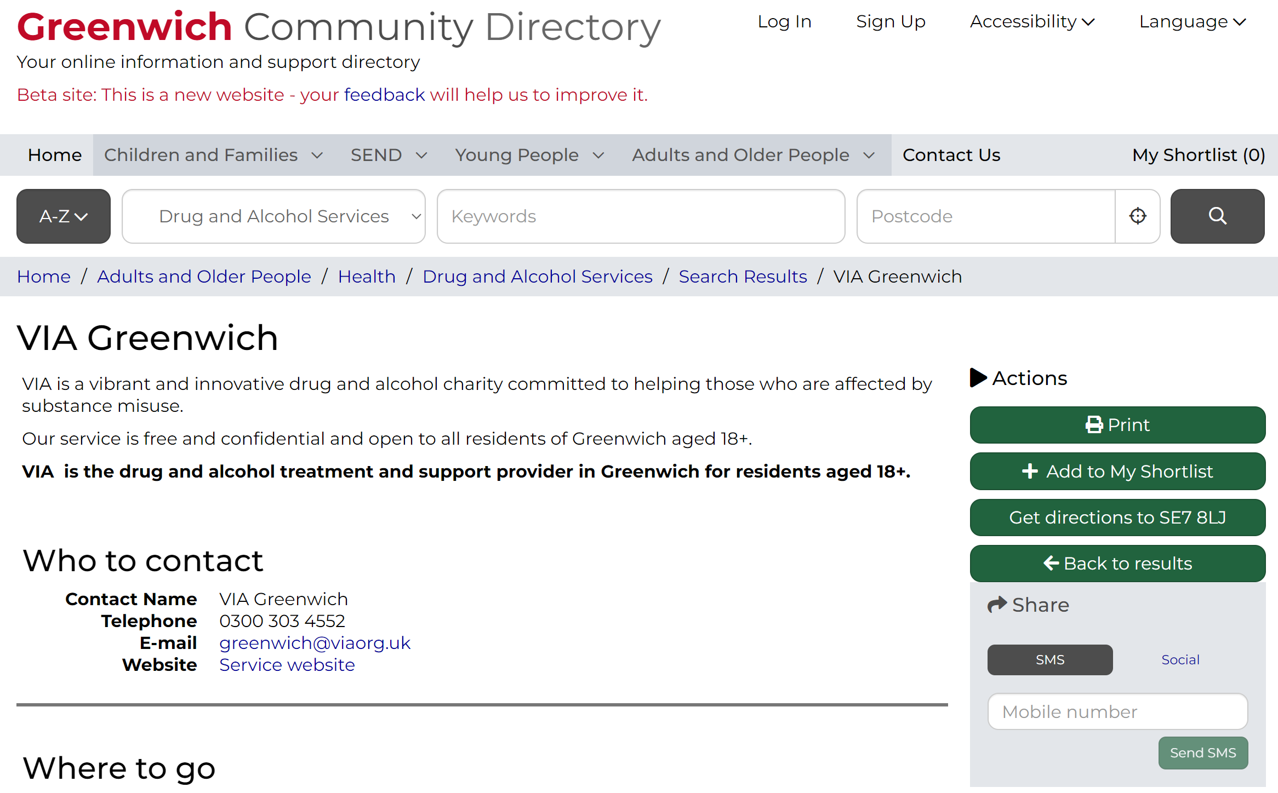
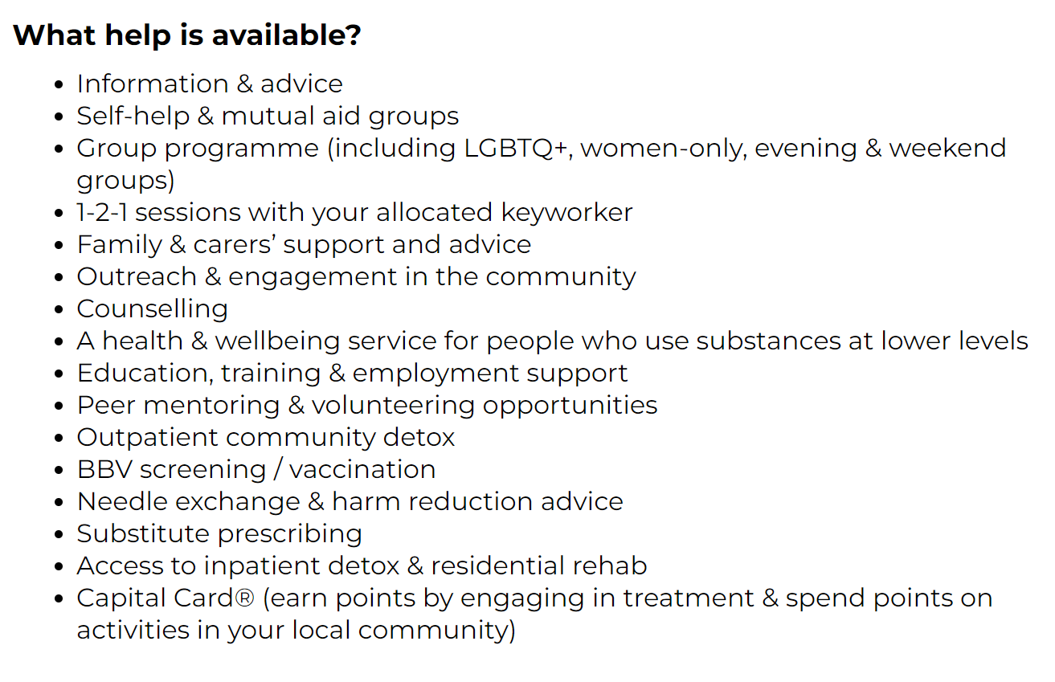
Alcohol and Drugs
Greenwich Adult drug and alcohol service
Self-Referrals (phone/online)
Practitioner referrals (phone/online)
Free and confidential support
Opiate prescribing
Alcohol support
Community & residential detox/rehab support
Family/Carer support
Recovery community
Peer- led community activities
Call: 0300 303 4552
Visit: Greenwich - via (viaorg.uk)

Slide 90
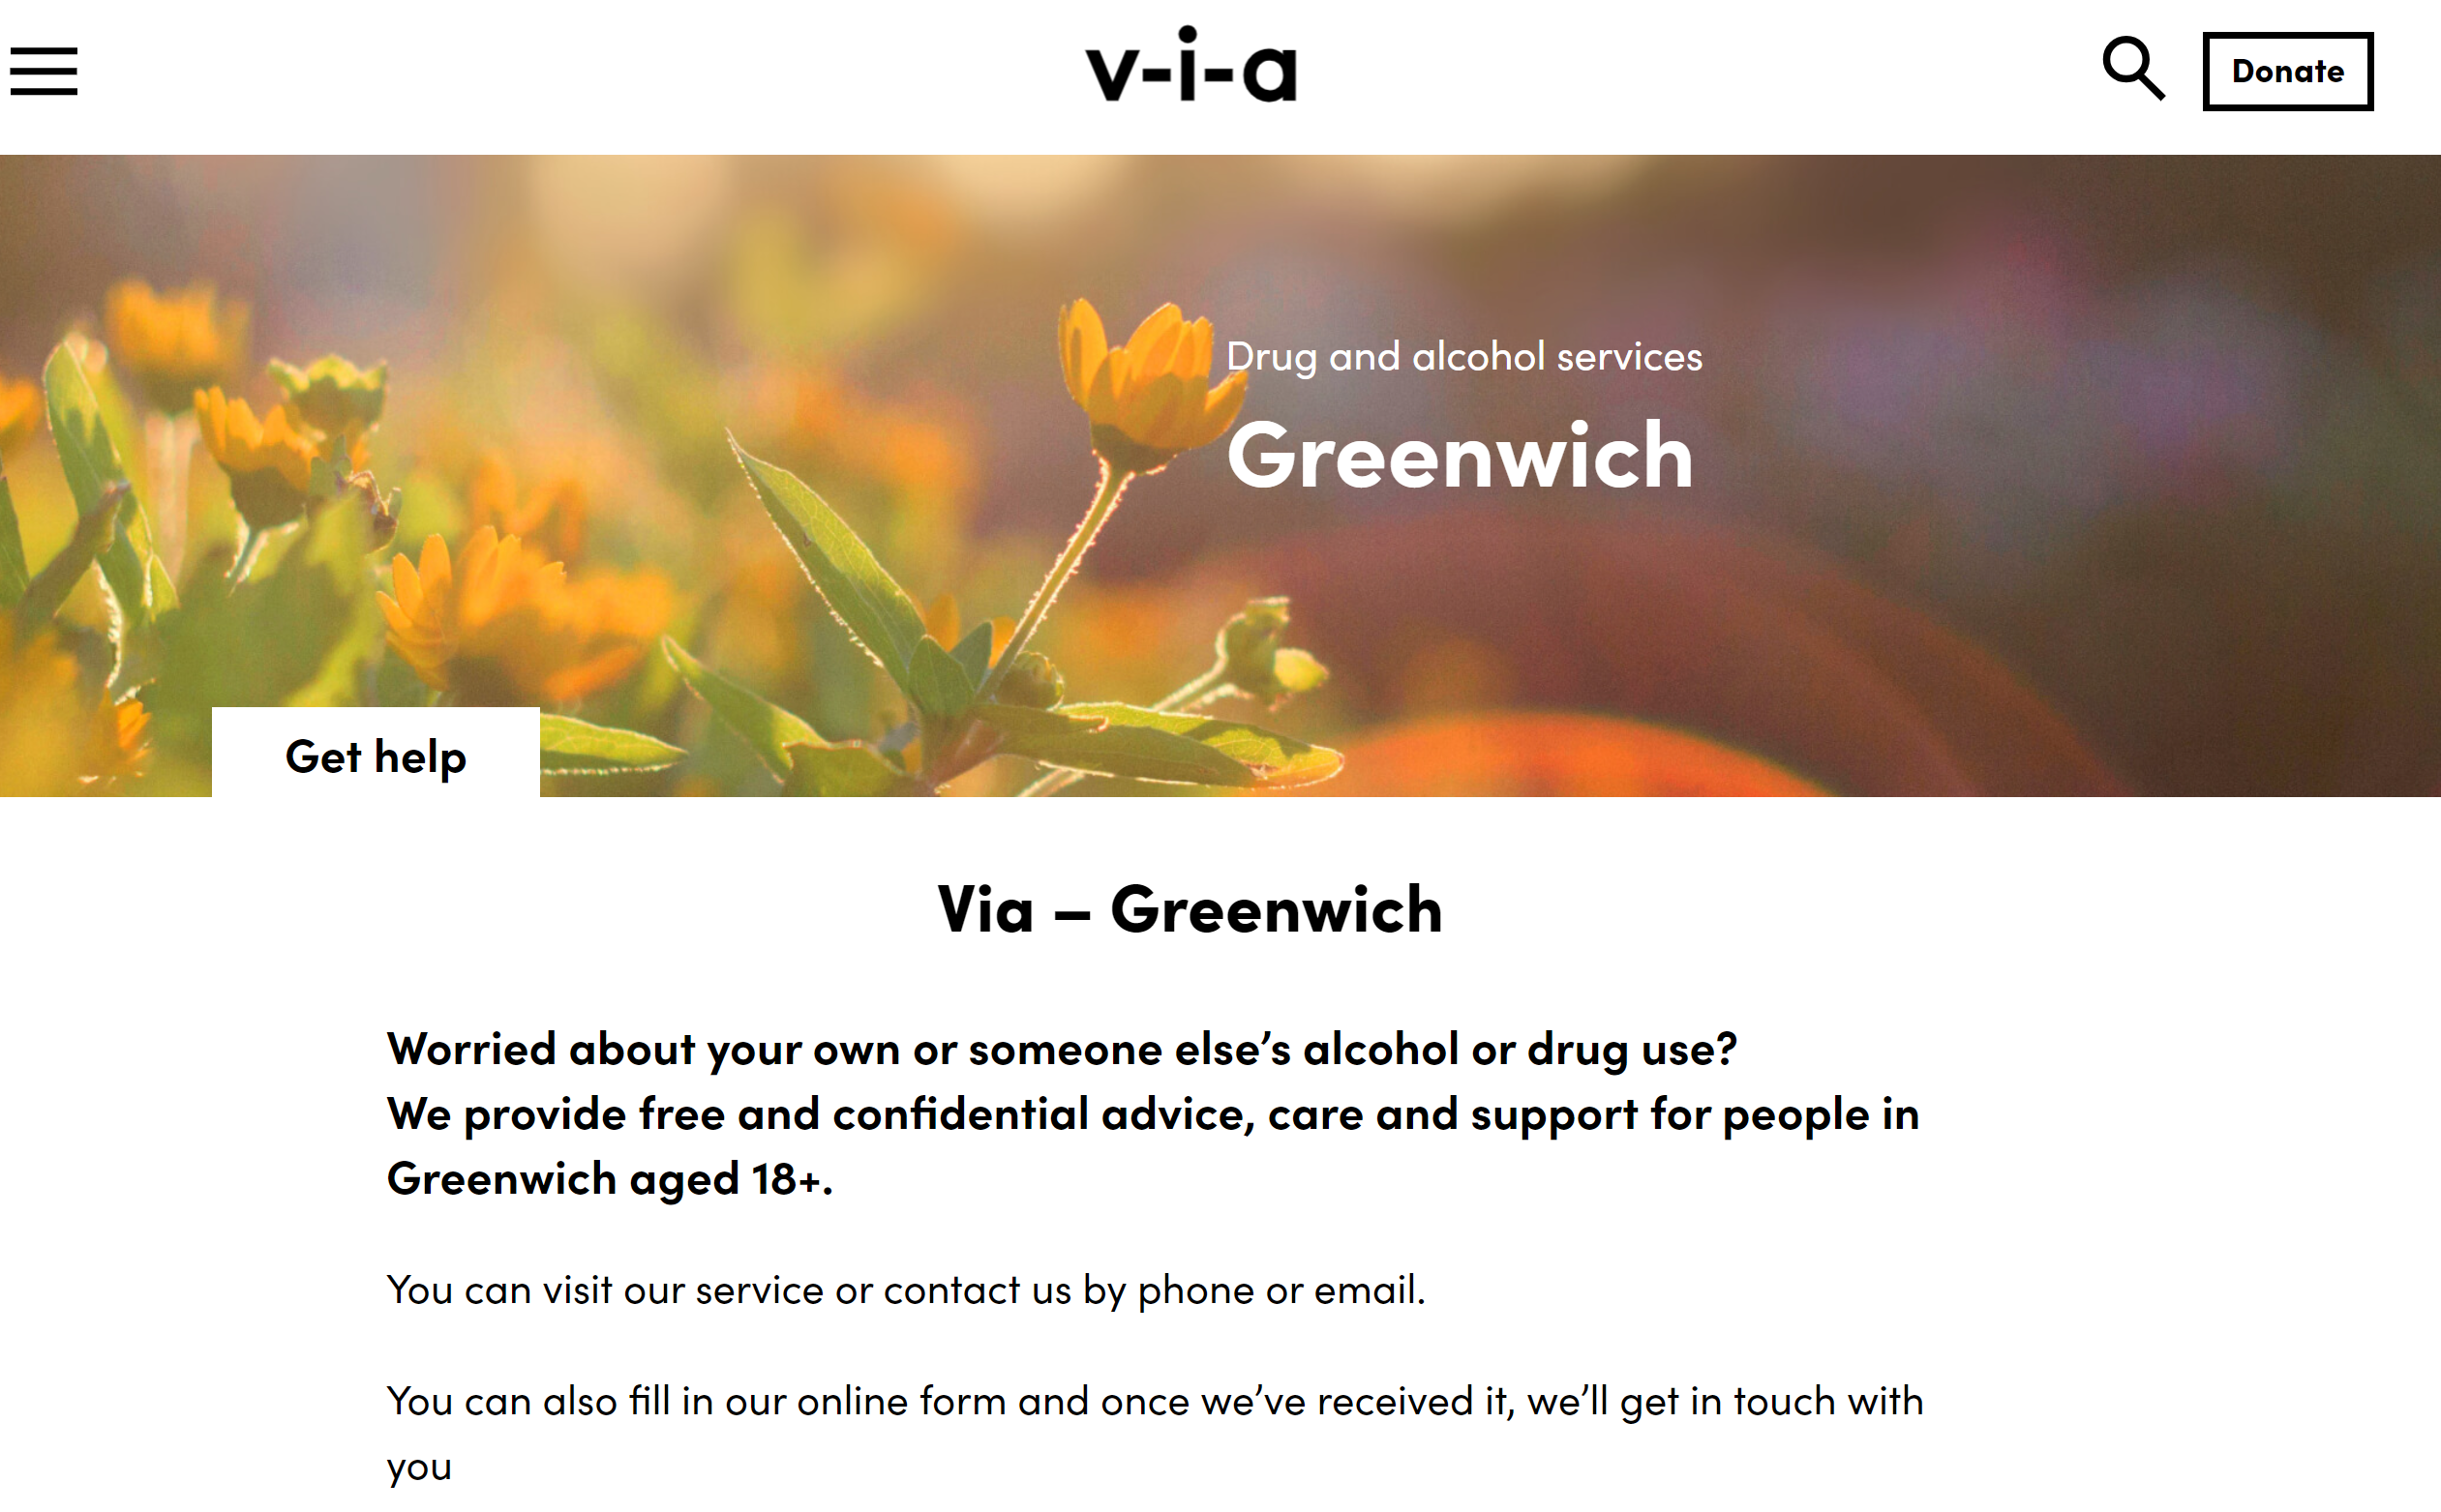
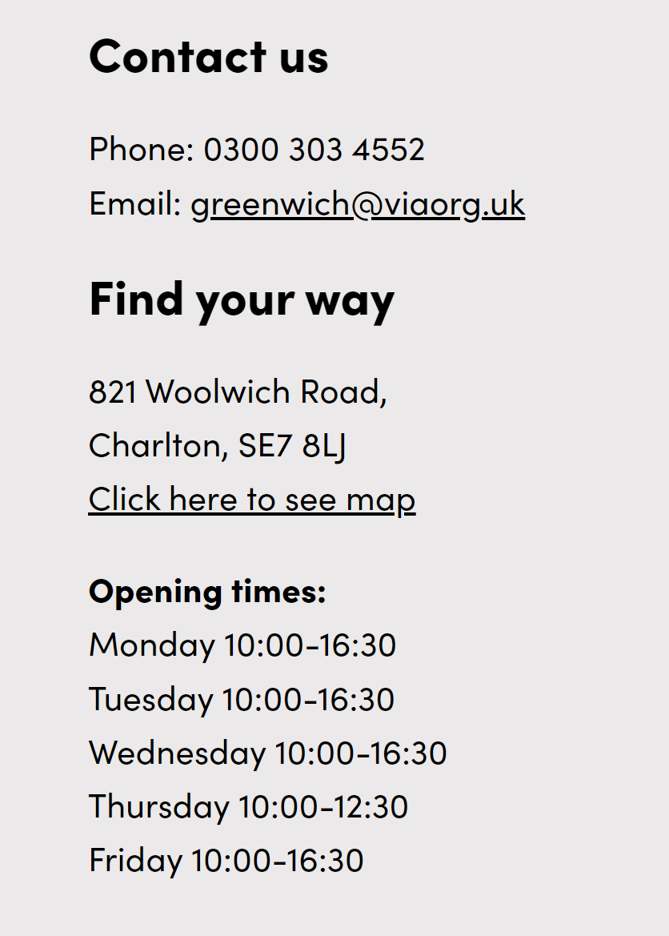
Alcohol and Drugs

Slide 91
Talking Therapies

Slide 92
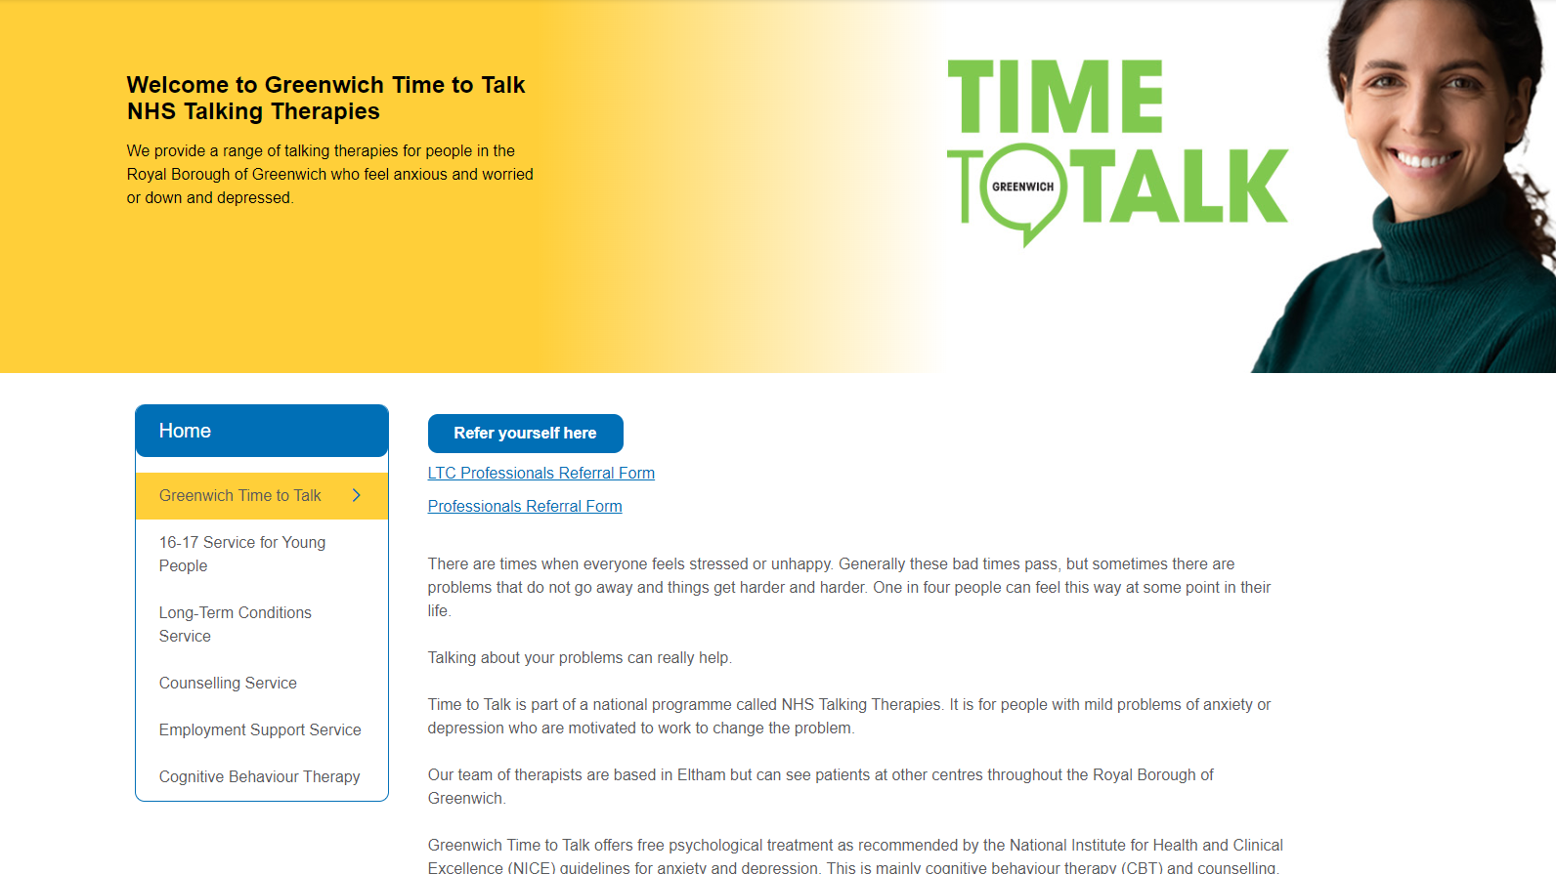
Talking Therapies https://oxleas.nhs.uk/greenwich-time-to-talk

Slide 93
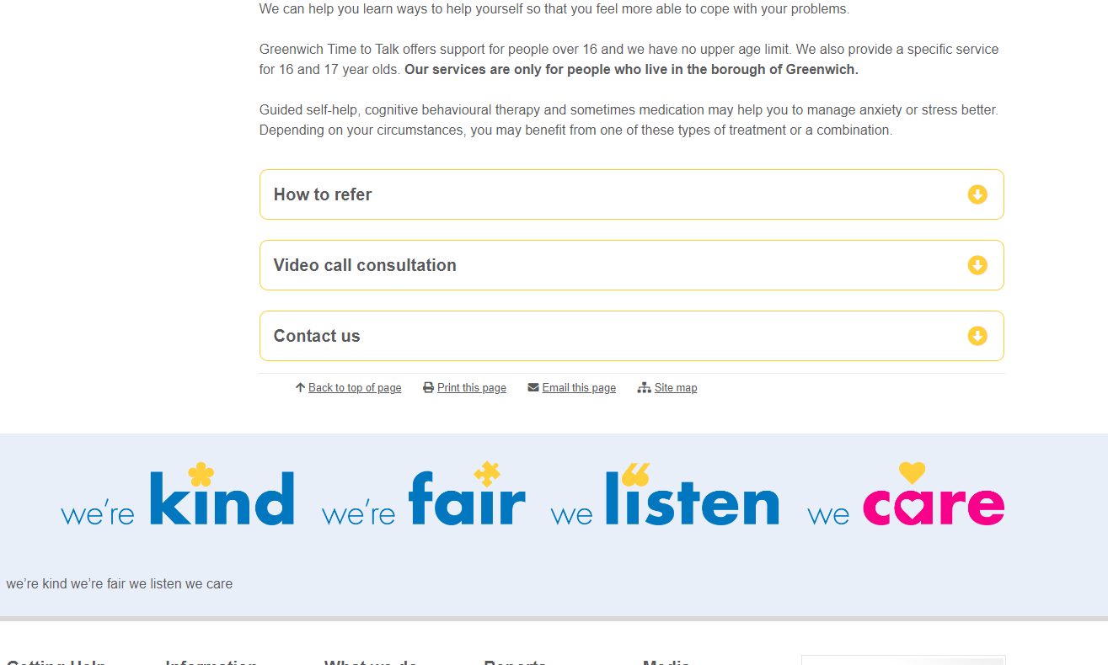
Talking Therapies

Slide 94
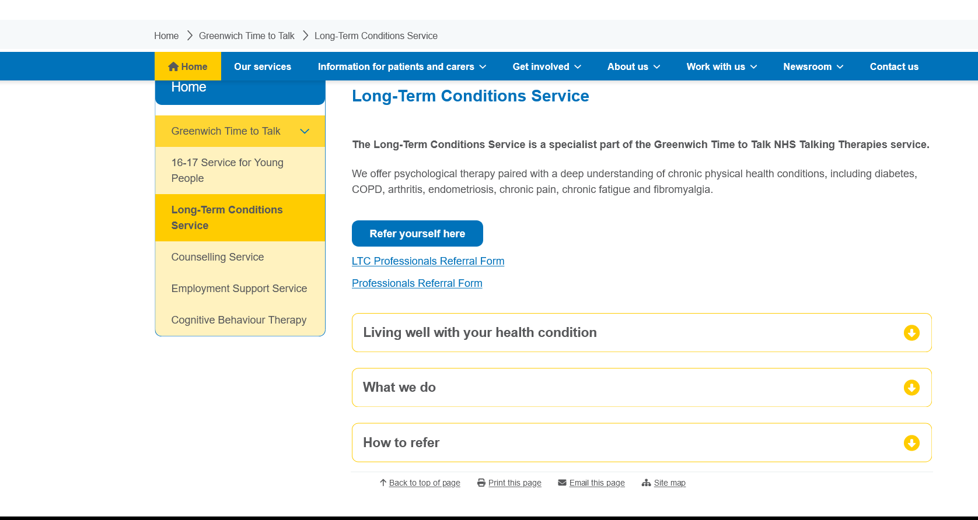
https://oxleas.nhs.uk/gttt-ltc/

Slide 95
Voluntary Sector

Slide 96
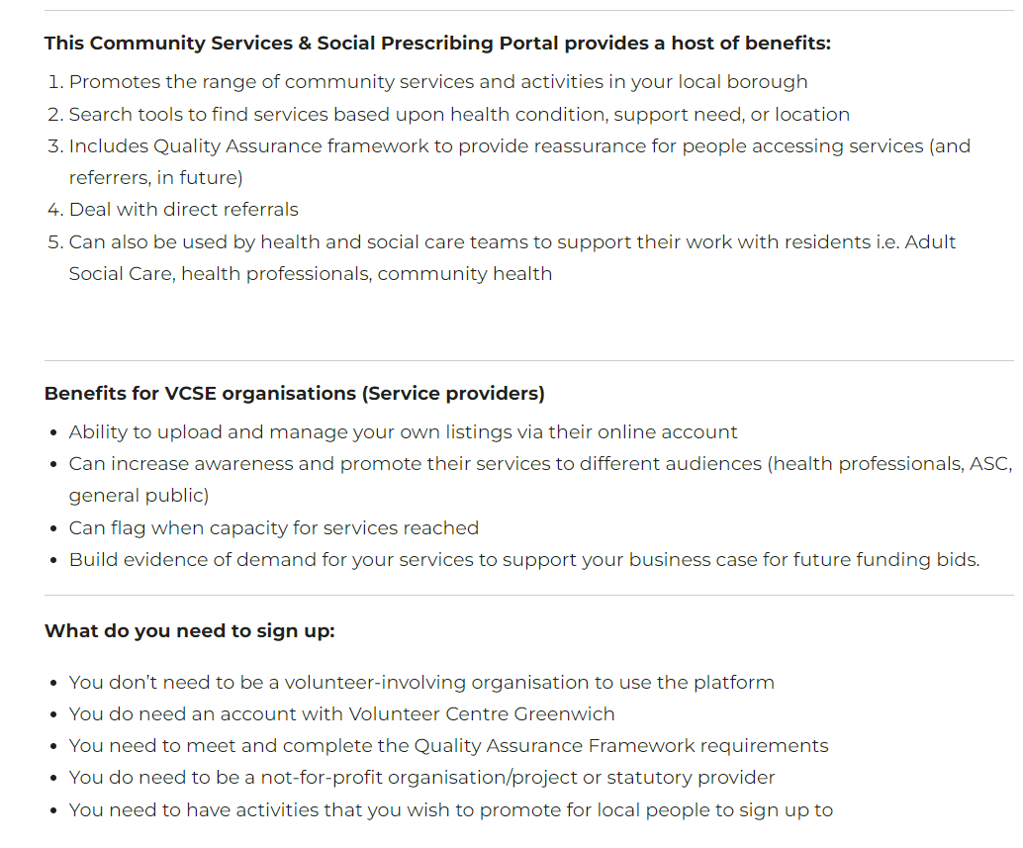
Greenwich Community Services & Social Prescribing Portal

Slide 97

Greenwich Community Directory

Slide 98
Greenwich Supports

Slide 99

Greenwich Supports
Lots of information and support about:
Money, housing and bills
Everyday costs, healthcare and families
Activities, reducing food waste and home improvements
Supporting you | Royal Borough of Greenwich (royalgreenwich.gov.uk)

