Slide 1

Greenwich Digital Forum
09.04.25

Slide 2

DXS – Recent Version Highlights

Slide 3
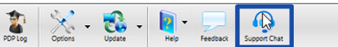
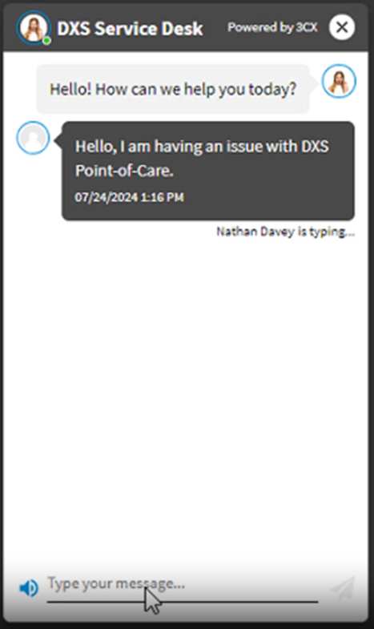
DXS – Live Chat
A Live Chat feature has been added for improved access to our Service Desk. This functionality is being trialled in selected areas. Communication will be sent to practice managers detailing roll-out plans.
The Support Chat feature can be accessed from the ‘Support Chat’ button on the Point-of-Care main toolbar

Slide 4
DXS – Reasonable Adjustment Flagging
This new feature promotes inclusive care by ensuring a patient requiring reasonable adjustments is catered for.
Highly visible on DXS SMART Referral forms, the feature utilises existing clinical record codes for impairments that have significant long-term effects and require adjustments to health and care access, as outlined in the standard’s core requirements.

Slide 5
DXS – ERS Integration

Slide 6
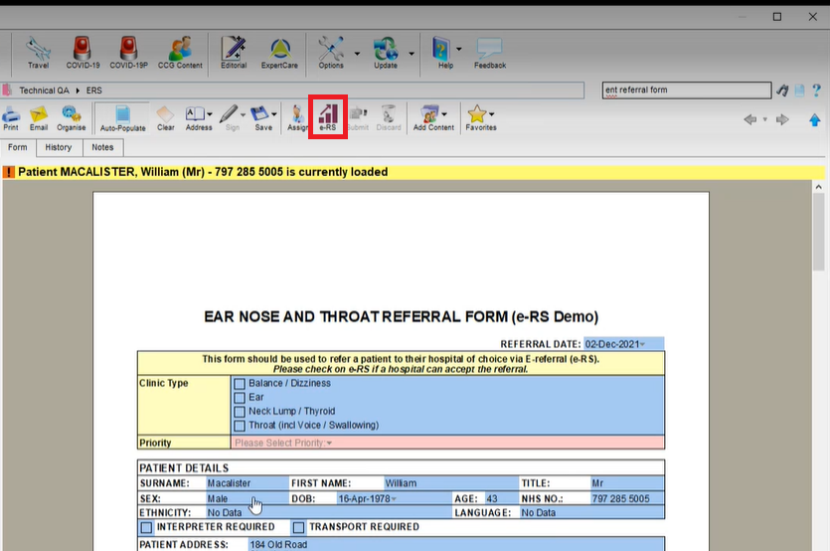
Dedicated ERS Button
When DXS launches the ERS functionality, it will feature a fully integrated ERS button allowing quick referral through to Secondary Care.

Slide 7
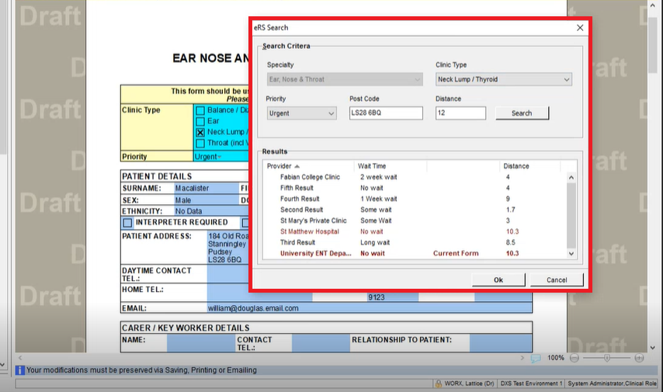
Dedicated ERS Button
Clicking the ERS button will enable the ERS search functionality to search through the form itself and pull through the necessary information for the ERS referral, if this functionality is tagged/required for the form.

Slide 8
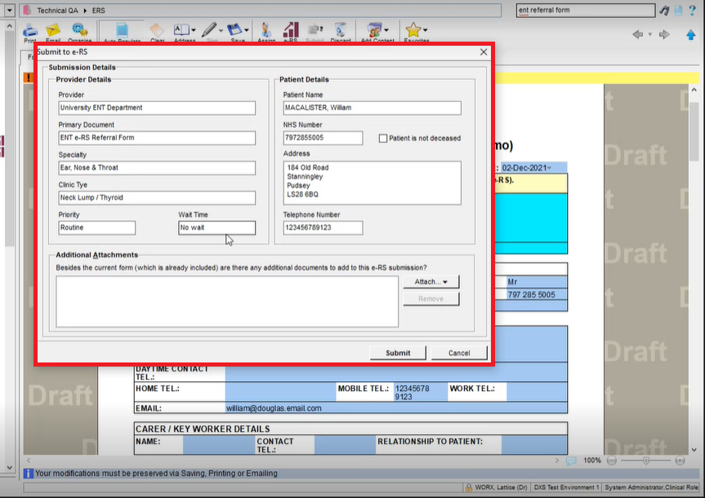
Dedicated ERS Button
Following this the ERS Submission/Checklist field will appear as the final step before the form is submitted through DXS and the form is saved back to the Patient Record.

Slide 9
DXS – Focus Areas

Slide 10
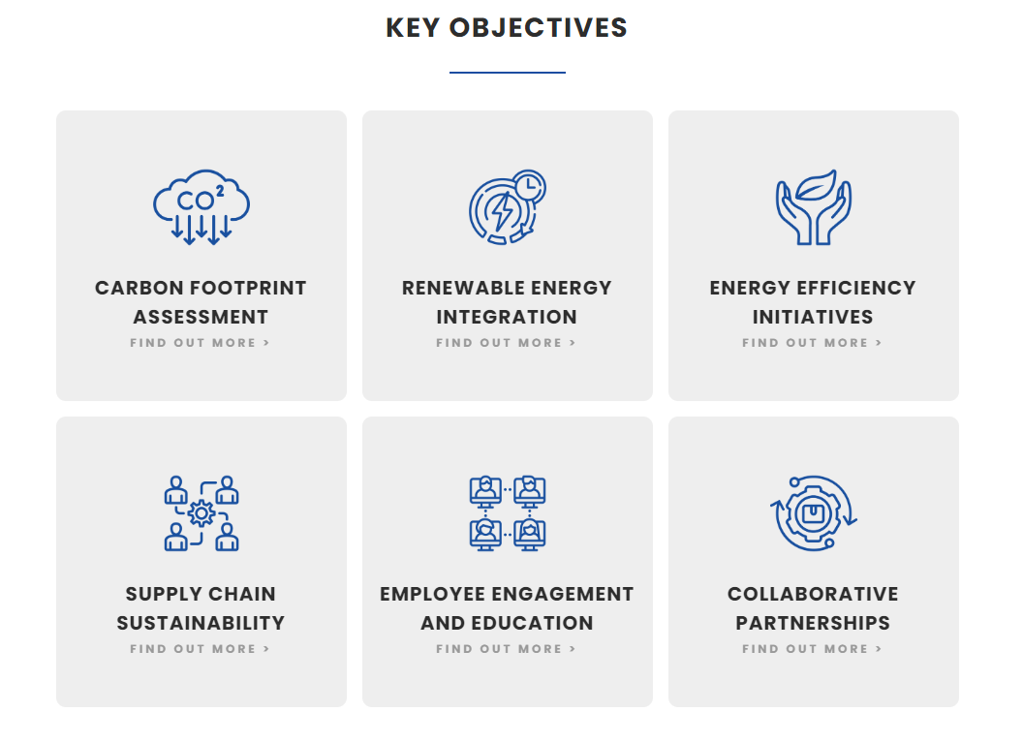

DXS Carbon Reduction Plan
DXS have now developed a comprehensive Carbon Reduction Plan to help contribute to a sustainable future.
This can be found on the DXS Website under - https://bestpathway.co.uk/carbon_reduction_plan.php

Slide 11
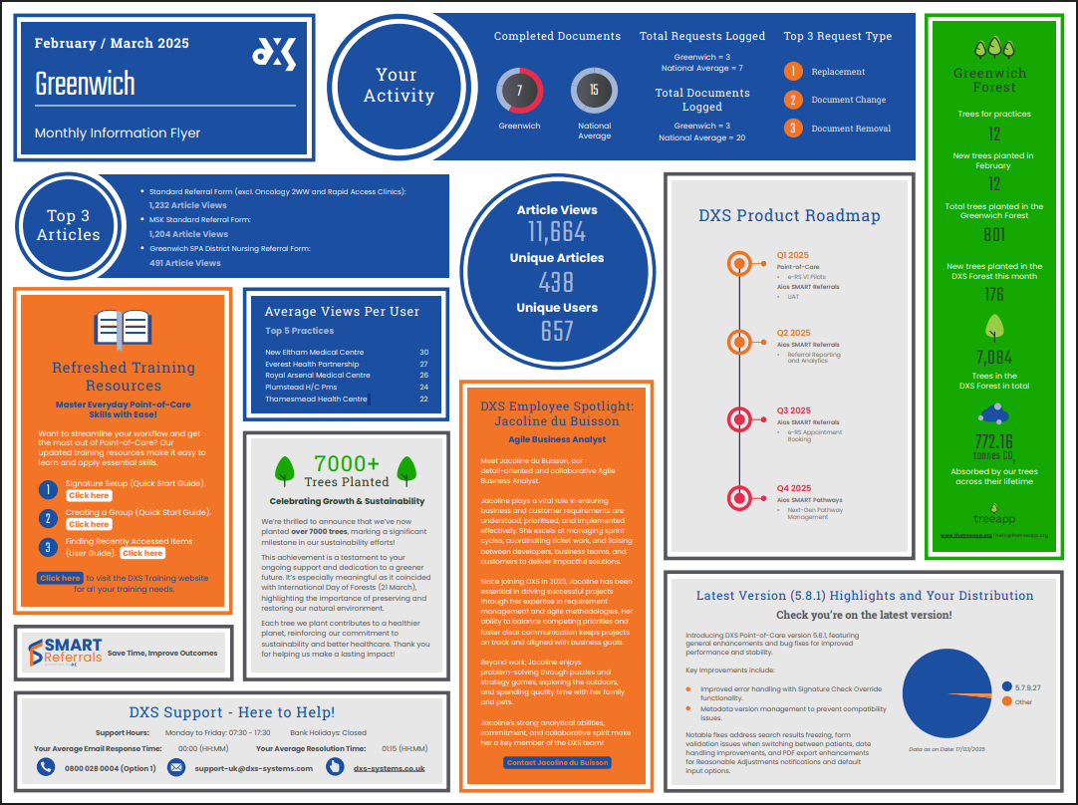
DXS Monthly Flyer

Slide 12
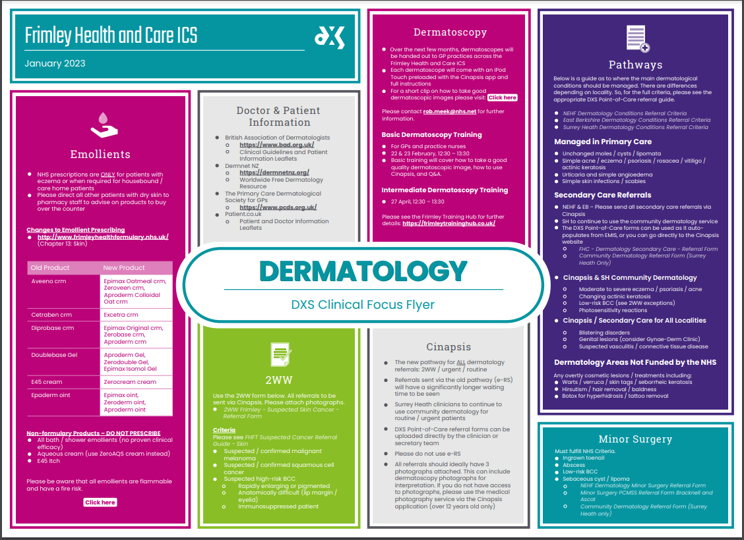
DXS Clinical Flyer

Slide 13
DXS Vodcast
DXS has launched a video and audio podcast channel, A DOSE OF DIGITAL HEALTH.
In the newest episode, we reconnect with Dr. Bharan Kumar to discuss his innovative Robo GP concept and the role of digital technologies in improving continuity of care.
Join us for conversations about digital health solutions and healthcare delivery in our time.
Watch or listen on the following platforms -
Spotify
YouTube
Apple Podcasts
Google Podcasts

Slide 14
DXS – ‘SMART’ Functionality

Slide 15
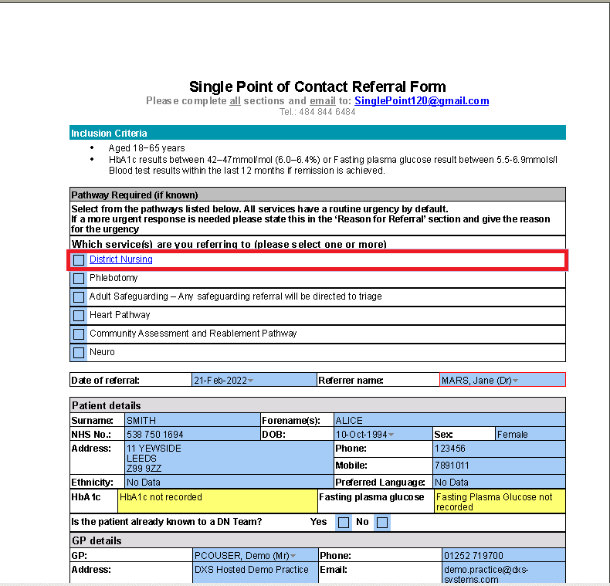
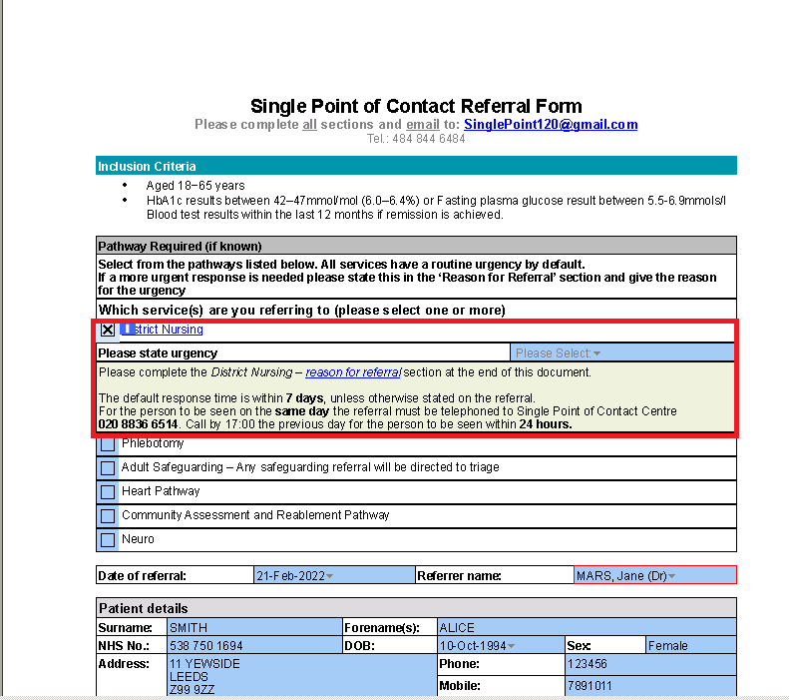
DXS forms can incorporate intelligent Hide/Show functionality, automatically expanding or shrinking based on triggers such as user selection or populated patient details. This ensures that only relevant sections are displayed, optimizing space and improving usability.
Hide & Show

Slide 16
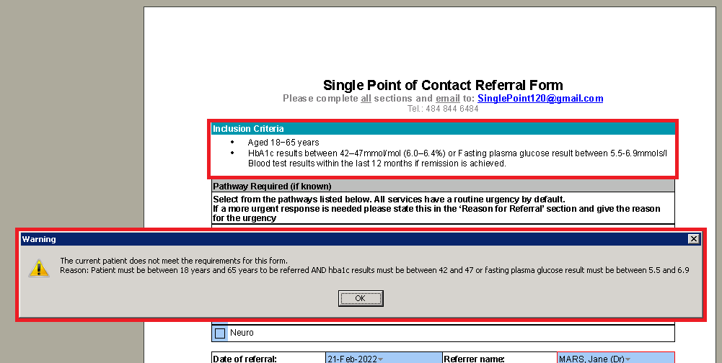
Validation
DXS can validate various form elements to ensure clear requirements and service-side acceptance. For example, it can check if the patient’s details or test data meet essential criteria for referral. This validation can be either mandatory or optional.

Slide 17
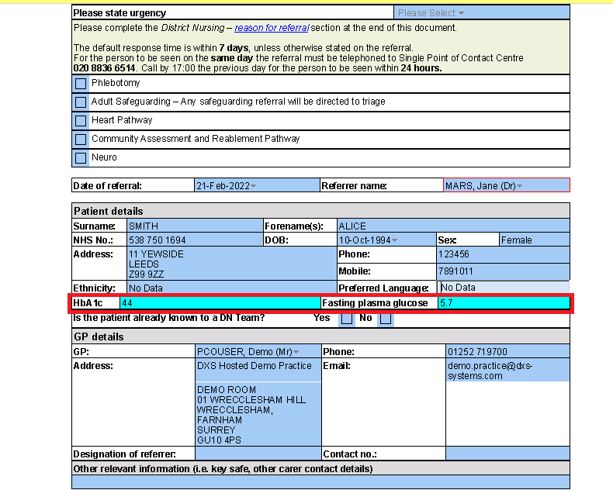
DXS can save relevant SNOMED codes during form completion. For example, if a form requires an updated BMI and it's manually added, it will automatically update the patient's medical record. This ensures accurate medical history and future data capture. This functionality supports various use cases, including QoF integration.
Passback Codes

Slide 18
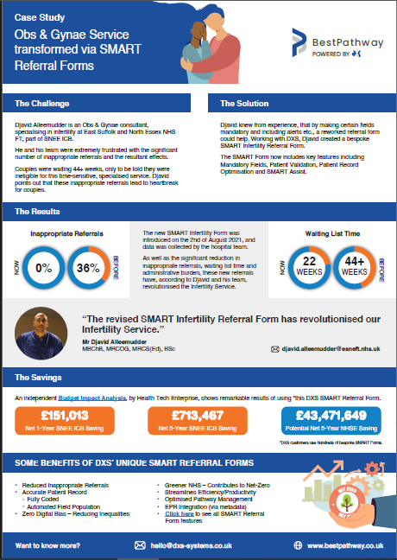
Suffolk Obs & Gynae Service Case Study
The introduction of a new SMART-featured Infertility form to the Suffolk Obs & Gynae service has seen a reduction of 36% rejected referrals to 0% and an average wait reduction of 22 weeks.
Djavid Allemudder, an Obs & Gynae consultant for the service has praised these reductions, as well as the administration improvements this has brought about, going so far to note that “The revised SMART Infertility Referral Form has revolutionised our Infertility Service.”

Slide 19
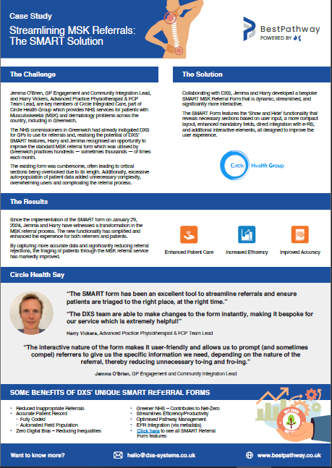
Greenwich MSK Case Study
Since the implementation of a DXS SMART form to Circle Health Group’s MSK Service on January 29,
2024, the service has witnessed a transformation in the
MSK referral process.
The new functionality has simplified and
enhanced the experience for both referrers and patients.
By capturing more accurate data and significantly reducing referral
rejections, the triaging of patients through the MSK referral service
has markedly improved.

Slide 20
DXS Point of Care – AIOS Development

Slide 21
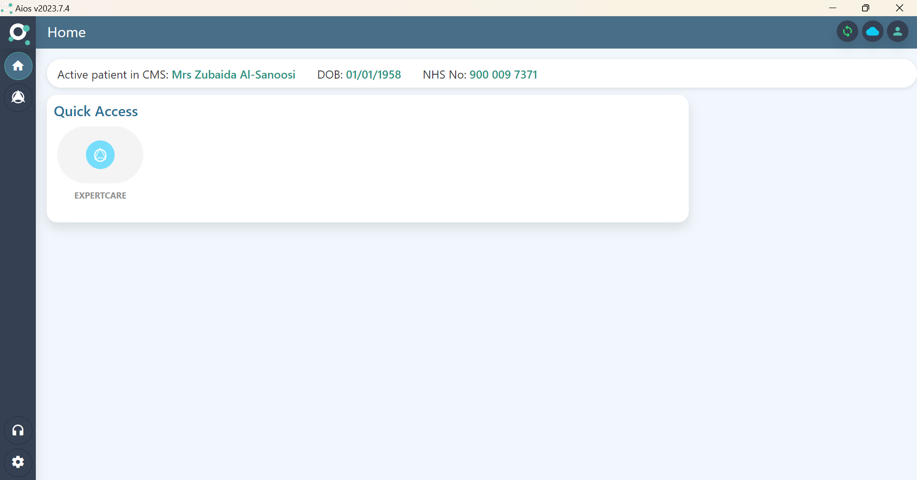
AIOS is a system agnostic, clinical decision support technology platform that delivers bespoke services and/or ‘modules’; supporting the optimisation of patient treatment outcomes across the health and social care landscape.
AIOS

Slide 22
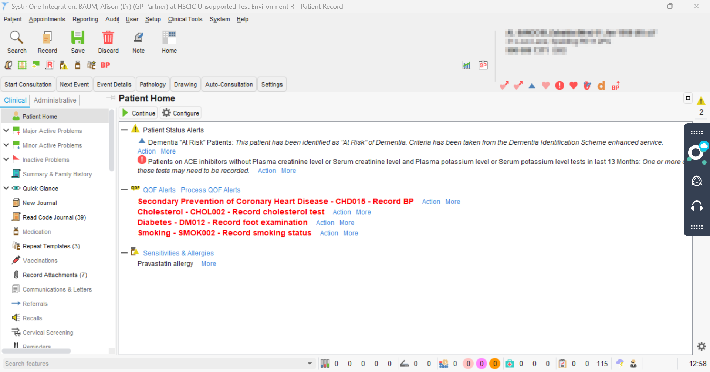
- As an Open API Platform, Aios will allow external organisations to easily integrate and leverage existing Aios services and/or ‘modules’.
- Data Analytics and Reporting are integral, supporting continuous improvement of service delivery e.g. Pathways Optimisation and Population Health Management.
- Aios SMART Pathways will introduce widely known benefits of artificial intelligence (AI) directly into the clinical consultation.
AIOS

Slide 23
Any Questions?

