Slide 1
Asthma
Dr Amy Moran

Slide 2
Pre school wheezers
Very common
Can be difficult to manage!
Notes:
difficult group
wheeze is very common in under 5s
no specific tests - therapy

Slide 3
URTI
Notes:
First symptoms usually fever and coryza
cough not always on day one
nasal secretions prolific thin, dry tickle cough then other symptoms subside, nasal secretions thick an green and subside then cough becomes thick and wet sounding then often very

Slide 4
Symptoms
Recurrent viral infections
Pause in symptoms even of few days
In those days are there interval symptoms
  wheezing
  cough
  breathlessness (reduced play, on laughing)
  nocturnal symptoms and awakenings
  change in mood, irritable, tired
Not all noise is wheeze
Some cultures do not have a word for wheeze
Objective evidence of wheeze

Slide 5
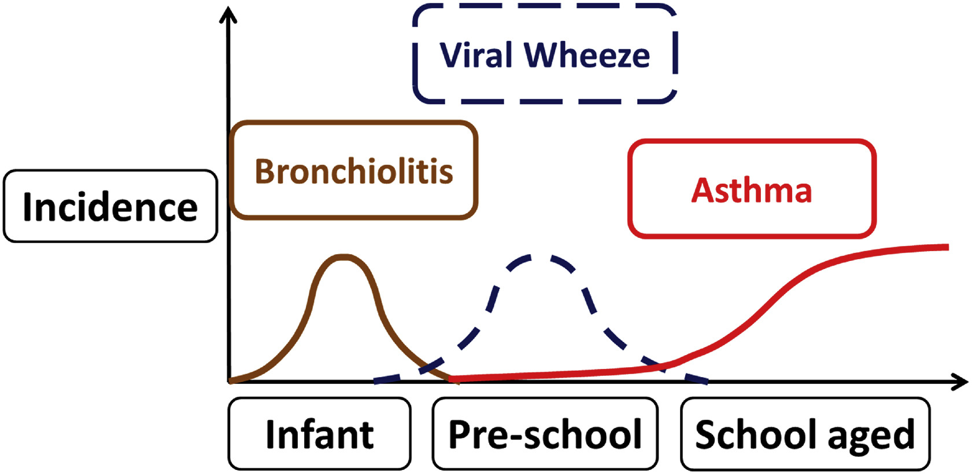
Lots of overlap
No good diagnostic system for infant and childhood wheeze

Slide 6
Different phenotypes & endotypes of preschool wheeze exist
Preschool wheeze
Asthma
Chronic inflammation
Hyper-reactivity
Bronchoconstriction
Bronchiolitis
Mucus blocking small airways

Slide 7
What is wheeze
high pitched musical expiratory wheeze
inspiratory noise - severe uncontrolled asthma can have biphasic wheeze
ruttle - often younger children, T21, “darth vader” mucus in upper airways, non specific
Mouth breathers
inspiratory noise upper airway - recurrent croup
is wheeze just a catch all for noisy breathing

Slide 8
lower lung function compared to those who never/infrequent wheeze
RSV and Rhinovirus associated with recurrent wheezing in childhood
Notes:
Large longitudinal study birth -7yrs 12,000 childnre
40% had wheezing at some point in the 1st 6 years of life

Slide 9
Transient early wheezers
1st yr of life, resolved 4 yrs
attending childcare at earlier age
low socioeconomic status
material smoking
low birthweight
prematurity
low maternal age
non atopic, no eosinophilia maternal smoking, low birthweight

Slide 10
Late onset wheeze
atopic
smoke exposure
persist >6yrs

Slide 11
Prolonged early wheezers
Non atopic - episodic viral wheeze
Persistent disease
  >2 days/week, 1-2 nights/months, limits normal activities
  +/- more severe wheeze exacerbations

Slide 12
Intermediate
18-42 months persist into later child
recurrent flares of wheeze but healthy in between with minimal day to day symptoms
frequent ED visits
atopy
allergic sensitisation
more at risk of developing asthma
Notes:
intermediate v persistent

Slide 13
Phenotypes can help determine risk
Difficult to place a child in one at a specific point in time
Symptoms can change
Overlap between groups
Not all respond the same

Slide 14
What’s going on in the lungs?
Atopic, high use ICS | Non atopic with low infection rate, high use ICS | Non atopic, high infection rate | Non atopic, low infection rate, no ICS (control)
Sensitised | Low BAL neutrophils | High rates of bacterial & viral infection
High blood eosinophils |  | Neutrophil predominant BAL | No atopy
Moraxella predominant BAL |  | Haemophilus, Streptococcus and Staphylococcus
High use of ICS | Use of ICS | 2/3 used ICS | No ICS
Robinson et al 2020
Notes:
Identify end-types
-1-5yrs under bronchoscopy, blood eosinophils, BAL, specific iGE
more rhinovirus in recurrent severe wheeze, 50% had positive bacterial culture, eosinophils higher ir
Control group Non wheezing respiratory disease
Croup, recurrent LRTI without wheeze, tracheal compression
Group at roaly Brompton

Slide 15
Recurrent Severe Wheeze – median 6 hospitalisations & 4 steroid courses
More rhinovirus in RSW group
Majority of children with RSW are non atopic, neutrophilic, steroid-refractory
Multi-trigger wheeze and Episodic viral wheeze did not have differing airway pathology
1/3 of MTW and EVW were sensitised
More likely to have parents as smoker in MTW group
Subgroup of individuals susceptible to specific pathogens e.g. Moraxella = chronic infection & neutrophilia not resolving with ICS
Early life bacterial colonisation may be primary driver of wheeze

Slide 16
Phenotypes aren’t that useful for predicting treatment response
Symptoms change with time
Clinically it can be hard to tell what is going on at the lower airways
No personalised treatments at this stage
All we have are bronchodilators & steroids

Slide 17
Acute management of pre school wheeze
as needed SABA
2 puffs, one at a time, wait 2 minutes, repeat if necessary, up to 6 puffs
Relief should last 4 hours
No role for OCS if well enough to be at home

Slide 18
ICS first line in pre school wheeze
Daily ICS is preferred option and definitely if persistent disease
Intermittent ICS (pre-emptive high dose) is reasonable if intermittent disease
Neither will stop all exacerbations
Sub-optimal adherence well documented
Notes:
intermittent ICS fluticasone 44 mcg 2 puffs BD (used as daily ICS too) started at symptoms and continued until resolution or 7 days
INFANT trial - 300 children GED 1-4
DAILY ICS< INTERMITTENT ICS and daily montelukast
If no respond to initial treatment, try alternative before escalating
Aeroallergen sensitisations or eosinophilia responded better to daily ICS

Slide 19
Beigelman 2018, Curr Opin Allergy Clin Immunolo
Notes:
mAPI have external validatiy but none are great, not for diagnosis
MAY HAVE NOTICED MORE azithromycin being prescribed by secondary care - this is why
boys have smaller lungs than girls
at age 10 around the same
after puberty boys

Slide 20
When & what to start
Interval symptoms - 2/3 times per week, nocturnal symptoms once a week
Frequent attacks - 3 attacks a season
Severity of attack - severe
Low dose to start and assess response 2-3 month trial ICS & SABA
  very low dose Clenil 50mcg, 2 puffs BD
  low dose Clenil 100 mcg, 2 puffs BD
systemic side effects at low dose minimal (growth failure/adrenal insufficiency/bone density)

Slide 21
Trial of ICS
2-3 months
Stop and see if symptoms recur
Therapeutic trial may need to be repeated due to the variable nature of asthma in young children
Symptom pattern tends to change over time
Checking technique, adherence and exposure to smoking
Notes:
daytime symptoms less than once a week, no limitation on activity, not needing SABA mora than once a week, no night coughing or waking due to asthma

Slide 22
Is is asthma?
No specific tests
Therapeutic trial is itself a test
Can look at risk profiles
Consider differentials

Slide 23
SYMPTOM PATTERN may change over time
Symptoms (cough, wheeze, heavy breathing) for <10 days during2-3 episodes a URTI | Symptoms >10 days during URTI | Symptoms >10 days during URTI
2-3 episodes a year | >3 episodes a year or severe episodes and/or night worsening | >3 episodes a year or severe episodes and/or night worsening
No symptoms between episodes | May have occasional cough, wheeze or heavy breathing between episodes | Between episodes has cough, wheeze or heavy breathing during play or when laughing
 |  | Allergic sensitisation, atopic dermatitis, food allergy or family history of asthma
Few have asthma | Some have asthma | Most have asthma

Slide 24
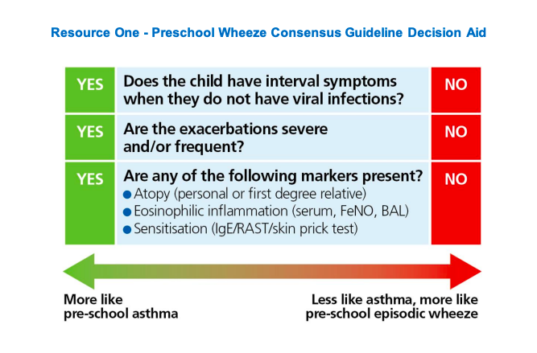
Is is asthma?
Notes:
These tools only identify risk of developing persistent asthma
interva symptoms - include not joining in with play, exercise, laughing, coughing

Slide 25
Steroid debate
low dose minimal side effects on growth
Growth velocity effects can be seen in first 1-2 years of treatment but not cumulative or progressive. One study showed a difference in 0.7% in adult height
Important to maintain normal play/activity levels for social and physical development
Poorly controlled asthma adversely affects adult height
Poorly controlled asthma affects lung growth

Slide 26
Technique
Adherence

Slide 27
What else could it be?
Recurrent viral respiratory tract infections
Gastro-oesophageal reflux & swallowing issues
Persistent bacterial bronchitis
Tracheomalacia
CF or PCD
Vascular ring
BPD
Immune deficiency
Inhaled foreign body
TB
Notes:
poor response to asthma medications
At the review - rethinking diagnosis

Slide 28
Chronic cough
Acute exacerbations often wet cough
Undertreated asthma can give you a wet cough (mucus)
However a wet cough all the time or as only symptoms re think - chronic suppurative lung disease e.g PBB (low level chronic infection, difficult to tease out)

Slide 29
Rest of the child
Is the child growing normally
What does the chest shape look like
Are there other illness - skin infections, diarrhoea, recurrent ear infections
How does the child feed
Finger clubbing
Oxygen saturation - Rarer lung diseases e.g. interstitial lung disease
Notes:
Primary ciliary dyskinesia - recurrent ear infections and persistent nasal discharge, situs inverses in 50%, neonatal RDS, cough
Vascular ring - persistently noisy breathing, recurrent croup

Slide 30
Onward referral
No improvement despite good adherence, good inhaler technique
Diagnosis is in doubt
Lower threshold in under 2s

