Slide 1
Reasonable Adjustment Digital Flag
June 2026

Slide 2

What is a Reasonable Adjustment Digital Flag (RADF) ?
Under the Equality Act 2010, healthcare organisations have a legal duty to make changes in their approach or provisions, called Reasonable Adjustments, to ensure that their services are as accessible to people with disabilities and impairments as they are for everyone else.
The RADF is a national digital record which indicates that RAs are required for an individual and optionally includes details of their significant impairments, key adjustments that should be considered and underlying conditions.
Criteria is defined within the Equality Act 2010
“A physical or mental impairment that has a substantial and long-term (greater than 12 months) negative effect to do normal daily activities”
The RADF was developed by NHS England to ensure that health and care providers meet their legal obligations under the Equality Act 2010 and has built the RADF into the NHS Spine to enable health and care professionals to record, share and view details of RAs digitally across the NHS, wherever the person is treated.
Healthcare professionals and frontline staff (including administrative staff) will need to identify and record RAs on the clinical systems or via the NCRS. NHSE are working with IT system providers to produce an interface which will automatically feed RADFs to/from the NHS Spine.
Notes:
Today we are going to provide you some important information regarding Reasonable Adjustment Digital Flags which is a legal requirement under the Equality Act 2010
So what is a Reasonable Adjustment Digital Flag.
As it states under the Equality Act ………………………..
The Digital flag is a national digital marker recorded on an individuals patient record that identifies the person that have a significant impairment or disability and therefore reasonable adjustments needs.
The criteria for RA’s in defined in the Equality Act as…..
Further information in this presentation will help GP practices staff and healthcare professionals to understand how RA’s can be applied and the steps required to meet this legal compliance.

Slide 3
NHS Information standards
The original information standard for the Reasonable Adjustment Digital Flag (DAPB4019) was first published by NHS England in September 2023.
Update: A new version of this information standard was published in December 2025, which replaced the 2023 version.
Overview of changes:
Change to lawful basis for data sharing - The lawful basis for data sharing on the Reasonable Adjustments Digital Flag (RADF) has been changed from that of explicit consent to that of implied consent.
Change to terminology - The terminology for recording and sharing patient adjustment needs has shifted from the Reasonable Adjustment Flag to the more comprehensive Reasonable Adjustment Digital Flag (RADF)". The flag is now central to the National Care Records Service (NCRS), which replaces the term "NHS Spine" for viewing this information, allowing health professionals to view and share patient needs across the NHS.
Personal data - Article 6 of the UK GDPR (General Data Protection Regulation) sets out the lawful bases for processing personal data. For individual care, the accepted lawful basis for information shared for the purposes of direct care is described in condition 6(1)(e) "…for the performance of a task carried out in the public interest or in the exercise of official authority…"
Special categories - Article 9 of the UK GDPR. For information shared between professional bodies providing individual care, condition 9(2)(h) applies and can be relied upon for the purposes of data sharing for direct patient care "…medical diagnosis, the provision of health or social care or treatment or the management of health or social care systems…"
Opt-out - As required by this lawful basis, a person may choose to object to this information being shared outside of the organisation.
Notes:
NHS England first published an Information Standard in September 2023.
These information standards are mandatory rules and guidelines that dictate how health and adult social care data is recorded, processed, and shared across the UK.
This RADF information standard has been round for a while now, but has recently been updated.
Previously to apply a RA healthcare professionals would have required the individuals consent. This has recently changed and is now specifically ‘implied consent’.
The slides show the lawful basis for processing this information (performance of a task carried out in the public interest and for the provision of direct care/medical diagnosis.
There have also been some changes in terminology relating the national care record service rather than referring to the NHS spine.

Slide 4
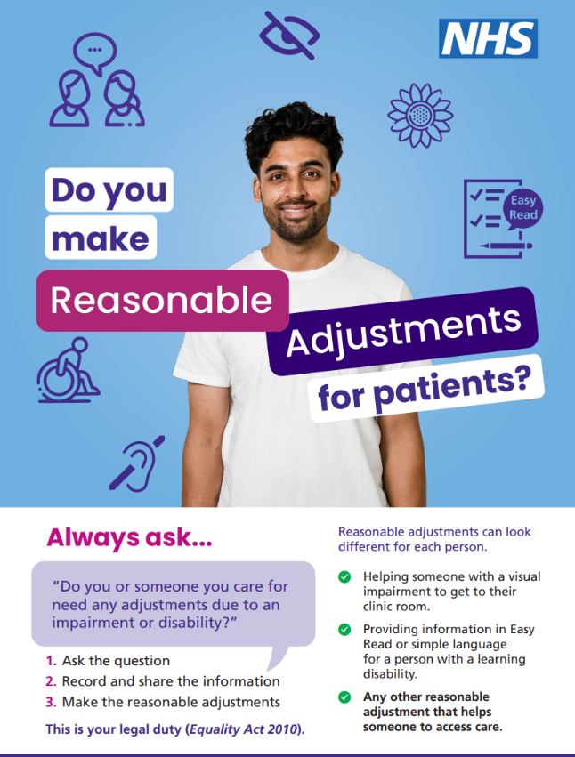
Key objectives of the Reasonable Adjustment Digital Flag (RADF)
The national roll-out of reasonable adjustment digital flags will help millions of disabled people to access publicly-funded health and care services more easily, improving the patient's journey and improve efficiencies.
Improve Access: Ensure disabled patients can access, use, and navigate services as easily as everyone else.
Identify Needs: Clearly highlight to healthcare professionals what specific,, personalised adjustments a patient requires.
Share Information Efficiently: Allow the flag to be shared across various health and care settings (e.g., GP to hospital).
Support Legal Compliance: Assist organisations in meeting their duty under the Equality Act 2010 to make reasonable adjustments.
Reduce Health Inequalities: Ensure consistent, proactive care to prevent poor health outcomes for disabled patients.
Notes:
This national roll out of the RADF aims to help millions of disabled people access their health care.
It aims to improve their patient journey, not having to repeat information about their RA needs at the places they receive their care.
It aims to advise staff to help understand the patients conditions ahead of appointments and treatment, so they can accommodate for their adjustments.
With the ultimate aim to reduce health inequalities and the provided the best outcomes for disabled patients.

Slide 5

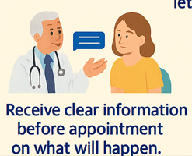
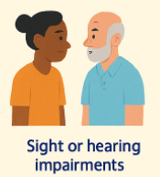
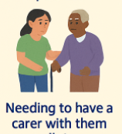
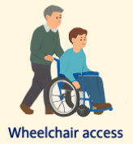
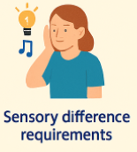
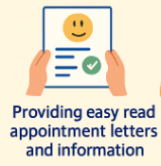



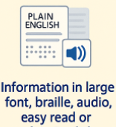
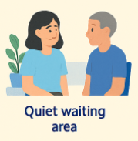

Examples of reasonable adjustments
Notes:
Many of you are probably already meeting some of the RA’s
Things, such as wheel chair access, hearing loops, large print and British sign language are already widely in place at GP practices.
As part of the steps to compliance for the RADF, GP practice will need to consider the types of RA they can make and/or check what they already have available.
For example, its good that practices may have a hearing loop in place, but NOT GOOD if its not working! Or you have a wheel chair access ramp which is blocked with boxes.

Slide 6
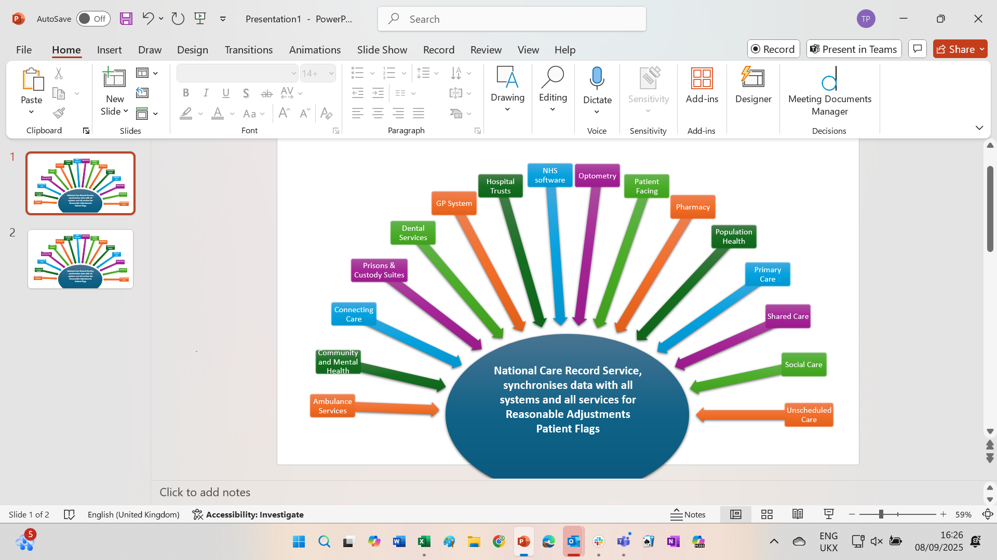
Technical interoperability
Working together - NHS England are working with other healthcare organisations and third-party system suppliers to ensure that the RADF technical capabilities and integration is in place.
Interoperability - It is the first national interoperability project to unit every system supplier and every service user under a single shared objective.
Voluntary sector groups are involved in supporting the development of the RADF.
Deadline - All NHS and publicly-funded providers must be able to read, write and share the flags via the National Care Record Service. The deadline for completion 30th September 2026.
Third party suppliers - Details of the suppliers onboarding can be found on the NHS England website. (These include Optum, AccuRx, Ardens, DXS, Epic, Medicus) Supplier interest list - NHS England Digital
If you have an IT system supplier not yet registered, please advise them of this link:
Patient Flag API supplier interest form - NHS England Digital.
Notes:
NHS England are working with third-party system suppliers to get them on to put the technology in place for RAs to be recorded and shared with the NCRS. They have a deadline of 30th September to complete this.

Slide 7
The six steps for achieving Reasonable Adjustment Information Standards
6
5
4
3
2
1

Slide 8
RADF six steps
Identify Ask about reasonable adjustments
Check existing cohorts of patients
New patient registrations, recall, review and appointment letters
Check on first contact
During standard health checks
Opportunistically
Resource (questionnaires, posters)
Record Use agreed SNOMED* codes
Record the details of the reasonable adjustment on the clinical system The RADF can be recorded on the patients record Reasonable adjustments and accessibility needs SNOMED clinical coding supports data sharing across supplier and NCRS
3. Flag Flag the adjustment
Alert - A patient status alert will show on clinical system if a patient has any of the 3 essential RADF codes or a legacy RA code. The flag will be visible and provides and opportunity to ‘review’ the reasonable adjustments. Some clinical systems will direct staff to the RA communications template so information can be updated
4. Share Share the adjustment in all communications
National Care Records Service (NCRS): The flag is visible on the NHS Spine, which allows authorised staff across the NHS to view your needs, even if they have not treated you before. Information is shared with authorised personnel involved in the patients care including; NHS Trusts/Foundation trusts, Emergency Care Services (A&E, UCC, Ambulance Trusts), PCNs, Social Care, local authorities and includes administrative and support staff, such as receptionists, administrators and practice managers)
5. Meet - Make every effort to meet the adjustment and support your patients.
Make every effort to meet the adjustment Patient Services and organisations must endeavour to use their best efforts to always meet the reasonable adjustment. Plan ahead – prepare for RA’s Develop a policy Staff awareness and training Awareness campaigns on premises and website Comply with patients' preferences (Opt-out) On going review
6. Review Regularly review the RADF.
It is important to regularly check if the adjustments are still meeting the persons needs in a suitable timeframe (for example every 12 months) Standardised review – health checks, outpatient clinics, annual reivew Proactive review – data audits to identify those who have RA codes Reactive review- Opportunistic review on diagnosis or new condition or impairment.

Slide 9


1. Identify
Ask about reasonable adjustments and how you can help your patients.
Check existing cohorts of patients
Check on first contact
During standard health checks
Opportunistically
Resource (questionnaires, posters)
Cohorts of patients (Not limited to)
Learning disabilities – To ensure staff know that this cohort of patients need extra support to understand information or communicate.
Autism– Similar to those with learning disabilities, autistic people are a core focus for the flag to ensure equitable access.
Physical or sensory disabilities – Including people with vision loss (blindness/partial sight), hearing loss (deafness/partial hearing) or mobility limitations.
Patients with long term conditions, such as dementia, chronic fatigue, or asthmas (that substantially affects daily living).
Individuals with mental health conditions – Those whose conditions significantly impair their ability to access services.
Patients with communication needs – Anyone who requires a BSL interpreter, information in easy read or longer appointment times
New patient registrations, recall, review and appointment letters
Reasonable Adjustments : Ardens EMIS Web
Reasonable Adjustment Digital Flag (Equality Act 2010)
Notes:
Firstly it is good practice to carry out some initial benchmarking figures to determine how many RADF currently exist. Make a note of current figures as this will help evidence the actions the practice has taken to meet compliance. (if requested by CQC) - You can use an Ardens screening template to do this.
The next step is to identify cohorts of patients whose characteristics are defined under the Equalities Act. The list above is a good place to start. Ardens already provide screening templates for LD, autism and dementia.
All staff must be aware of RA’s and take steps to identify requirements from first contact, opportunistic and during standard visits and health checks. (Training is available, which we will direct you to at the end of this video)
The NHS patient on-line registration already has Ras included in the template, but any manual hard copy forms still in use must also be update.
Resource material has been made available to practice via SEL NET and NHS Futures, which include questionnaire templates (including easy read) and posters.
There is also a work plan that practices can you to log and record the activities carried out.

Slide 10

2. Record
Record the details of the reasonable adjustment and accessibility needs on the patients record.
Details of significant impairments (based on the Equality Act 2010).
Specific key adjustments needed for care (e.g., easy read leaflets or longer appointments).
Optional underlying conditions that inform care requirements.
Mandatory SNOMED Codes: NHS England has created SNOMED codes to identify patients' reasonable adjustments needs, focusing on impairments and communication needs.
There are specific codes for impairments and the types of adjustments required which link to over 200 specific SNOMED codes as the details of the patients' reasonable adjustments are recorded on the communications template.
A full list of the SNOMED codes is available on the NHS Website
  Reasonable adjustments impairment and adjustment codes - NHS England Digital
Record | Reasonable Adjustment record | SNOMED Code
Equality Act Disability Threshold | Impairment with substantial and long term adverse effect on normal day to day activity (Equality Act 2010) | 1326341000000105
Data Sharing objection | Objection to upload data to Reasonable Adjustment Digital Flag upheld (finding) | 1853781000000109
Review | A review of the patients Reasonable Adjustments needs has been completed. | 1833271000000103
Notes:
Details of the RA’s must be recorded on the patients record.
The Ardens communication template provides the functionality to record the information through drop down menus and free text. (Edyta to demonstrate)
There are standard sets of SNOMED codes which are linked to the impairment recorded, key adjustments and underlying condition. This accumulates to over 200 specific SNOMED codes. NHS E provide a full list of the codes on line, but by using the template these will record automatically.

Slide 11
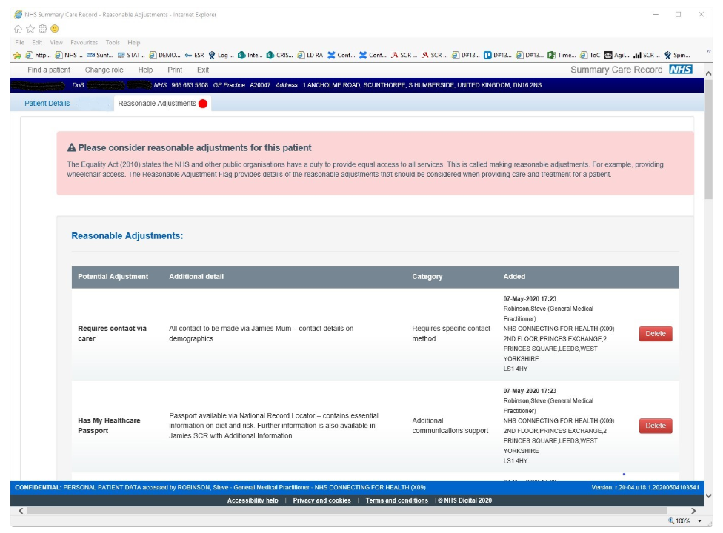
3. Flag
Alert - A patient status alert will show on clinical system if a patient has any of the 3 essential RADF codes or a legacy RA code.
The flag will be visible and provides and opportunity to ‘review’ the reasonable adjustments. (Step 6)
Some clinical systems will direct staff to the Reasonable Adjustment communications template so information can be updated.
Case study example NHS England website
Notes:
When a flag has been applied this will be clearly visible when the patients record is called up.
Staff will be see the RA’s and be able to support the patient from the information in front of them.
This is also a key opportunity to ‘review’ the patients RA’s and mark the communications template accordingly.
By clicking on the flag this should direct you straight to the template.

Slide 12
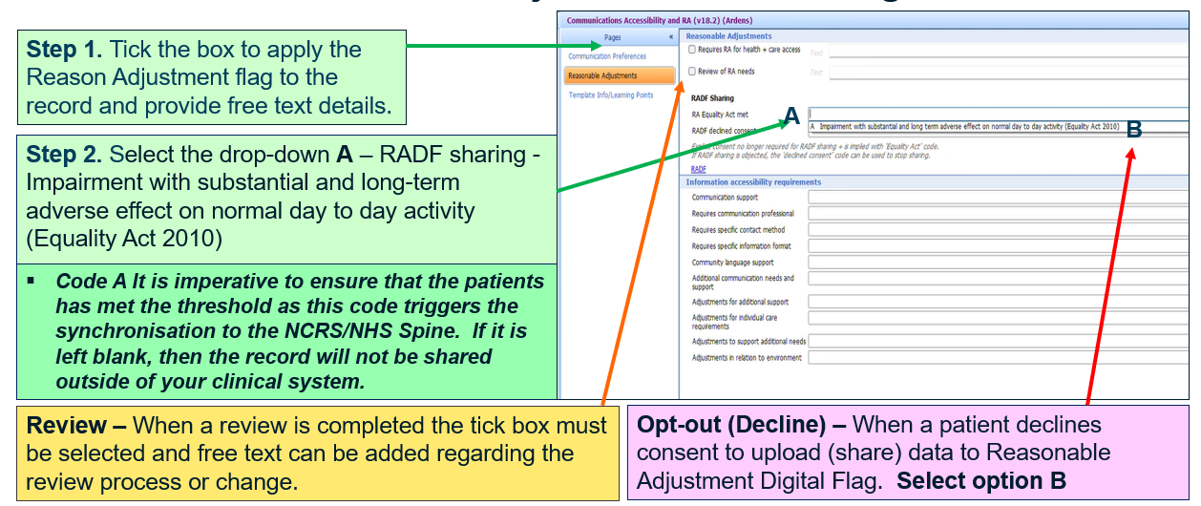
4. Share
Share the adjustment in all communications
National Care Records Service (NCRS): The flag is visible on the NHS Spine, which allows authorised staff across the NHS to view your needs, even if they have not treated you before.
Information is shared with authorised personnel involved in the patients care including; NHS Trusts/Foundation trusts, Emergency Care Services (A&E, UCC, Ambulance Trusts), PCNs, Social Care, local authorities and includes administrative and support staff, such as receptionists, administrators and practice managers)
Notes:
As stated at the start of the presentation, RA’s can now be added under implied consent and any RA’s ticked in the communications template to apply the RA flag will be shared via the NCRS.
As outline this information is shared with authorised personnel involved in the patients care.
If a patient decides that they want to opt-out of sharing data relating to RA’s then the declined (opt out) drop down must be selected. The record will still remain on the clinical system at GP practice level.

Slide 13
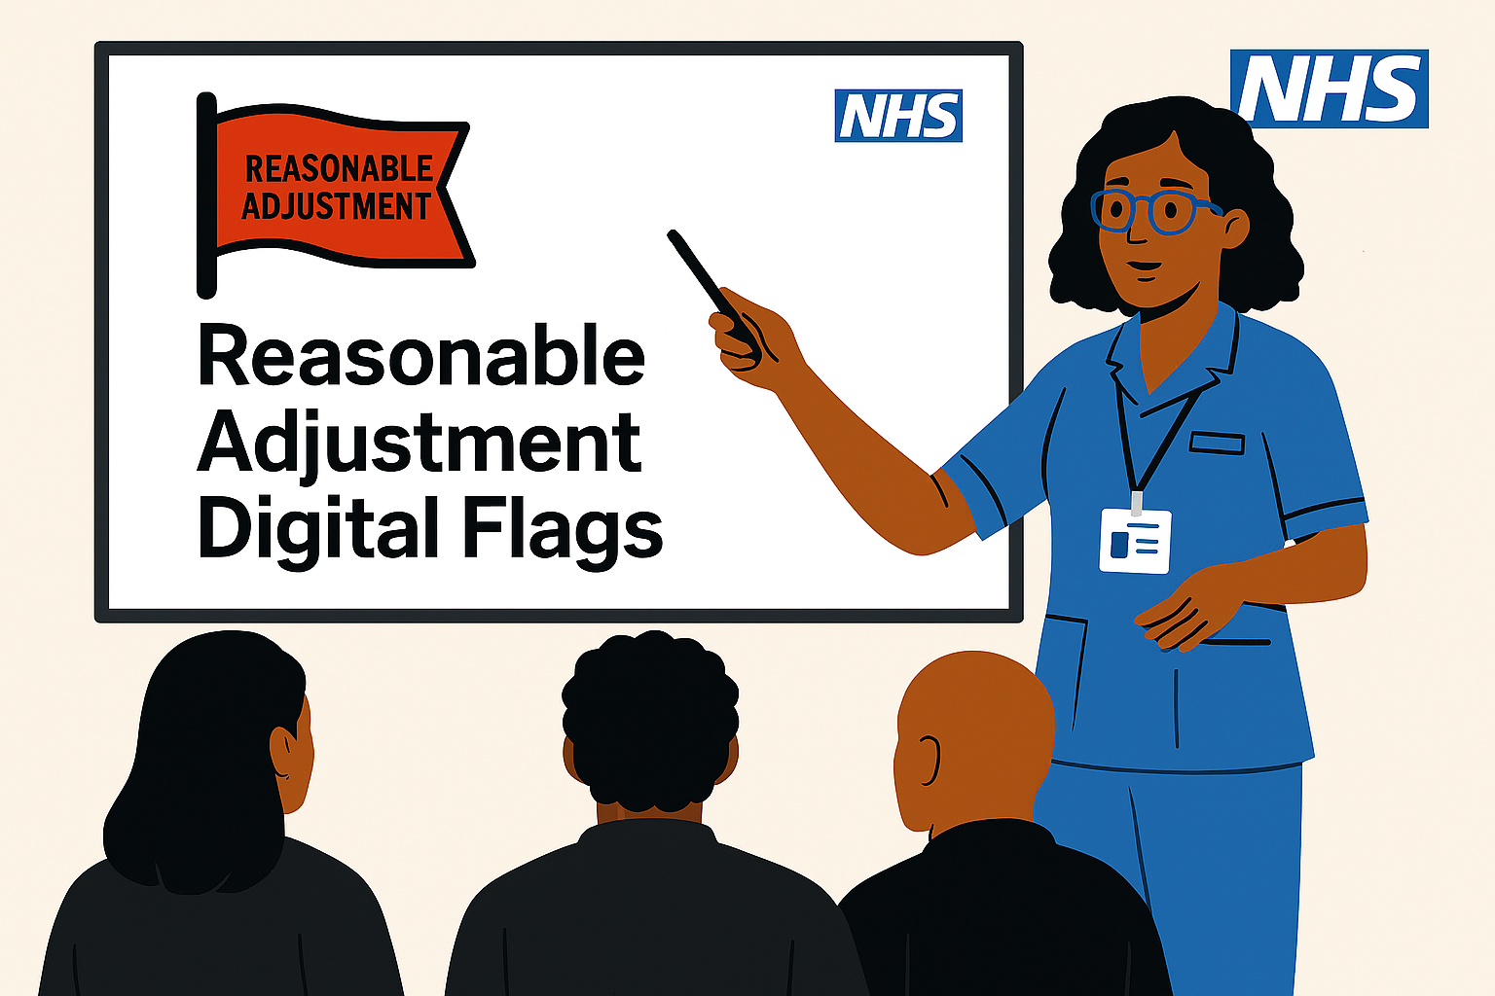


5. Meet
Develop a policy and maintain with national guidance
Staff awareness
and training
Posters and awareness campaigns
Plan ahead
Make every effort to meet the adjustment for your patients.
Health and care services and organisations must endeavour to use their best efforts to always meet the reasonable adjustment
Comply with patients’
preferences (Opt-out)
On going review
Notes:
Patient Services and organisations must endeavour to use their best efforts to always meet the reasonable adjustment.
Plan ahead – prepare for RA’s – Look at ways the practice can make reasonable adjustments and what they are already doing to support patients. Ensure staff are aware how to meet the adjustments – for example booking BSL, booking additional consultation times, using the hearing loop.
Staff awareness and training – We all have a responsibility - E-learning for health provide free online training (registration is required, but practices can contact eLearning to arrange multiple registrations )
Awareness campaigns on premises and website – NHS E have provided a range of templates and material that can be adapted by GP practices for use. Some of these documents have been made available on SEL NET.
Comply with patients' preferences (Opt-out) Remember to comply with patients requests and ensure the patient record reflects their decision to decline.
On going review – GP practices must ensure on going reviews are completed, either through contact and assessments with their patients or by regularly identifying patients through reporting and questionnaires.

Slide 14
6. Review
It is important to regularly check if the adjustments are still meeting the persons needs in a suitable timeframe (for example every 12 months)
Standardised review – health checks, outpatient clinics, annual review
Proactive review – data audits to identify those who have RA codes
Reactive review- Opportunistic review on diagnosis or new condition or impairment.

Slide 15
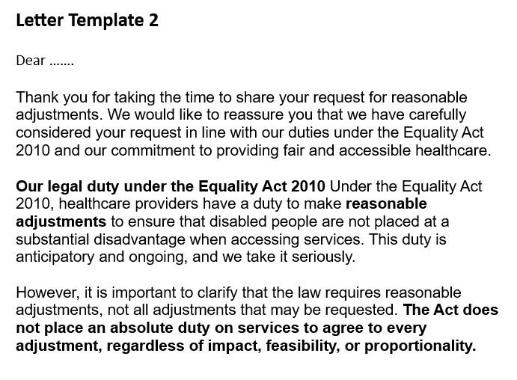
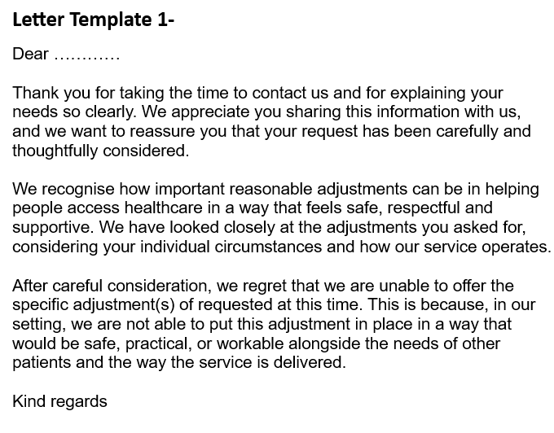
How is reasonableness assessed?
It is important to clarify that the law requires reasonable adjustments, however, not all reasonable adjustments requested can be made. The Act does not place an absolute duty on the organisations to agree to every adjustment and therefore will consider the requests based on the following assessment.
Whether the adjustment would be effective in overcoming the disadvantage identified.
The practicality of making the adjustment.
The impact on other patients, staff, and service delivery.
Health and safety considerations.
The resources available to the service.
Whether alternative adjustments could meet the same need in a
less disruptive way.

Slide 16


Failure to comply
Discrimination Claims: A failure to implement reasonable adjustments, especially when a digital flag is present in the patient record, constitutes a "failure to make reasonable adjustments," which is unlawful disability discrimination. Patients may take legal action under the Equality Act 2010.
Negligence Claims: If the failure causes the patient to suffer harm, the GP may be deemed negligent, leading to lawsuits for compensation regarding pain, suffering, or injury.
CQC Action: The Care Quality Commission (CQC) monitors compliance with these duties, and failures can result in poor inspection ratings and regulatory enforcement action.
Professional Discipline: In serious cases, such as neglect, GPs may face investigations by the General Medical Council (GMC), which could result in warnings, suspension, or removal from the medical register.

Slide 17
Further links and resources

Slide 18




Good to know!
Resource sharing - NHS England and the Regional RADF groups have developed a variety of resources, guidance and templates which can be adapted for use by other health and care organisations. This includes a draft RADF policy, posters, website information template, easy read leaflets and more – NHS Futures (registration is required)
Care Quality Commission – RADF now form part of the CQC assessment framework under “Response” and Well-led domains. Any evidence in implementing RADF compliance should be maintained for inspection purposes.
National Care Record Service:
Guide to Using the Reasonable Adjustment Flag in NCRS - NHS England Digital
Guidance from NCRS team re accessing NCRS without access to smartcard or HSCN (PT) - Flagging Reasonable Adjustments - everything I need to know – Futures.
Ardens report templates (Emis Web/System One) Ardens guidance contains a training video to support organisations regarding RADF reporting. Practices can contact Ardens if they require any further assistance on this process. Ardens support on: support-emis@ardens.org.uk
Suppliers on boarding RADF - NHS England website - RADF - Supplier Interest List
If you find an IT system supplier not yet registered, you need to advise them of this link:
Patient Flag API supplier interest form - NHS England Digital.

Slide 19
Key strategic links:
Why are Reasonable Adjustments important?
Long Term Plan Commitment: By 2023/24 a "digital flag" in the patient record will ensure staff know a patient has a learning disability or autism and what their reasonable adjustment needs are to support their experience of health or social care. https://www.england.nhs.uk/publication/the-nhs-long-term-plan/
Equality Act 2010 – the right to reasonable adjustments. https://www.gov.uk/guidance/equality-act-2010-guidance
NHS Standard Contract, SC13 Equity of Access, Equality and Non-Discrimination Section that: NHS constitution. https://www.england.nhs.uk/nhs-standard-contract/
The Care Quality Commission have published a number of information packages - GP myth buster 67: Reasonable adjustments for disabled people - Care Quality Commission
The Accessible Information Standard (AIS) is linked to Reasonable Adjustments and both teams are working closely together. NHS England Presentation Template
NICE guidelines on care and support of people with learning disabilities states that service providers must make these reasonable adjustments. NICE impact people with a learning disability
The RADF future platforms site outlines the governance of the National RADF project, resources to assist implementation, contact details of regional leads, FAQ and a forum for active discussion https://future.nhs.uk/NationalReasonableAdjustmentFlag

Slide 20
Links and guidance
NHS Information Standards (DAPB4019)
Equality Act 2010
RADF background information
RADF Checklist
RADF - Best Practice Videos
E-Learning for health training / Futures Dashboard RADF training
NHS Reasonable Adjustment Digital Flag Information standard DAPB4019
SNOMED Codes
SEL NET Resource and template documents
Reasonable Adjustment Flag case study (based on pilot version of the flag) - NHS England Digital

