Slide 1
MichaelOlawinga.
83yrs old
14 Belbot close, Greenwich.
You are a Pharmacist in General Practice. You have a consultation with this patient, you review the record before calling them in to see you.
The Emis notes are available on the next slide,
The scenario will run as a friendly (!) standard f2f consultation

Slide 2

EMIS notes
Michael Olawinga
Patient medical record
Repeat medication
  83 years old
  Amlodipine 5mg od
  Ramipril 5mg od
  Bisoprolol 2.5mg od
  Atorvastatin 80mg od
  Metformin 500g bd
  Gliclazide 80mg od
  Aspirin 75mg od
  Omeprazole 10mg od
  Tamsulosin 400mcg od
  Finasteride 5mg od
Major active problems
  Hypertension
  High cholesterol
  Type 2 Diabetes
  IHD (NSTEMI 2008)
  Cataracts
  Benign prostatic hypertrophy
Last consultation
  6months ago came for a review following a mechanical fall at home:
  BP 124/74 pulse 67 regular.
  Well in self, no injuries, pt reassured and POC was increased to twice a day 6m ago
  Lives alone, was independent until ~10 months ago.
  Foot check, retinal screen NAD. HbA1c = 40
  Last renal bloods > 1 year ago (NAD at the time, GFR = 73)

Slide 3
Presenting complaint
Michael Olawinga
83-year-old patient experiencing light-headedness
“How can I help today…?” Presenting complaint:
Over the past 6-12months you are feeling more unsteady and light headed.
You had your first fall 6m ago - you were in the garden, bending down, and fell forward onto the concrete. You were not Injured, but you and your daughter were very shaken and worried.
You gave up your driving licence last year due to lack of confidence
You already have someone to help with the washing/cleaning for the past year, but your daughter organised someone to come in during the evening too - this makes you feel safe, but it is frustrating to loose your Independence.
You don't know what's wrong. You don't fell 'ill', just more frustrated at the decline.

Slide 4
Presenting complaint
Michael Olawinga
83-year-old patient experiencing light-headedness
Contd. Presenting complaint:
You have not had another fall, but have felt light-headed when walking around at home
You feel unsure about walking to the shops and tend to stay at home
You have had to give up going to your swim sessions and Bridge lessons
You don’t have a fever.
You had a bit of a cold last week but that went away after a few days and you now feel well in yourself.
You have not had any loss of consciousness.
You have no chest pain and no shortness of breath.
You have not had slurring of your speech, no weakness of your arms/legs and you have had no headache.
You have not had any aura, sweating or shaking during the episodes.

Slide 5
Ideas concerns and Expectations (ICE)
Michael Olawinga
83-year-old patient experiencing light-headedness
Ideas, Concerns and Expectations:
You are feeling anxious about these episodes and whether they could be a sign of a stroke. Your dad had a stroke in his 80s.
You are worried about falling and injuring yourself and losing your independence further.
You are feeling quite low about it all and want to get back to swimming/seeing friends/Bridge lessons.
Examination
Temp 36.4, HR 72 regular, BP 125/75 sitting, BP 115/70 standing, Sats 98 RA, RR 14.
Gait is steady, but slow and tentative.

Slide 6
Discuss……

Slide 7
Learning Points
Michael Olawinga
83-year-old patient experiencing light-headedness
Suggested Clinical Management:
Reduce HTN medication with plan for review to reduce further meds over time
Stop SU/Gliclazide – glucose monitoring
Offer bloods
Given the patient’s age and risk factors, students should explore and exclude any red flags for immediate hospital admission such as stroke.
Teaching Points
What else can we offer this patient beyond this consultation?
How might you best ensure the patient will comply with these follow ups?
Is there anything you need to do straight away - is there any urgency here?
What type of primary care services or community projects might help this patient?
- e.g. Oxleas Frailty Team Referral

Slide 8
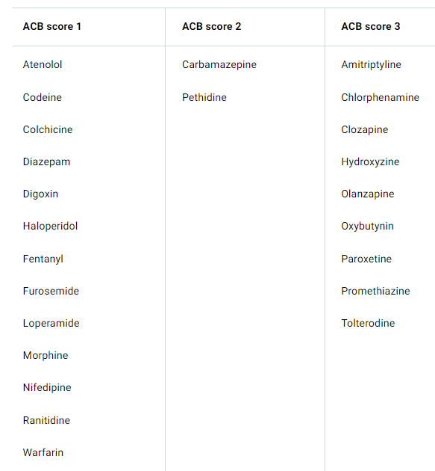
ACB Calculator
Many of the medications that we commonly prescribe have anticholinergic properties. In patients over 65 years of age these can cause adverse events, such as confusion, dizziness and falls. These have been shown to increase patient mortality.
You can use this calculator to work out the Anticholinergic Burden for your patients; a score of 3+ is associated with an increased cognitive impairment and mortality.
www.acbcalc.com

Slide 9
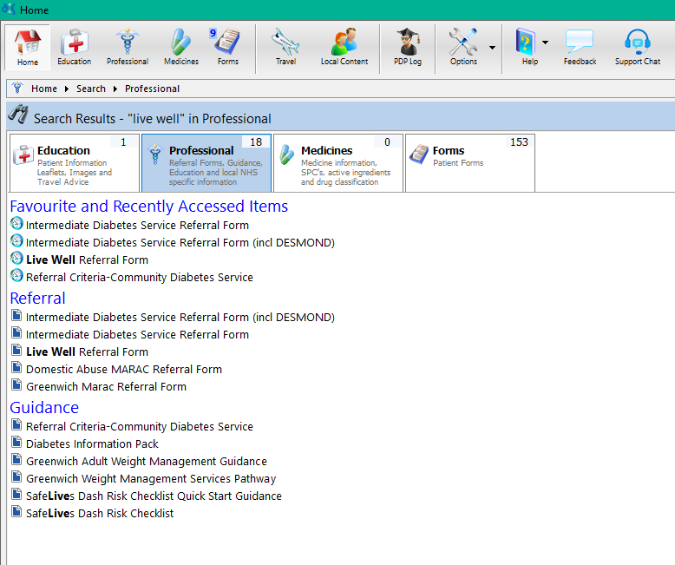


How to do a referral - DXS
Michael Olawinga
On the DXS Box, type in the service you require: e.g. ‘Live Well’
Once the form is completed, press ‘Email’ on the left hand side bar. ‘Save as complete’ and follow the steps to send the referral
Select the correct form, fill in all the details and ensure all the required boxes are filled in

Slide 10

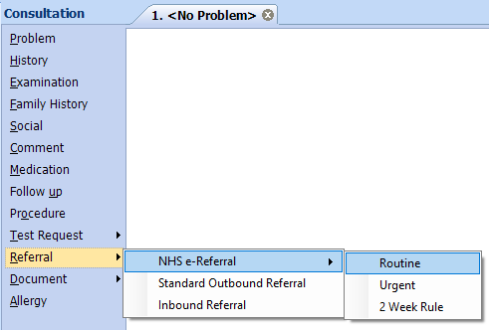
How to do a referral – e-RS referral
Michael Olawinga
Under consultation, click:
‘Referral’ → NHS e-Referral
and then choose the referral type
Referring a patient - NHS e-Referral Service - NHS England Digital

Slide 11
Jennifer Beale
52yrs old
2 Range Heath, Greenwich.
You are a Pharmacist in General Practice. You have a telephone consultation with this patient and you review the record before calling them.
The Emis notes are available on the next slide,
The scenario will run as a friendly, standard medication review consultation

Slide 12
EMIS Notes
Jennifer Beale
Patient medical record
Repeat Medication
  52 years old
  Methotrexate 15mg once a week (Fridays)
  Folic acid 5mg (takes every day apart from Friday)
  Estradiol pessaries 1 tablet twice a week
  Omeprazole 20mg OD
Major active problems
  2010: Rheumatoid Arthritis
  2012: Perforated Duodenal Ulcer
  2012: Major depressive disorder
  2014: Sjogren's syndrome
Last consultation
  URTI 2 weeks ago, patient has recovered and feels better.
  Monitoring bloods conducted 5days ago

Slide 13
Blood results
Jennifer Beale
52yrs old Medication review
Blood test | Result | Normal Range
GGT | 45 | 2-30
AST | 32 | 0-40
ALT | 25 | 0-40
ALP | 49 | 30-130
HbA1c: | 40
Hb | 143 | 138-181 g/dL
Platelets | 389 | 150 - 400
MCV | 90 | 83-101
WBC | 3.9 | 4 - 11
MCH | 29 | 27- 32
MCHC | 345 | 310 - 370
Eosinophil | 0.10 | 0.04 - 0.40
Basophil | Negligible | <0.1
Monocyte | 0.4 | 0.2- 0.8
Neutrophil | 1.4 | 2.0 - 7.5
Lymphocytes | 2.2 | 1.0 - 4.5

Slide 14
Presenting complaint
Jennifer Beale
52yrs old Medication review
“Hello, I’m phoning about your medications today…”
Presenting complaint:
“Thank you so much for speaking to me today for my medication review. I'm just on my way out to my Birthday dinner”
You feel well, some general pain on the right knee but this is normal for you - you have lived with Rheumatoid arthritis for many years.
You have recovered to about 80% baseline from your recent virus. You are not worried and don't want to waste the pharmacist's time
You finish by saying "I don’t really have any worries, I am only expecting a medication review".

Slide 15
Presenting complaint
Jennifer Beale
52yrs old Medication review
Presenting complaint:
If asked to rate your knee pain on a scale of 1 to 10 (1 being less severe and 10 being most severe), you say it is now a 4.
If asked: You feel more tired than usual, and you have felt a bit sweaty but otherwise you feel okay in yourself. The coughing has reduced but is still there.
You live with your family and they are celebrating with you tonight; your cousin has come from Melbourne for a big family reunion.
Past medical history: Rheumatoid Arthritis:
You were diagnosed over 10 years ago and are reviewed by the Rheumatologist every 6 months.
Your last review went well and you were told your bloods were normal.
You are currently taking Methotrexate and have no side-effects.
You had a flare-up 9 months ago where you had increased pain, swelling and stiffness in your hands and feet and your Methotrexate dose was increased.
You have ongoing lower back pain that is longstanding, and you manage this with paracetamol and heat patches.

Slide 16
Ideas Concerns and Expectations
Jennifer Beale
52yrs old Medication review
Ideas, Concerns and Expectations:
You are excited about the party later and feel much better!
Examination (The patient has access to a BP cuff, thermometer and sats probe)
Temp 37.7, HR 102 regular, BP 101/63, Sats 98% RA,
No respiratory distress/SOB on the call
The cough is mild, but present

Slide 17
Blood results
Jennifer/James Beale
52yrs old Medication review
Blood test | Result | Normal Range
GGT | 45 | 2-30
AST | 32 | 0-40
ALT | 25 | 0-40
ALP | 49 | 30-130
HbA1c: | 40
Hb | 143 | 138-181 g/dL
Platelets | 389 | 150 - 400
MCV | 90 | 83-101
WBC | 3.9 | 4 - 11
MCH | 29 | 27- 32
MCHC | 345 | 310 - 370
Eosinophil | 0.10 | 0.04 - 0.40
Basophil | Negligible | <0.1
Monocyte | 0.4 | 0.2- 0.8
Neutrophil | 1.4 | 2.0 - 7.5
Lymphocytes | 2.2 | 1.0 - 4.5

Slide 18
Discuss……

Slide 19
Learning Points
Jennifer Beale.
52yr old Medication review
Suggested Clinical Management:
This patient unfortunately has neutropenia, likely from an unresolved LRTI (developed from the URTI). The duty doctor is aware and has asked you to have the next conversation….
This patient needs to be assessed and possibly treated for neutropenic sepsis in a secondary care environment
Escalation is necessary – how will this happen?
Teaching points:
Recognise the Neutropenia is secondary to infection/methotrexate treatment and possibly autoimmunity; it is the most likely diagnosis given the history, supportive clinical findings and that the patient is on an immunosuppressant.
Neutropenic sepsis is the worst-case scenario diagnosis but cannot be clinically excluded and therefore the only safe course of action is same-day referral given the risk.
Explaining oral antibiotics are not safe enough to 'cover' for this.

Slide 20
Breaking Bad news
CUSS
C = I am Concerned
U = I am Uncomfortable
S = I feel this isn’t Safe
S = We need to STOP (what we’re doing)
This isn’t a classic BBB scenario, but the news is unexpected and the patient will have to cancel their plans. Spending an evening in A+E could be seen as bad news!
‘SPIKES’ is a model developed for compassionate & diagnostic BBB. Set up – Perception – Invitation – Knowledge – Empathy – Summary
‘CUSS’ is a better model for escalation and finding the right words in a difficult situation. I am Concerned – I am Uncomfortable – I feel this isn’t Safe – We need to STOP
Before you pick up the phone/invite the patient in, have a think how you would want the information delivered to you or a loved one.
Remember we can only advise (and influence!) but we cannot force or coerce. If the patients have capacity, the decision is ultimately with them.
Text the patient the plan

Slide 21
Sara Singh
48yrs old
2a Mersey street, Greenwich.
You are a Pharmacist in General Practice. You have a telephone consultation with this patient and you review the record before calling them.
The Emis notes are available on the next slide,
The scenario will run as a friendly, standard medication review consultation

Slide 22
EMIS Notes
Sara Singh
Patient medical record
Repeat Medication
  42 years old
  Promethazine – acute script
  Previous Meds
  Codeine for menstrual cramping
  Takes occasional Ibuprofen for Migraines
Major active problems
  2004: Endometriosis
  2010: Fibroids
  2015: Migraine without Aura
  2024: Hot flushes
Last consultation
  Seen 6months ago requesting Sleeping tablets as she is struggling to sleep due to night sweats.
  There are no recent DOCMAN/Documents available for this patient on the system.
  BP = 124/74 3 months ago.

Slide 23
Presenting complaint
Sara Singh
42yrs old Medication review
“Hello, I’m phoning about your medications today…”
Presenting complaint:
“Thank you so much for calling, I hope this is an easy one”
For the last 2 months, you have been seen a private Menopause consultant with regards to your Hot Flushes and poor sleep. Your hormone levels were checked and were given some HRT patches + progesterone capsules to take.
You have found these very beneficial and found your migraines have reduced and your sleep is much improved – you feel like a new person!
You finish by saying “I was told I could get these patches on the NHS and I’d like a prescription please. The private consultant also mentioned that I would need my hormones level checked again just to ensure the HRT is working”

Slide 24
Presenting complaint/Idea Concerns and Expectations
Sara Singh
42yrs old Medication review
History of Presenting complaint:
You have been diagnosed with peri-menopausal symptoms and have been prescribed Estrogen and Progesterone patches for 6 weeks by your private clinic.
The current dose is Evorel sequi 50mcg patches 2 patches a week
You still have your periods, but they are becoming a little irregular
You have finished your family; you live with your partner and child.
Past medical history:
You’ve struggled with night sweats and labile mood for ~6m
No Migraine history, nil Breast or Ovarian PMH, nil VTE concerns, non smoker BMI = 23
Last BP = 124/74
Ideas, concerns and expectations
You paid for a private menopause specialist and are now looking to move care to the NHS as money is a little tight.

Slide 25
Discuss……

Slide 26
Learning Points
Sara Singh
42yr old Medication review
Suggested Clinical Management:
Can we issue the HRT patches?
  Shared care document, nil clinic letter
What could we do to ensure next steps are easy for this patient?
Has this patient had a thorough review for HRT?
Teaching points:
‘Perimenopause’ — if the woman has vasomotor symptoms and irregular periods.
‘Menopause’ — if the woman has not had a period for at least 12 months (and is not using hormonal contraception).
Do not routinely use blood tests such as follicle-stimulating hormone (FSH) measurements in women aged over 45

Slide 27
Cora Stringfold
67yrs old
72c Trafalgar mews, Greenwich.
You are a Pharmacist in General Practice. You have a telephone consultation with this patient and you review the record before calling them.
The Emis notes are available on the next slide,
The scenario will run as a friendly, standard medication review consultation

Slide 28
EMIS Notes
Cora Stringfold
Patient medical record
Repeat Medication
  67 years old
Oestrogel 2 pumps OD
Mirena coil (due for renewal 2028)
Pt takes Calcium + Vit D tablets OTC
Major active problems
2004: Type 2 Diabetes
2006: Obese BMI >30
2008: Hypertension
2010: Osteopoenia - DEXA scan
2020: Type 2 Diabetes in remission
Last consultation
BP 2 months ago 127/75, BMI = 26
6m ago Patient was seen under Breast 2ww; diagnosed with Fibroadenoma left breast.
HbA1c = 41.

Slide 29
Presenting complaint
Cora Stringfold
67yrs old Medication review
“Good morning. I am here to discuss my medications.
Presenting complaint:
“Thank you so much for calling, I would like to update my HRT
Previously you struggled with chronic Illness, obesity and T2DM.
You started HRT In 2010 and feel things have only got better; your BMI is now 26, your BP has settled and your T2DM is in remission.
You are aware of the Breast cancer risk
You are aware of the VTE risk
You have not had any bleeding
You feel that if you have your regular Breast checks, and are aware of the blood clot symptoms you don’t see the problem.

Slide 30
Presenting complaint
Cora Stringfold
67yrs old Medication review
Past medical history:
You stopped HRT abruptly 6months ago on advice from the GP on finding a lump In your breast and you felt awful - you slept poorly and had hot flushes.
You are a retired Prison officer. You have 2 grandchildren and currently enjoy Zumba and French lessons. You live at home with your partner.
If asked: No Migraine history, nil Breast or Ovarian PMH, nil VTE concerns, non smoker BMI = 23
Last BP = 127/75. No recent bloods.
Family History
Her aunt had breast cancer at 55yrs (RIP from stroke at 89yrs), but not her mother or sister.
Ideas, concerns and expectations
"Please don’t make me stop HRT doctor, it's given my life back"

Slide 31
Discuss……

Slide 32
Learning Points
Cora Stringfold
67yr old Medication review
Suggested Clinical Management:
Can we issue the HRT?
Teaching points:
Most women stop taking HRT 2-5yrs after starting, I.e. once menopausal symptoms should have stopped
However, there is no clear guidance on stopping
Evidence Indicates HRT protects against: Osteoporosis, CVD and T2DM
T2DM - explanatory mechanisms are unclear.
Stopping HRT should not be cold turkey; It should be a slow reduction over 4-6m as Menopausal symptoms can return
Oestrogen level testing Is not recommended - Oestrogen levels fluctuate over 24hrs, thus it is not a specific Indicator of HRT treatment.
There Is no reason to offer blood monitoring for HRT specifically.
What next steps might be sensible?
  Clinical meeting/senior GP Input

Slide 33
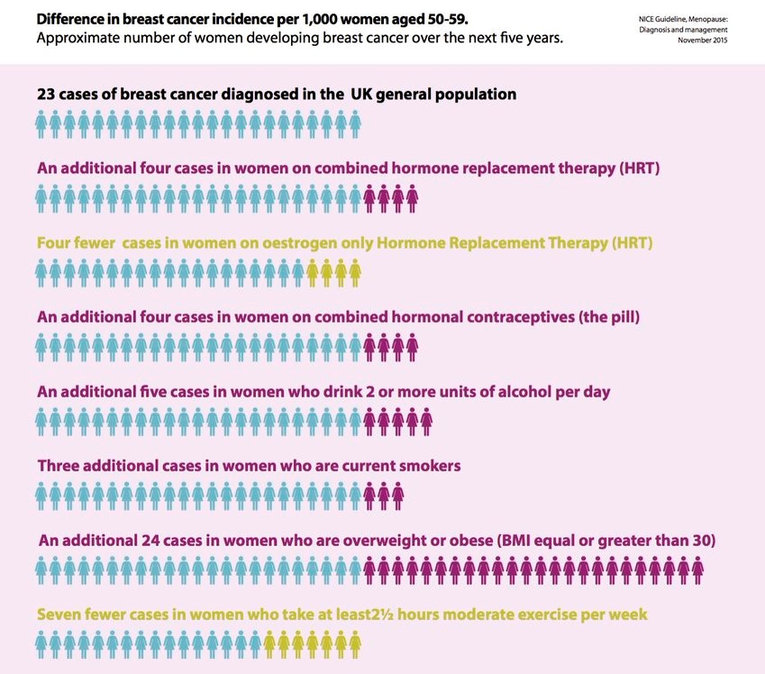
HRT Breast Cancer
The risk of Brest cancer is well know, however there is evidence to suggest it may have been over exaggerated.
Risk of Breast ca is low; there are 5 extra cases in ever 1000 patients taking combined HRT for 5 yrs.
Obesity is a much higher risk for Breast ca.
VTE risk is at baseline for normal population for transdermal Estrogen and low for Micronized Progesterone versus Medroxyprogesterone/northesterone.

