Slide 1


ARRS Induction Presentation
Prepared by Mark Shek
ARRS Lead, Greenwich Training Hub

Slide 2



ARRS INDUCTION SLIDES
WELCOME TO GREENWICH
Contents of this induction Pack:
✅ ICS AND ICB
✅ Healthier Greenwich Partnership
✅ Medicine Optimisation Team
✅ Borough PCN and Practice Maps
✅ The Neighbourhood Model
✅ NHS 10 year plan
✅ Resources for working in a GP Practice in Greenwich
(For Clinical Staff)
✅ Community pharmacy services

Slide 3
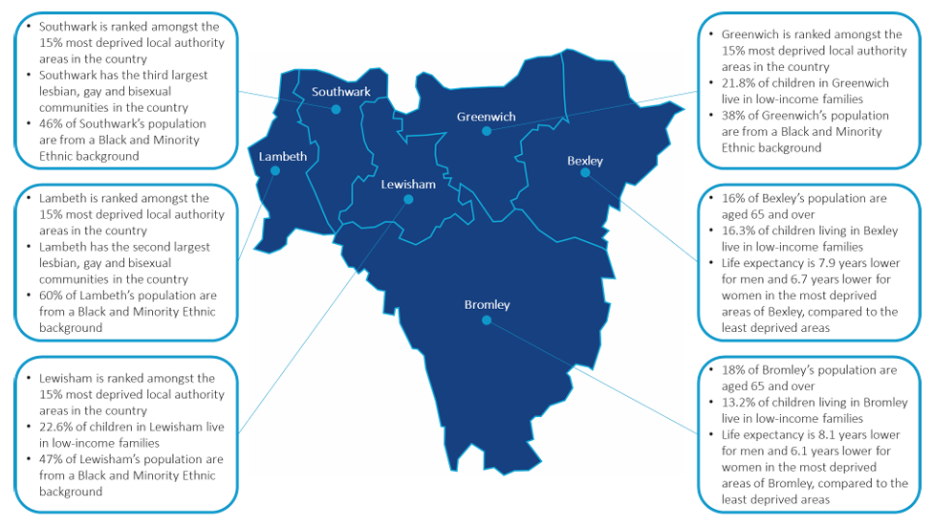
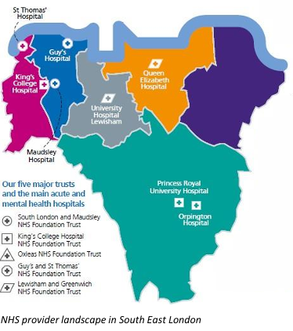
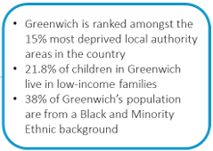
Integrated Care System
An Integrated Care System (ICS) brings together NHS organisations, local authorities, community services, voluntary organisations and other partners to improve health outcomes for local people. The aim is to provide more joined-up, preventative and person-centred care.
Think of the ICS as the partnership that joins all health and care organisations together across South East London. Rather than organisations working independently, they work collectively to improve outcomes for residents.
ARRS INDUCTION SLIDES
NHS South East London ICB is the statutory NHS organisation responsible for planning and funding services across Bexley, Bromley, Greenwich, Lambeth, Lewisham and Southwark.
Delivery is increasingly organized through system (SEL-wide), place (borough level) and neighbourhood (local population groups)
Core Objectives:
✅ Improve population health
✅ Reduce health inequalities
✅ Improve quality and access to services
✅ Support neighbourhood-based care
✅ Use NHS resources effectively and sustainably
What is an Integrated Care System and what does it mean for you? https://bit.ly/WhatIsAnICS
Explaining our South East London Integrated Care System (ICS) and our partnerships https://www.youtube.com/watch?v=6uGJFHn8ntI&feature=youtu.be
The King’s Fund – Primary Care Networks Explained https://www.kingsfund.org.uk/insight-and-analysis/long-reads/primary-care-networks-explained

Slide 4
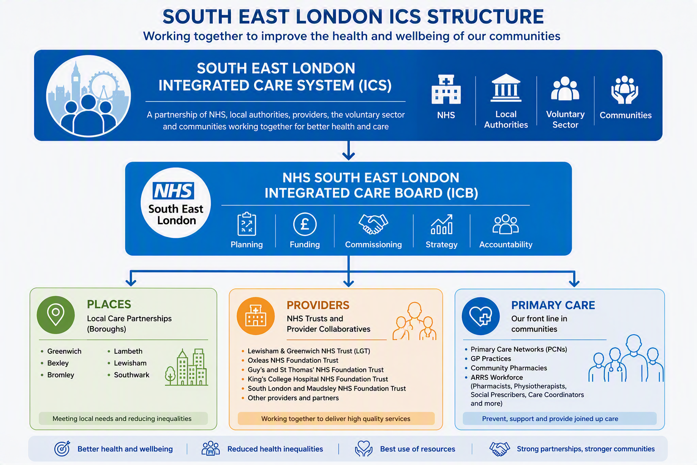
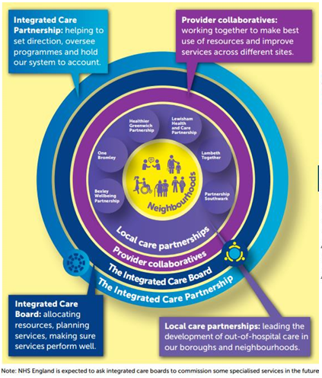
South East London Integrated Care Board (SEL ICB)
SEL ICB is the statutory NHS organisation within the ICS for South East London. It is responsible for:
Planning NHS services
Allocating NHS funding
Commissioning healthcare services
Developing strategic priorities
Ensuring delivery of the integrated care partnership strategy across SEL
ARRS INDUCTION SLIDES
What can it mean for ARRS:
✅ Your employer will be either GPA or Greenwich Health
✅ Your priorities are influenced by the PCN, Place and ICB
✅ Programmes are coordinated through the ICB and local partnerships.
E.g. Medicine optimisation, Vital 5, CORE20PLUS, Neighbourhood Health Services,
Pharmacy First, Pharmacy First Plus, etc

Slide 5

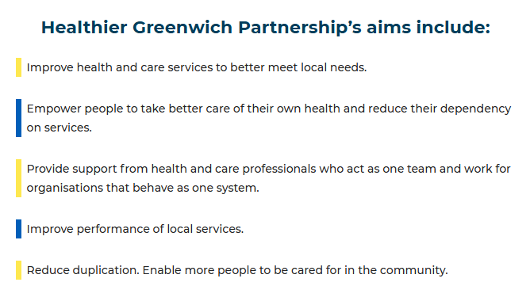


Healthier Greenwich Partnership (HGP)
Healthier Greenwich Partnership (HGP) is the place-based partnership for Greenwich, bringing together NHS organisations, the Royal Borough of Greenwich, community services, and voluntary sector partners to improve health and care outcomes for local residents. It formally reports to the Greenwich Health & Wellbeing Board.
What can it mean for ARRS:
✅ Working as part of a system, not just a practice
✅ Access to Integrated Neighbourhood Teams (INTs)
✅ Closer collaboration with community, mental health
and social care teams
✅ Shared focus on prevention, health inequalities and
population health
✅ Support for initiatives such as: Frailty Pathways,
Pharmacy First, Social Prescribing, Vital 5, Long-term
condition management
ARRS INDUCTION SLIDES

Slide 6
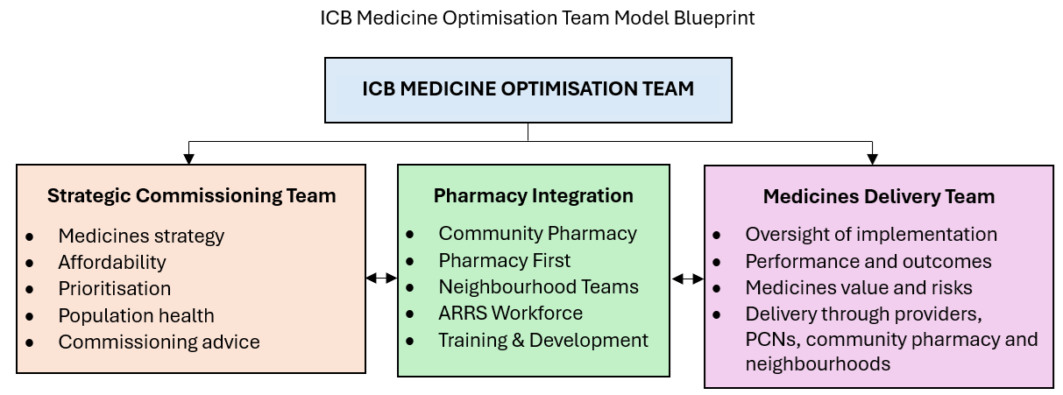
Medicine Optimisation Team
Medicines optimisation plays a critical role in every one of the four core purposes set out for ICSs:
Improve population health and healthcare
Tackle unequal outcomes and access
Enhance productivity and value for money
Help the NHS to support broader social and economic development
ARRS INDUCTION SLIDES
NHS England » National medicines optimisation opportunities 2024/25
Notes:
Improve population health and healthcare
Ensure patient safety and improved quality of care with integrated medication reviews across primary and secondary care prescriptions to ‘First Do No Harm.’
Develop shared care protocols and triangulate data to assess compliance and health outcomes.
Use innovative diagnostics, drugs, devices and digital technologies to improve health outcomes.
Tackle unequal outcomes and access
Identify the CORE20PLUS5 priorities and opportunities to improve access to medicines and social prescribing.
Identify medicines use and social prescribing best practice for each of the CORE20PLUS5 priorities.
Enhance productivity and value for money ​
Implement NICE guidelines and best practice on clinical effectiveness.
Shift the mindset from cost saving and budget management to investment, value for money and the return on investment of improved patient outcomes from medicinal interventions and medical devices over a whole care pathway.
Drive investment in primary care medicines to avoid more expensive secondary care interventions.
Decommission medicines and prescribing when no longer appropriate to meet local population health needs.
Help the NHS to support broader social and economic development​​
Enable people with long-term and multiple health conditions to continue to work and live independently for as long as possible.
Improve quality of life and reduce demand for NHS services through appropriate use of social prescribing.
Reduce the use of dependence-forming medicines.
Leverage the NHS’s capability to undertake research, monitor outcomes and uptake innovative medicines.

Slide 7
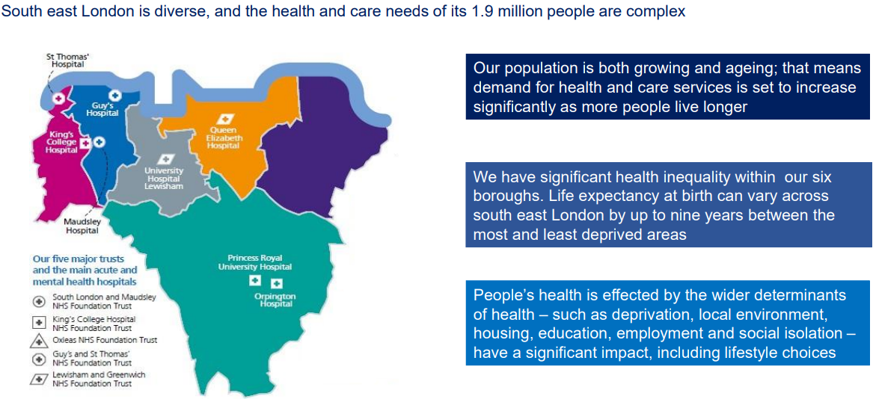
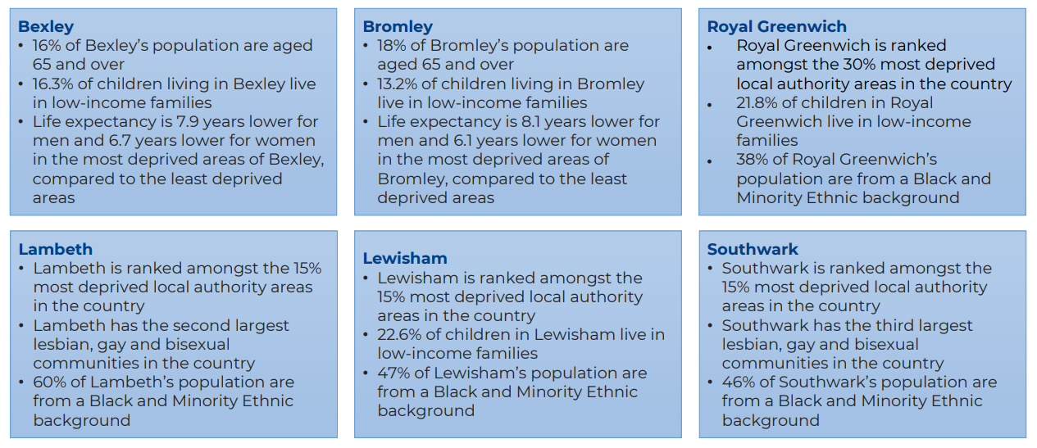
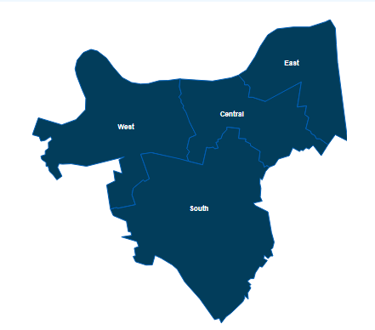
Six Boroughs in SEL (Local Care Partnerships)
ARRS INDUCTION SLIDES

Slide 8
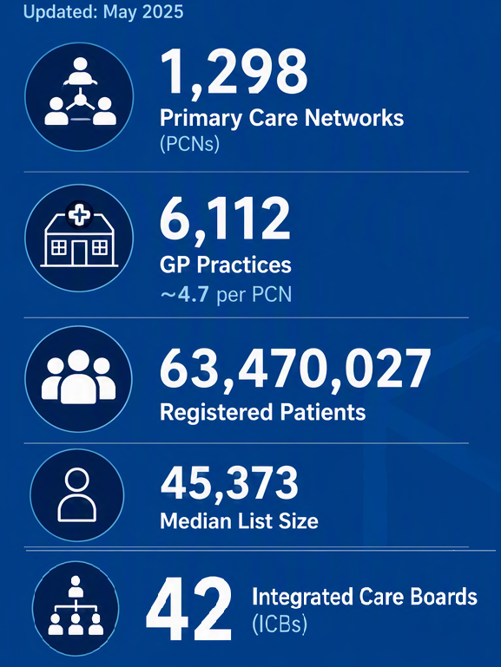
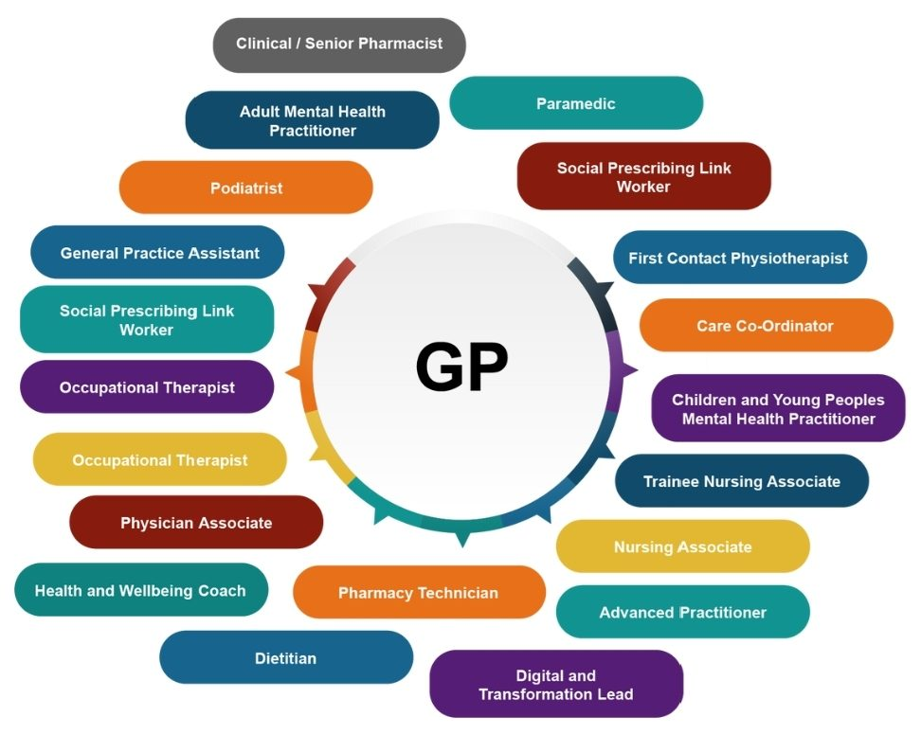
Primary Care Network
ARRS INDUCTION SLIDES
A Primary Care Network PCN is a group of GP practices working closely together, aligned to other health and social care staff and organisations, providing integrated services to their local population.
A PCN covers a patient population, of 30,000 – 50,000 patients, although by approval of the commissioner, this may be lower in rural and remote areas, and higher where it is appropriate.
A group of PCNs in a defined geographical area sits within a corresponding ICS.
Each primary care network is aligned to a local care partnership.

Slide 9
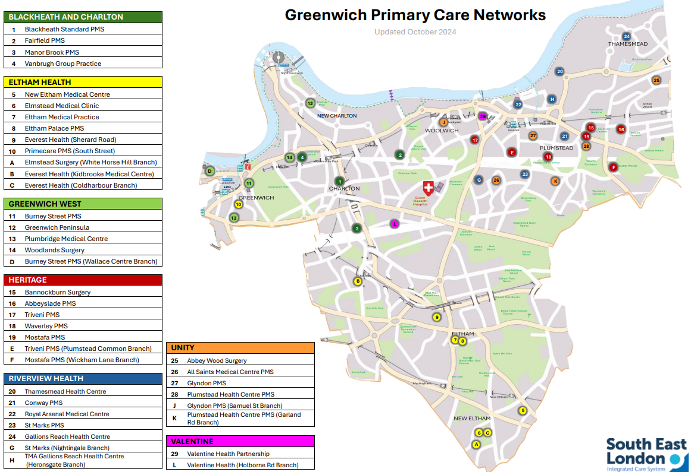
ARRS INDUCTION SLIDES
Greenwich PCN Map

Slide 10

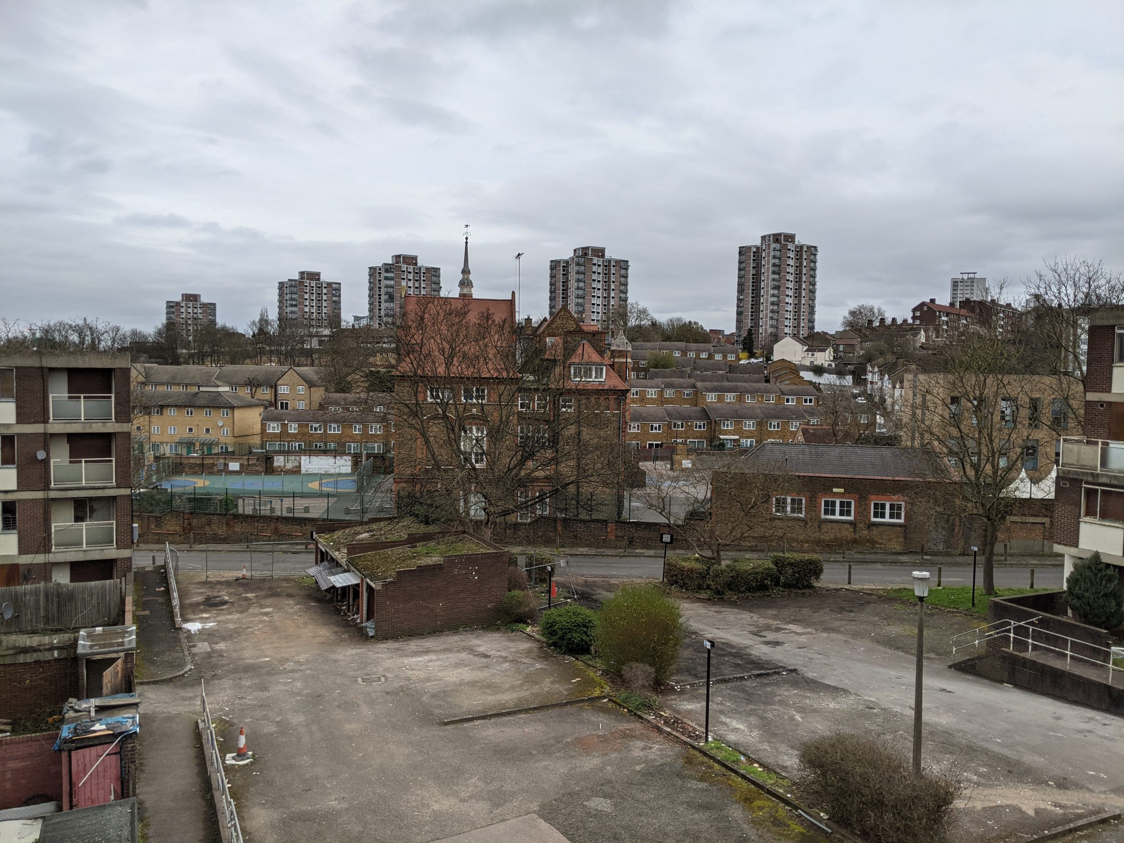
The Neighbourhood Model
What is a Neighbourhood?
A neighbourhood is a group of local services working together to support a defined population. Neighbourhoods bring together primary care, community services, mental health, social care, community pharmacy and voluntary sector partners to deliver coordinated, person-centred care.
ARRS INDUCTION SLIDES
Who works within a :
🏥 GP Practices & PCNs (and ARRS)
💊 Clinical Pharmacists & Pharmacy Technicians
🧠 Mental Health Teams
🏠 Community Nursing
👥 Social Care Teams
🤝 Voluntary & Community Sector
🏪 Community Pharmacy
🚑 Specialist Services
What can it mean for ARRS:
✅ Working as part of a wider MDT
✅ Support proactive population health management
✅ Participate in MDRs and neighbourhood case discussion
✅ Help deliver care closer to home
✅ Reduce fragmentation between organsiation

Slide 11
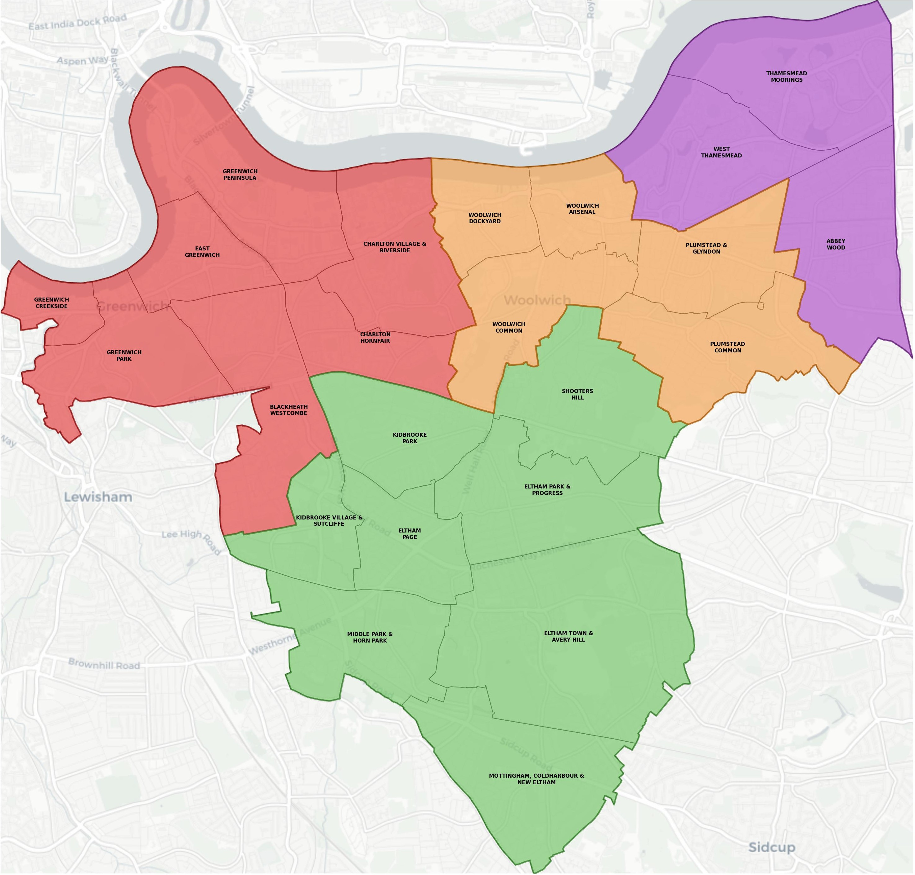
Greenwich’s Neighbourhood Geographies
Healthier Greenwich Partnership Board agreed adoption of four geographical Neighbourhood footprints in spring 2025.
This enabled an optimal balance of:
Population size and growth
Deprivation and need
Natural communities that residents identify with
Feasibility for primary, community, secondary, social and voluntary services to organise around these footprints
ARRS INDUCTION SLIDES

Slide 12
East
Abbey Wood Surgery
Gallions Reach Health Centre
Heronsgate Branch
Thamesmead Health Centre
West
Blackheath Standard Surgery
Burney Street Practice
Wallace Centre Branch
Greenwich Peninsula Practice
Manor Brook Medical Centre
Plumbridge Medical Centre
South Street Medical Centre
Fairfield Centre
Vanbrugh Group Practice
Woodlands Surgery
ARRS INDUCTION SLIDES
Central
Abbeyslade Surgery
Bannockburn Surgery
Conway Medical Centre
Glyndon Medical Centre
Samuel Street Branch
Plumstead and Wickham Lane Surgery
Wickham Lane Branch
Plumstead Health Centre
Garland Road Branch
Royal Arsenal Medical Centre
St Marks Medical Centre
Nightingale Branch
The Waverley Practice
Wickham Street Branch
Triveni
Plumstead Common Branch
Valentine Health Partnership
South
All Saints Medical Centre
Elmstead Medical Clinic
White Horse Hill Branch
Eltham Medical Practice
Well Hall Road Branch
Westmount Road Branch
Everest Health Partnership
Kidbrooke Medical Centre
Coldharbour Branch
New Eltham And Blackfen Medical Centre
Valentine Health Partnership - Holborne Rd Branch

Slide 13
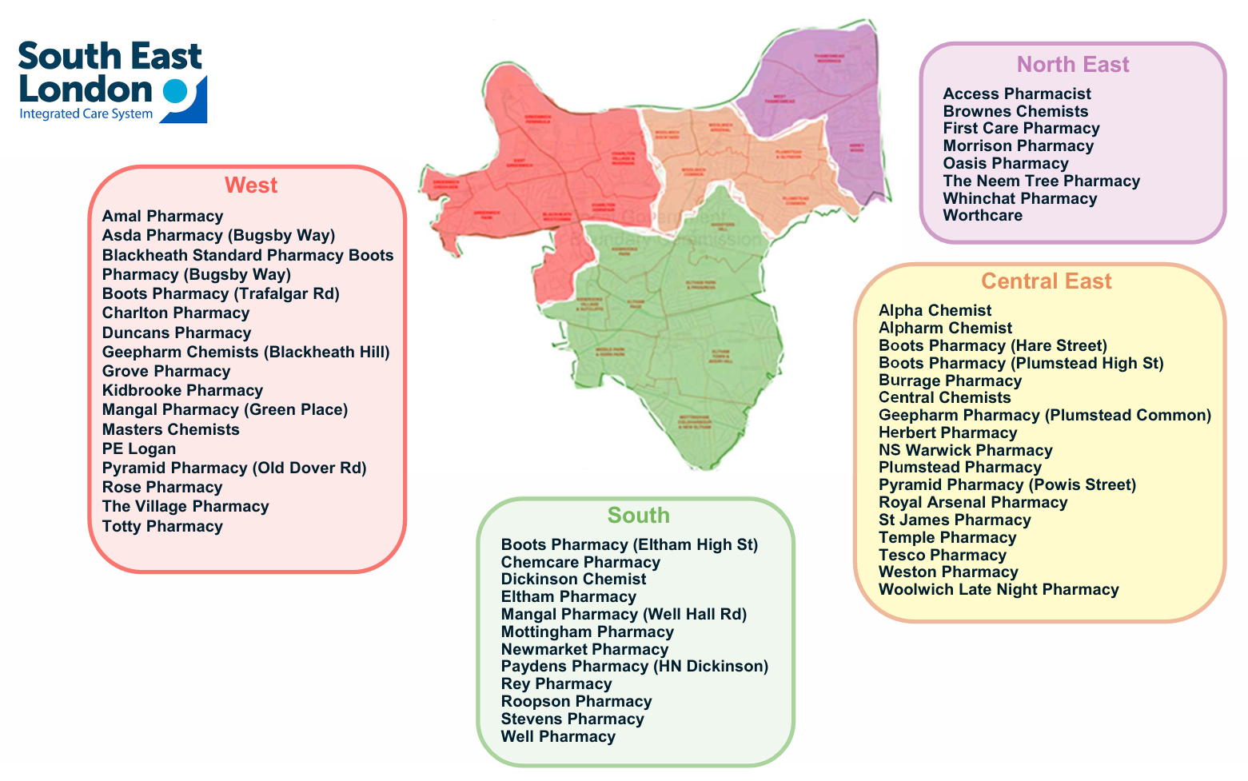
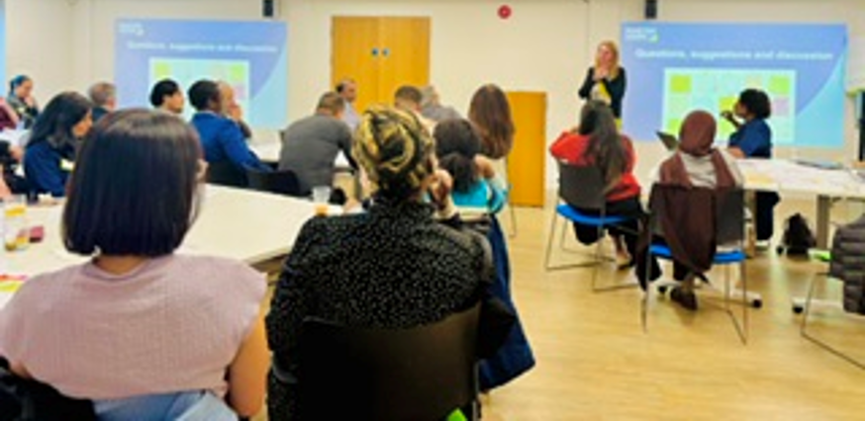
ARRS INDUCTION SLIDES

Slide 14
 | Primary Care Network (PCN) |  | Integrated Neighbourhood Team (INT)
Primary Purpose | Deliver primary care services across a group of GP practices Employ and deploy ARRS staff Improve access, prevention and long-term condition management |  | Deliver joined-up care for people with complex needs Coordinate care across organisations Keep people well and out of hospital where possible
Population | Usually 30,000 to 50,000 patients |  | A whole neighbourhood footprint. Often contains multiple PCNs
Main Focus | General practice Enhanced access QOF, IIF/CAIP and contractual delivery Medicines optimisation Long-term condition management |  | Frailty Multiple LTCs Mental health Children and young people | High-intensity users Admission avoidance Prevention
Who Works here? | GPs Practice Nurses Clinical Pharmacists Pharmacy Technicians | Social Prescribers Care Coordinators First Contact Practitioners Other ARRS roles | PCN staff Community nursing Social workers Mental health teams | Community pharmacy Hospital specialists Voluntary sector Housing and welfare services
Typical work | Medication reviews Structured Medication Reviews LTC recalls | Care home support Population health searches Practice support | MDT meetings Complex case discussions Care planning | Care coordination Shared risk management Cross-organisational working
PCN Vs INT
ARRS INDUCTION SLIDES

Slide 15
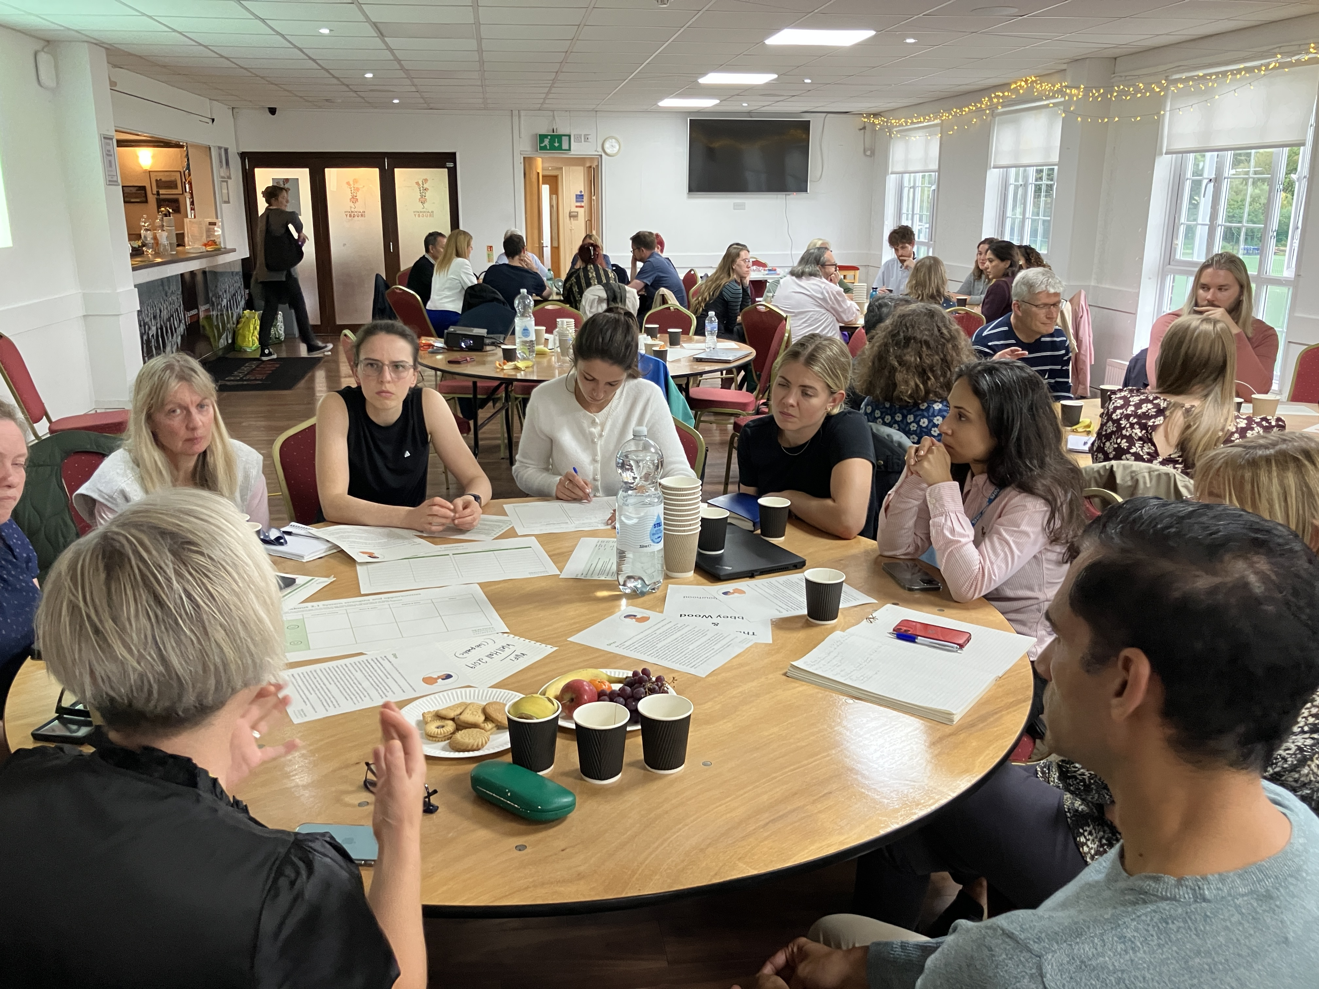
Greenwich priority pathways:
→From sickness to prevention
→ From hospital to community
→ From digital to analogue
Proactive Care Pathways –
Moderate and Severe Frailty
Proactive Care Pathways –
Multiple (3+) Long Term Conditions
Children and Young People’s models of health and care in the community
Prevention, focusing on mild frailty prevention
Integrated Neighbourhood working in Mental Health and wellbeing services
Urgent same day care provision and interfaces at Greenwich Neighbourhood level

Slide 16


A typical Integrated Neighbourhood Team
1
People in Greenwich
Through proactive case finding, we will identify adults who are frail, have three or more long-term conditions, as well as children, young people, and their families who would benefit from a holistic approach to improving their health and wellbeing. People who meet the risk criteria will be supported by bespoke Integrated Teams.
Our communities
Strong communities should be our first line of support. By backing carers, investing in local initiatives, and building a more people-friendly borough, we can prevent problems early and ease pressure on overstretched services – without compromising access to vital care.
Network partners
Network partners could come from the NHS, council, providers or VCSF. Their role in the Integrated Neighbourhood Teams (INTs) is to attend MDT meetings, support casework or provide advice to case coordinators when and if their expertise is needed.
Neighbourhood leadership group
Representatives from health, council, VCSF and other system partners are responsible for understanding neighbourhood challenges and will drive neighbourhood working in their network. This will include INT Clinical Leads, Neighbourhood Coordinators and Community Connectors.
4
Neighbourhood
Leadership Group
Housing &
Homelessness
3
Services for
children
Adult Social Care
2
Benefits and welfare advice
2
Employment
support
Finance and
dept advice
Adults who
are frail
Homecare /
Residential
care
1
DHACT
Service
District
Nursing
3
Children & young people
Adults with
3+ LTC
(incl. SMI)
Crisis
support
Mental health
support
Primary
care
VCSF
4
Law
enforcement
Substance
misuse
Pharmacies

Slide 17
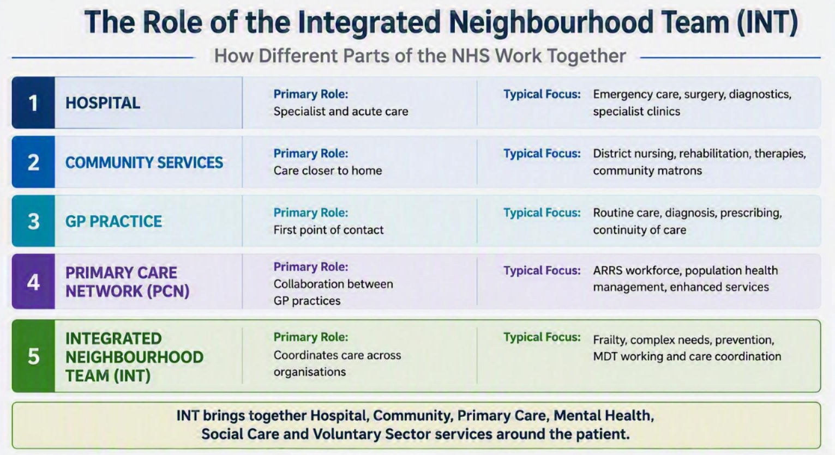
Integrated Neighbourhood Teams (INT)
An Integrated Neighbourhood Team (INT) brings together professionals from health, social care, mental health, community services, voluntary sector organisations and primary care to support people with the most complex needs.
What can an INT actually do:
✅ Proactive care for frailty and complex patients
✅ MDT meetings and case discussions
✅ Admission avoidance
✅ Care planning
✅ Links health, social care and voluntary services
✅ Coordinates support around the patient rather than around organisations
ARRS INDUCTION SLIDES
A GP Practice delivers care to individual patients.
A PCN delivers services across practices.
An INT brings all organisations together around patients with the most complex needs

Slide 18

NHS Ten Year Plan
NHS England » Fit for the Future: 10 Year Health Plan for England
New Government elected, July 2024
Fit for the Future: Ten Year Health Plan, July 2025
‘Reinvent the NHS’ though three radical ‘left shifts’:
From hospital to community
From analogue to digital
From sickness to prevention
Sec of State commissions Lord Darzi’s independent report into the state of the NHS, Nov 2024
Key challenges identified:
Many cannot get a GP or dental appointment
Waiting lists for hospital and community care have lengthened significantly
Staff are demoralised and demotivated
Outcomes on major killers like CVD and cancer lag behind other countries and are going in the wrong direction
Conclusion: “the NHS is in critical condition, but its vital signs are strong”.
The NHS Ten Year Plan developed following consultation with thousands of staff and members of the public…
Over 250,000 contributions via the Change.NHS website.
ARRS INDUCTION SLIDES

Slide 19




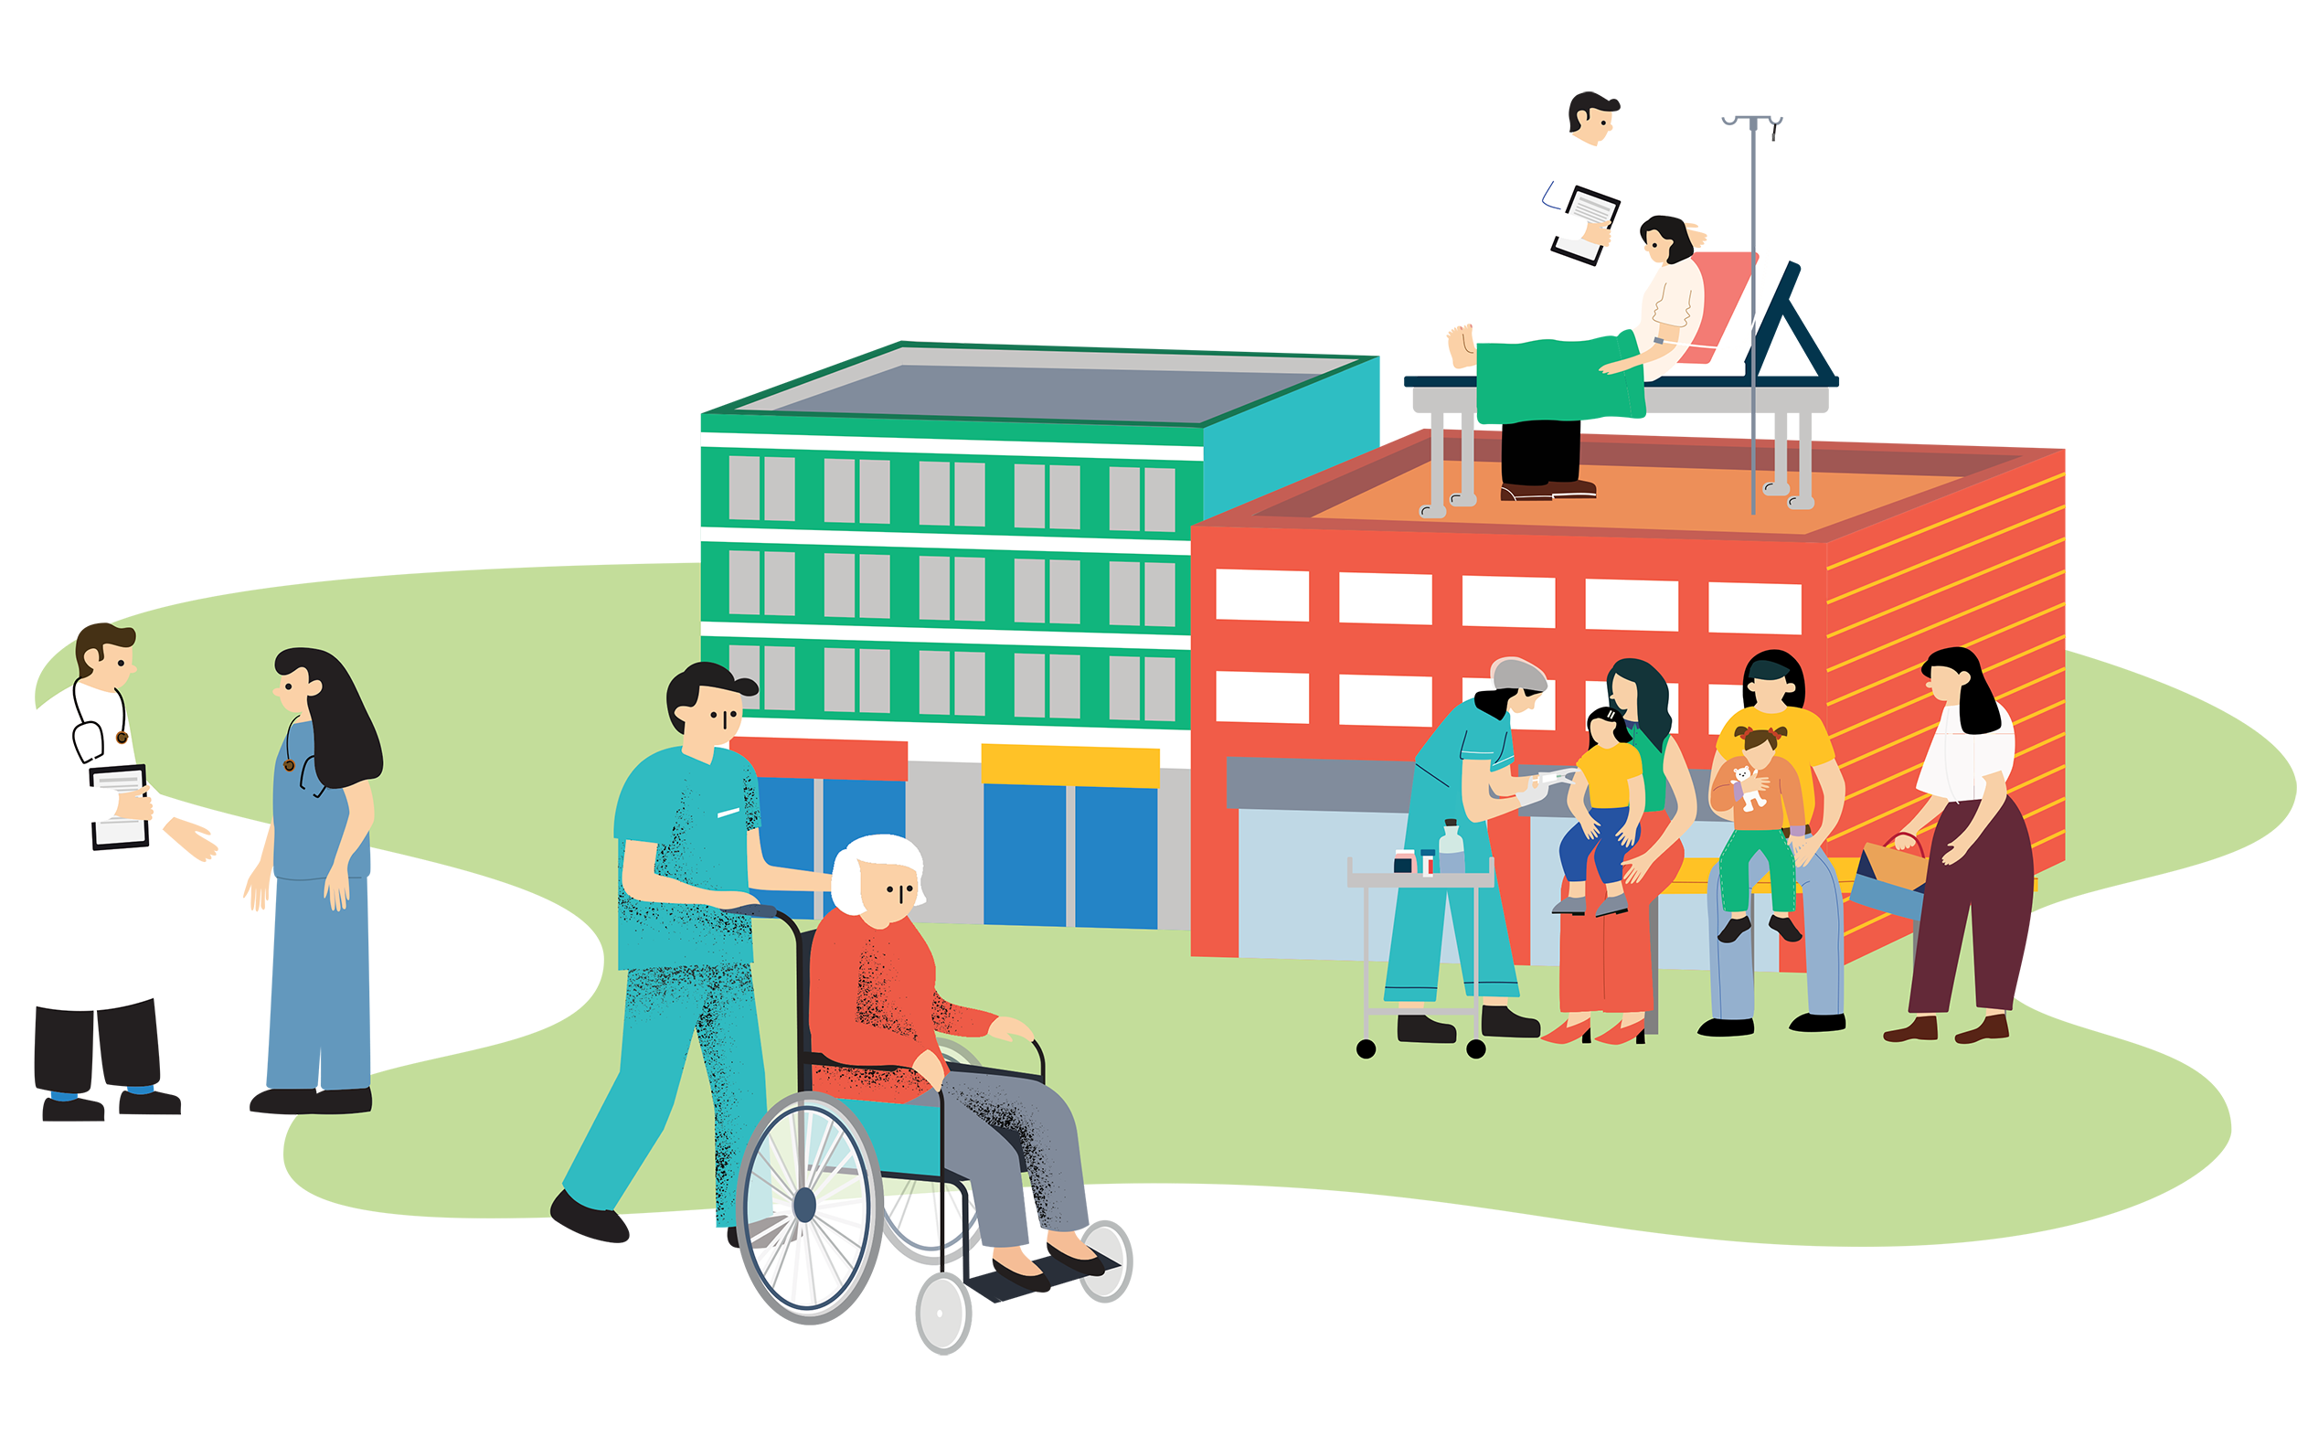
NHS 10 Year Plan
NHS England » Fit for the Future: 10 Year Health Plan for England
ARRS INDUCTION SLIDES
What can it mean for ARRS?
✅ Clinical Pharmacists & Pharmacy Technicians
✅ Working in Integrated Neighbourhood Teams
✅ Population Health Management
✅ Digital First Working
✅ Community Based Care
From hospital to community
From analogue to digital
From sickness to prevention
Notes:
Clinical Pharmacists & Pharmacy Technicians
Deliver proactive medication reviews
Support frailty and complex patients
Reduce polypharmacy and medicines-related harm
Work across practices and neighbourhoods rather than in isolation
Working in Integrated Neighbourhood Teams
Collaborate with GPs, community nurses, social workers and mental health teams
Participate in MDT discussions for complex patients
Contribute to admission avoidance and anticipatory care planning
Population Health Management
Use data to identify high-risk patients
Focus on prevention and early intervention
Support health inequality reduction initiatives
Digital First Working
Greater use of London Care Record (LCR)
Shared records across organisations
Digital consultations and population health tools
Community-Based Care
More care delivered outside hospital settings
Increased partnership with Community Pharmacy and Pharmacy First
Enhanced long-term condition management in primary care

Slide 20
Resources for working in a GP Practice in Greenwich
SELnet – Home
South East London Joint Medicines Formulary
Clinical Effectiveness SEL (CESEL)
SEL Integrated Medicines Optimisation Committee (IMOC)
PRESCQIPP: Webinars and Clinical masterclasses
OptimiseRx
Ardens Manager
EMIS searches
Ardens templates
Eolas – SEL Primary Care Antimicrobial Guidelines
Clinibee - SEL Paediatric Formulary
Home | OpenPrescribing
SELWDH
SPS - Specialist Pharmacy Service
Other Useful Resources
Slide 21
Slide 22-23
Slide 24
Slide 25
Slide 26
Slide 27
Slide 28
Slide 29
Slide 30
Slide 31
Slide 32
Slide 33
Slide 34
Slide 35
Slide 36-38
ARRS INDUCTION SLIDES

Slide 21
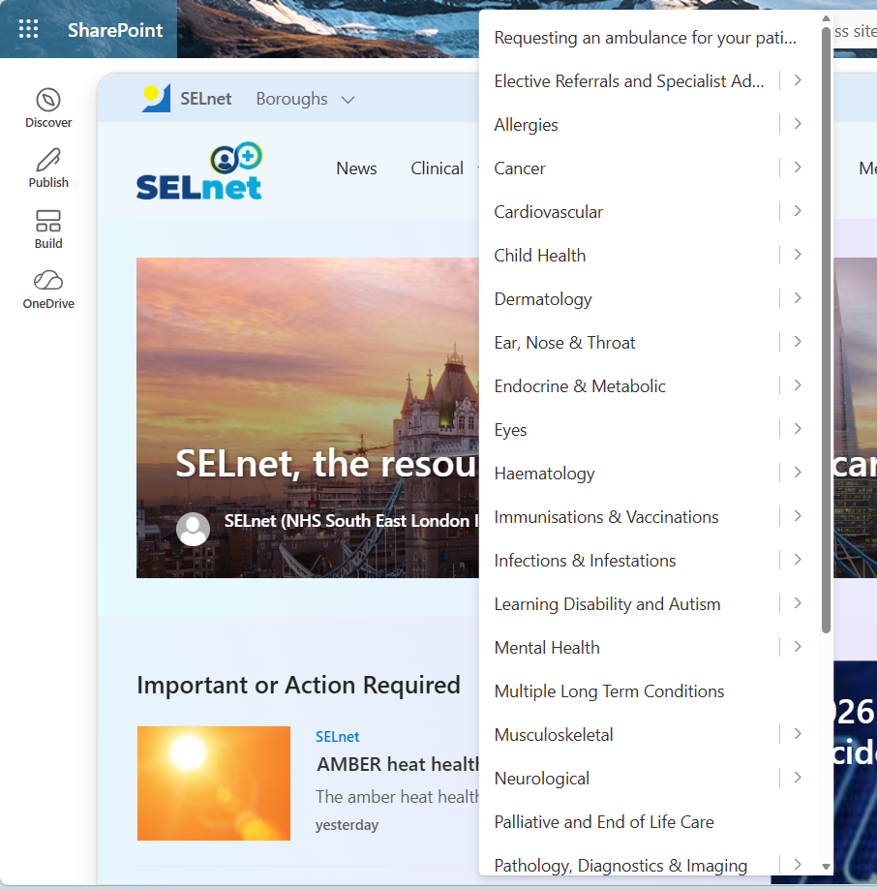
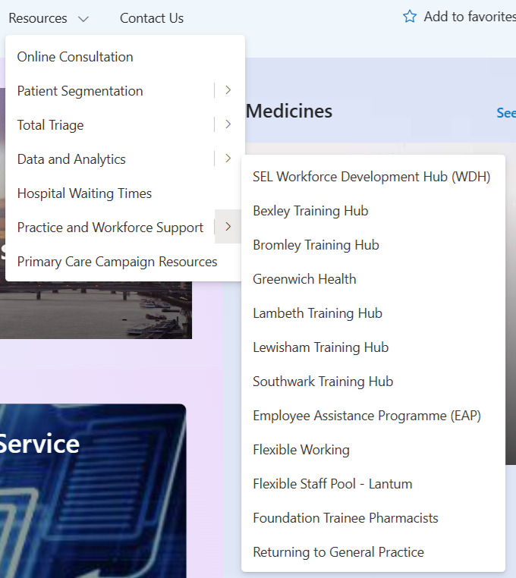
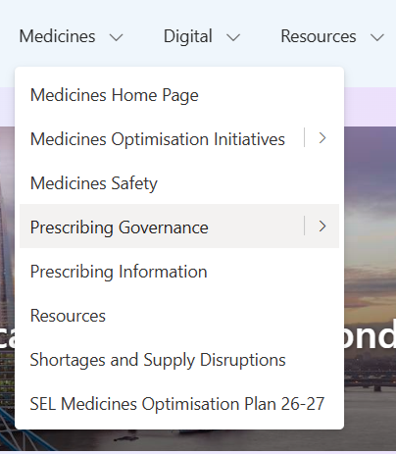
SELnet
SEL Net is a digital collaboration and knowledge-sharing platform for primary care staff across South East London, including ARRS roles working within PCNs and GP practices. It provides access to local guidance, training resources, clinical information, workforce updates, best practice documents, and opportunities to connect with colleagues across the system. SEL Net supports ARRS staff in staying informed, developing professionally, and accessing the tools and resources needed to deliver effective, consistent, and high-quality patient care.
ARRS INDUCTION SLIDES
If you don't have access to SELnet, please reach out to the main SELnet contact - sally-ann.sheppard@selondonics.nhs.uk

Slide 22
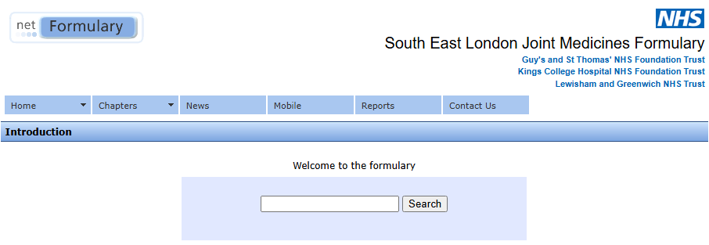
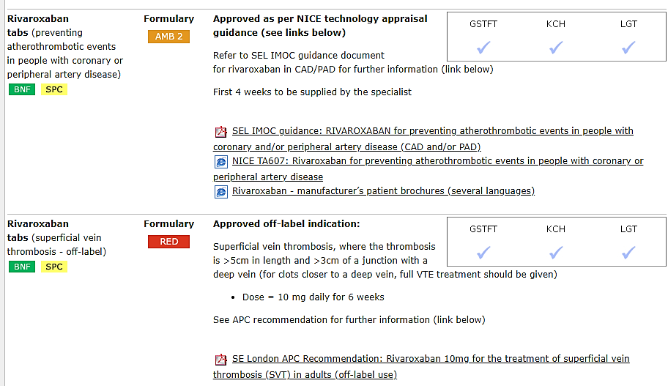
South East London Joint Medicines Formulary
ARRS INDUCTION SLIDES
The SEL Joint Medicines Formulary (JMF) is the South East London Joint Medicines Formulary, a shared list of medicines that are approved for use across the NHS organisations in South East London, including primary care, community services, and local NHS trusts. It is used across the six boroughs of Bexley, Bromley, Greenwich, Lambeth, Lewisham, and Southwark.

Slide 23
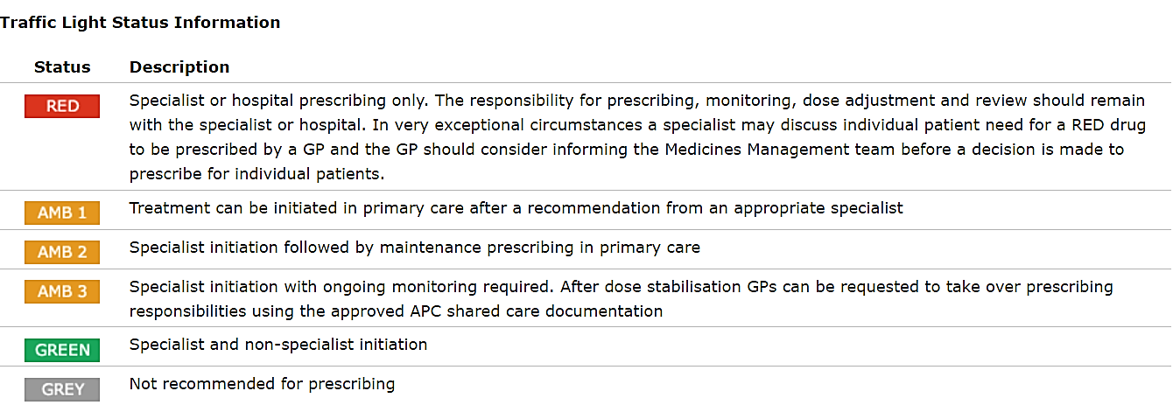
South East London Joint Medicines Formulary
RAGG list
ARRS INDUCTION SLIDES
The purpose of the RAGG list (traffic light status) is to promote safe, effective prescribing within the most appropriate setting by the most appropriate person. It is recognised that there will be individual exceptional situations that warrant a deviation from these recommendations upon the agreement of all parties.
However, the list raises the awareness that the drug requires additional knowledge, experience, monitoring or review in order that the individual management plan is explicit enough to ensure each party knows what their role is in the management of the patient.
A drug may have different recommendations according to the indication, e.g. off-label indications or rare conditions.

Slide 24

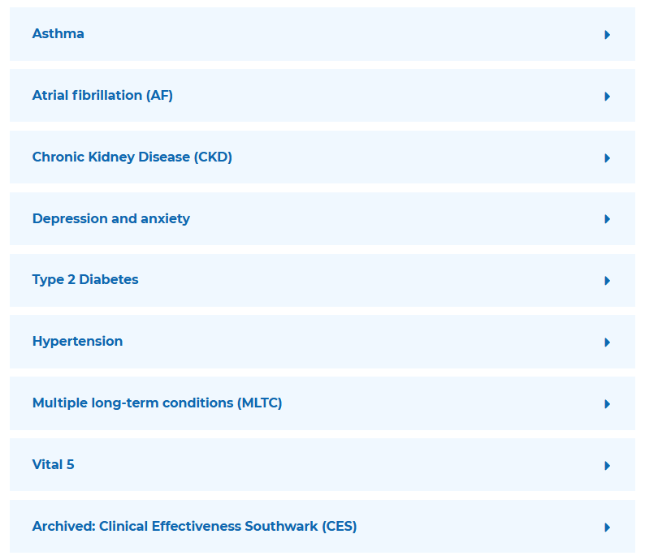
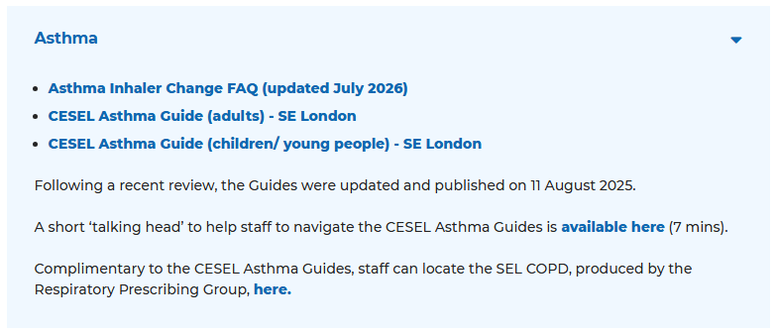
Clinical Effectiveness (CESEL) - NHS South East London
Clinical Effectiveness South East London (CESEL) provide a systematic evidence-based approach to quality improvement across south east London primary care, to help to improve health outcomes and reduce variation and inequalities for our local population.
As a collaborative endeavour across the ICS, alongside close links with our academic partners (KHP), CESEL provides population health capability, ensuring front line staff have the tools and resources to provide best-practice care.
ARRS INDUCTION SLIDES

Slide 25
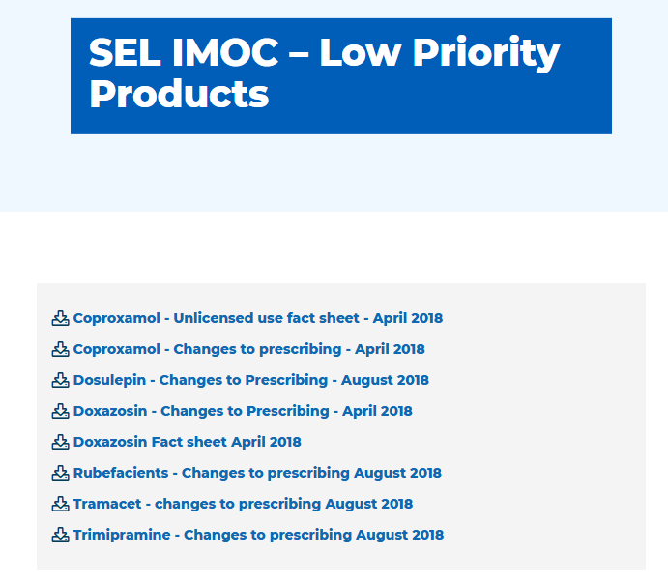
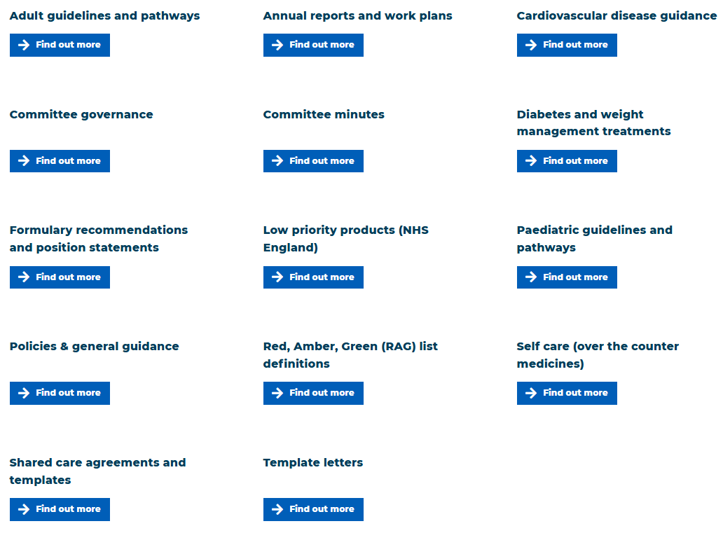
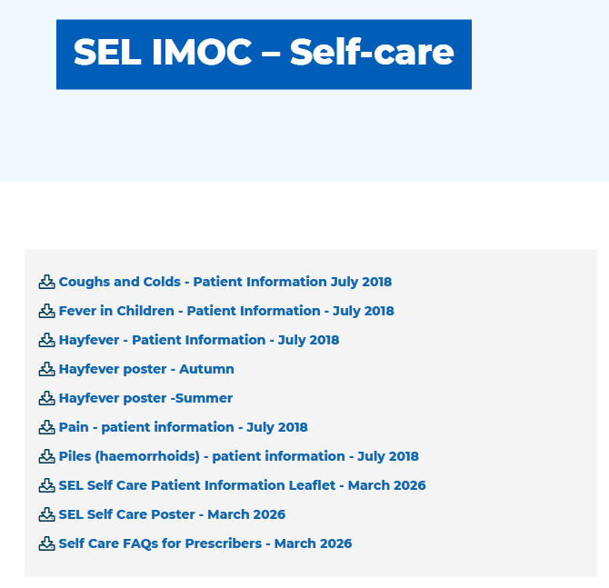
SEL IMOC - NHS South East London
The South East London Integrated Medicines Optimisation Committee (SEL IMOC, formerly known as the Area Prescribing Committee) is a partnership committee which provides advice and recommendations on important medicines related issues across the healthcare system in south east London.
ARRS INDUCTION SLIDES

Slide 26
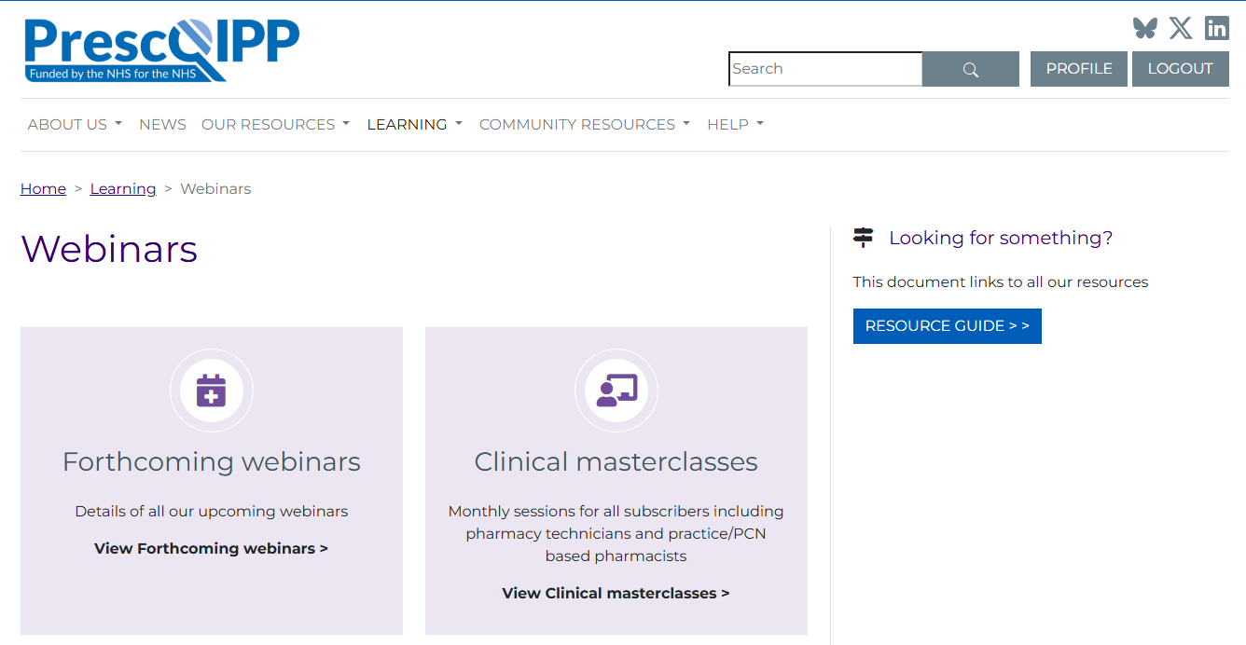
PRESCQIPP: Webinars and Clinical masterclasses
PrescQIPP offers a comprehensive programme of clinical masterclasses and webinars designed to support healthcare professionals in medicines optimisation, prescribing, and evidence-based practice. Monthly Clinical Masterclasses, delivered by national experts, cover a range of key therapeutic areas and emerging topics relevant to primary and integrated care. Alongside these, PrescQIPP provides a wide range of forthcoming webinars, including clinical updates, prescribing mastery sessions, genomics-informed medicines optimisation, medicines self-management, social prescribing, and sustainability in healthcare
ARRS INDUCTION SLIDES
REMINDER:
You must register with an nhs.net email to access the webinars and clinical masterclass

Slide 27
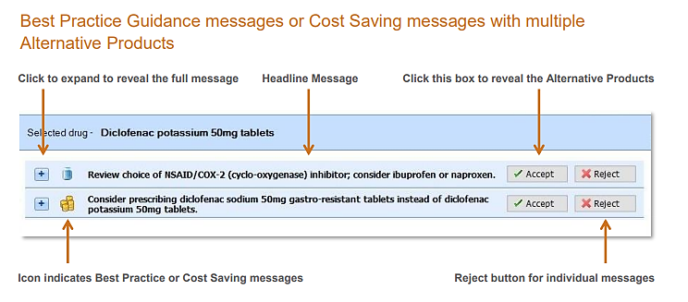
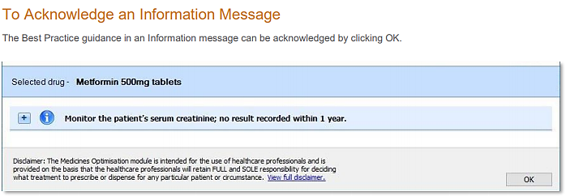
OptimiseRx
OptimiseRx is a built-in prescribing support tool to allow “pop up” advice appear at the point of prescribing to support decision making process for clinicians.
ARRS INDUCTION SLIDES

Slide 28
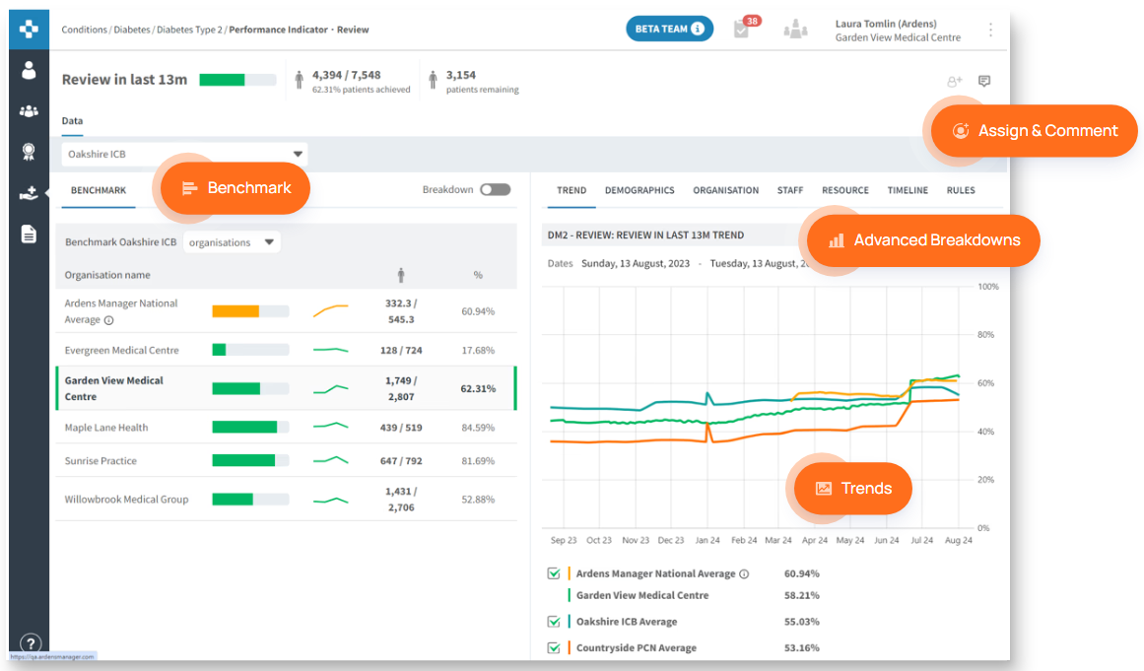
Training Video on SELnet:
SEL ICB Ardens Manager Webinar
Ardens Manager
Ardens Manager is a cloud-based data analytics platform designed for use in primary care settings like GP practices, Primary Care Networks (PCNs), and Integrated Care Boards (ICBs). It provides tools for monitoring, aggregating, and benchmarking activity across various service areas. Essentially, it helps healthcare organizations understand and manage their performance related to patient care, contracts, and population health using data-driven insights.
Key Functionality:
Data Aggregation and Benchmarking
Service Monitoring
Contract Management
Patient Identification and Management
Workforce planning
Decision Support
ARRS INDUCTION SLIDES
Benefits:
Near-to real-time Data
Time Saving
Improved Efficiency
Enhanced Performance
Better Patient Outcomes
Increased Contractual Income
Improved Data Quality
REMINDER:
Please speak to your Practice Manager to gain access.

Slide 29
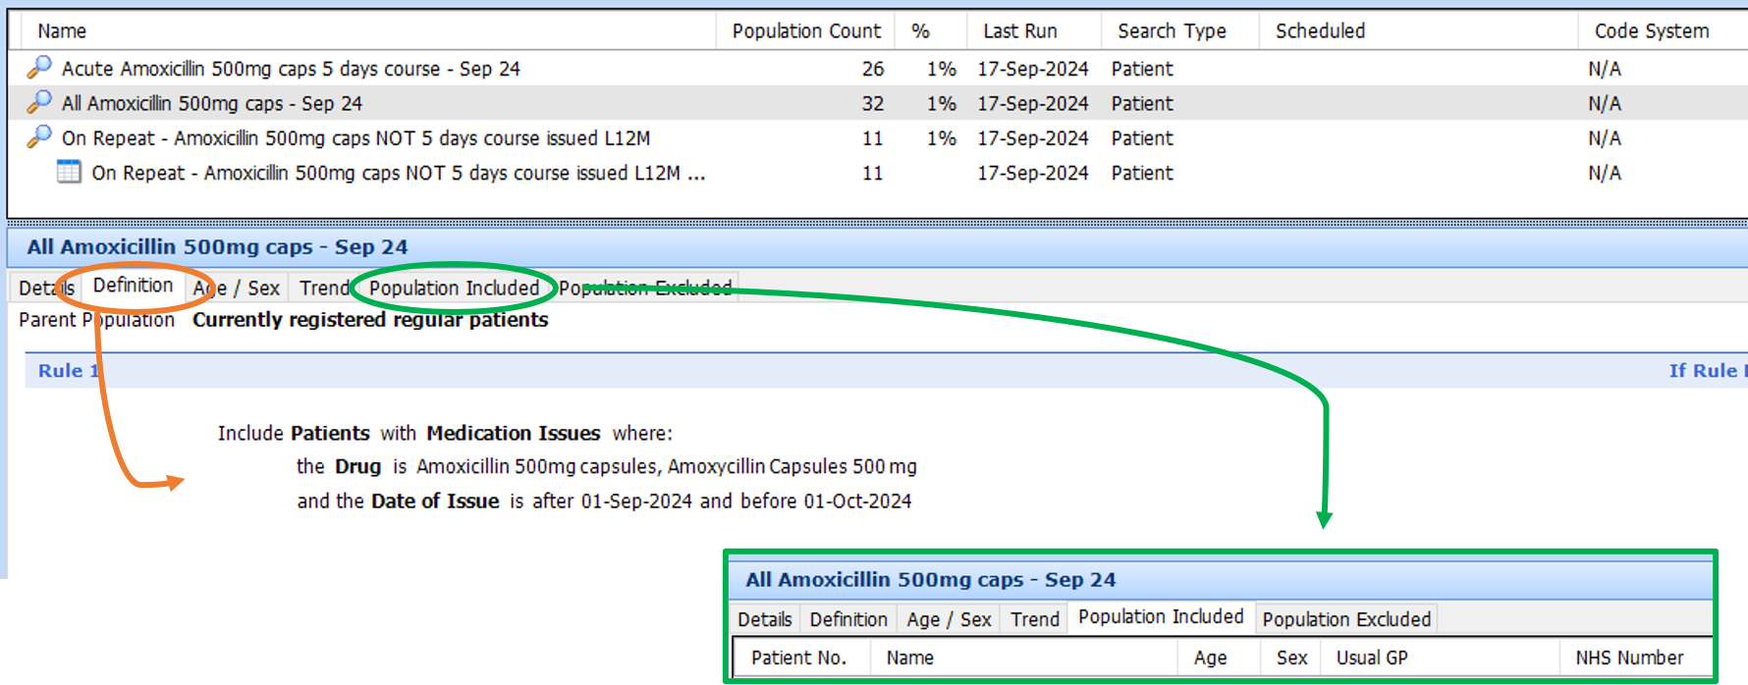
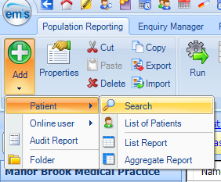
EMIS searches (Population reporting)
Searches are made up of rules, features and criteria:
Each search contains one or more rules
↓
Each rule contains one or more features
↓
Each feature contains one or more criteria
When a search is run, patient data either passes or fails the search rules, depending on whether or not the characteristics you're searching for are found.
EMIS population reporting enables practices and Primary Care Networks (PCNs) to identify, monitor and manage specific patient cohorts using accurate clinical data. Through tailored EMIS searches, healthcare teams can track long-term conditions, identify care gaps, monitor performance against local and national targets, support proactive patient recalls, and inform service planning. Population reporting provides valuable insights into the health needs of a population, helping practices deliver targeted interventions, improve patient outcomes, and meet contractual and quality improvement requirements..
ARRS INDUCTION SLIDES

Slide 30
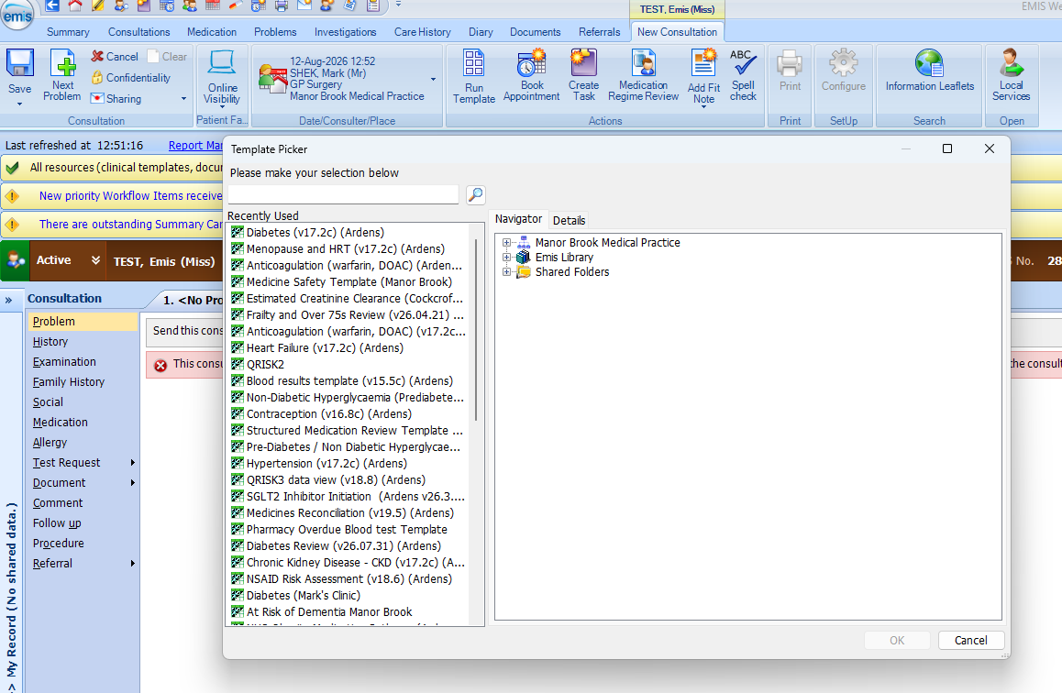
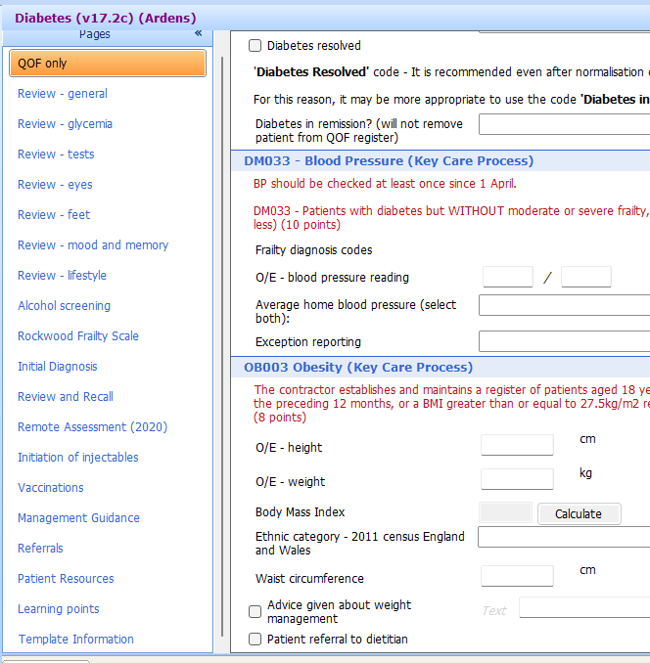
Ardens templates
Ardens templates are structured clinical templates integrated within EMIS Web that support consistent, efficient, and high-quality patient consultations. They guide clinicians through assessments, coding, data entry, and best practice workflows, helping to ensure accurate clinical records, standardised care, and improved data quality. Ardens templates are widely used across primary care to support long-term condition management, health checks, medication reviews, and contractual requirements, enabling practices to capture key information while streamlining clinical processes and reporting.
ARRS INDUCTION SLIDES
Training Videos:
Ardens Training Videos on Vimeo

Slide 31
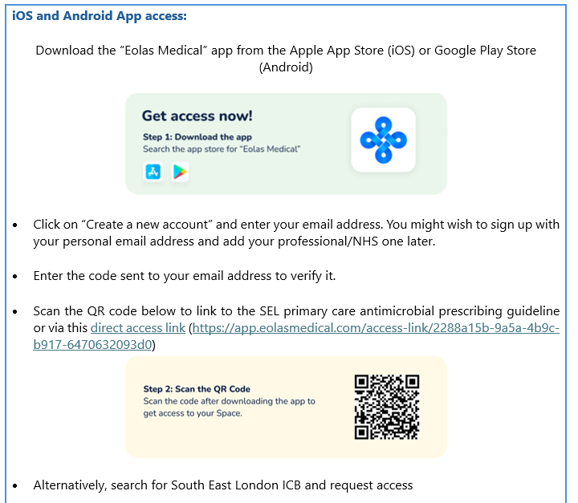
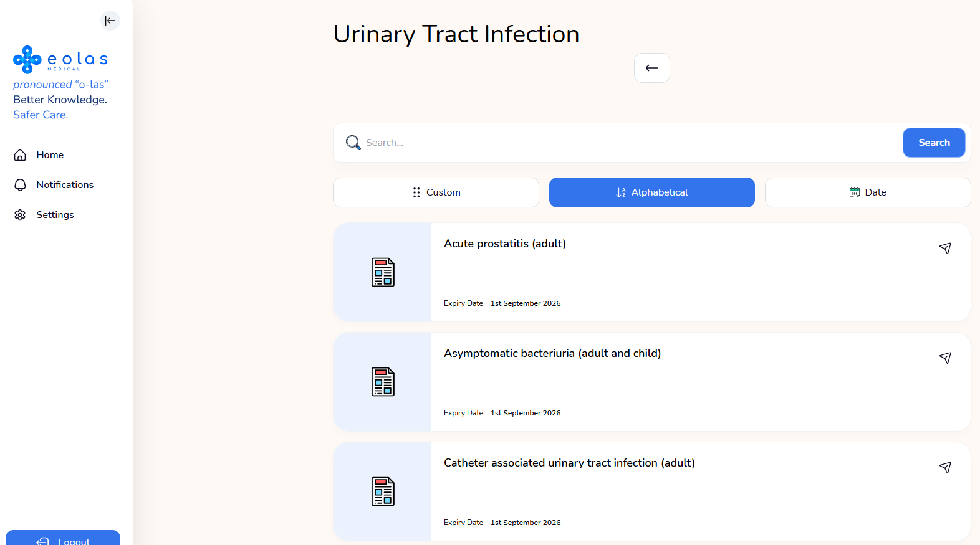
Eolas - SEL Primary Care Antimicrobial Guidelines
The guidelines on Eolas Medical can be accessed via an app on phones and tablets (iOS and Android), as well as through a PC web browser. As well as hosting the SEL Primary Care Antimicrobial Prescribing Guidelines the Eolas Medical® platform offers a range of functionalities not previously available on Microguide®, including a knowledge base repository to other medical resources and guidelines such as BNF, BNFC, NICE and other national guidelines.
REMINDER:
You must register with email for a login to access Eolas. Please follow the listed instruction
How to access the SEL primary care antimicrobial prescribing guidelines on Eolas Medical:
ARRS INDUCTION SLIDES
Training & Support:
For Eolas Medical® specific training and support - support@eolasmedical.com
For further information on the Eolas Medical® platform – refer to the Eolas Medical Support page (https://support.eolasmedical.com/)

Slide 32
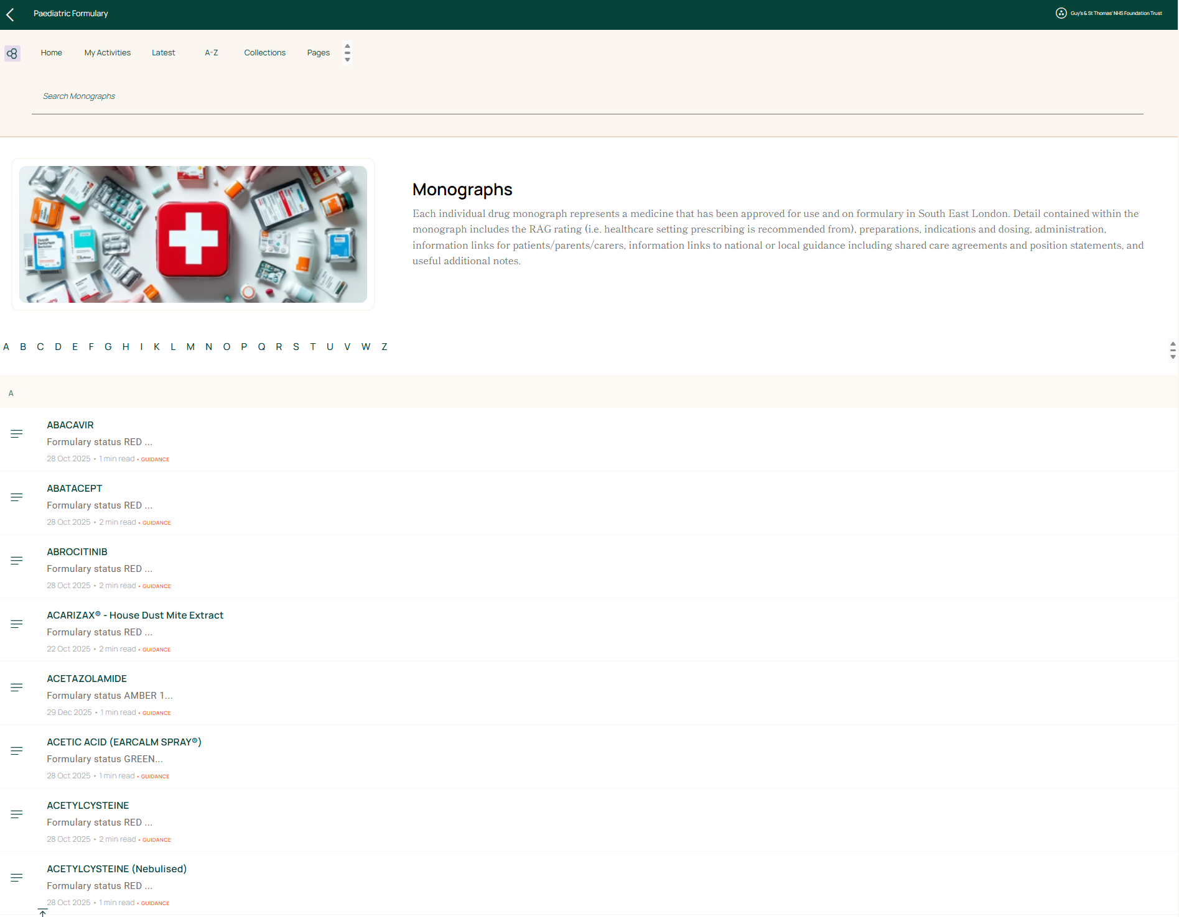
Clinibee - SEL Paediatric Formulary
The formulary is a prescribing list that includes the names of medicines approved by the Evelina Medicines Committee (EMC) and Integrated Medicines Optimisation Committee (IMOC) for use across the South East London Integrated Care System: Guy’s and St Thomas’ NHS Foundation Trust (GSTFT) King’s College Hospital NHS Foundation Trust (KCH) Lewisham and Greenwich NHS Trust (LGT) South East London Clinical Integrated Care System (ICS).
This formulary also contains some of the information necessary for prescribing, dispensing or administration. It should be used in conjunction with the British National Formulary for Children (BNFc), supplemented as necessary from specialist publications and manufacturers’ Summaries of Product Characteristics (SPC), local guidelines and national guidelines. It is intended for use by prescribers who have the necessary training and experience to interpret the information it provides.
ARRS INDUCTION SLIDES
REMINDER:
You must register with email for a login to access Eolas. Please select Paediatric Formulary once logged in

Slide 33
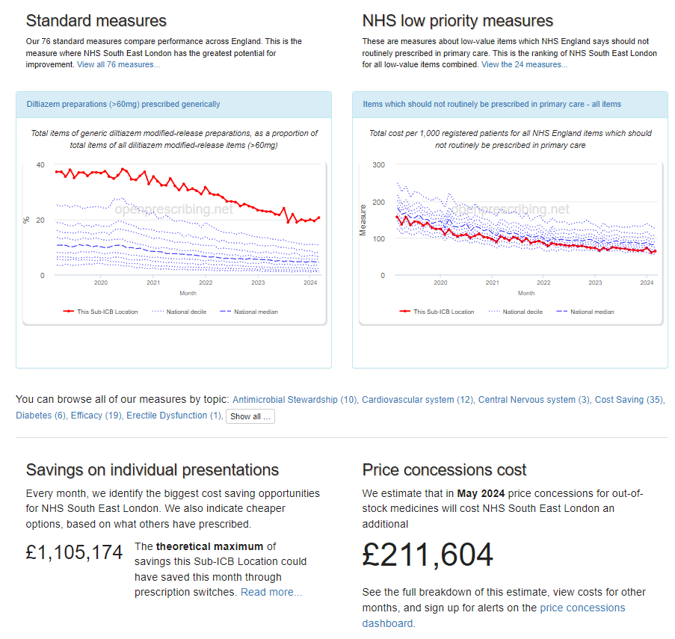
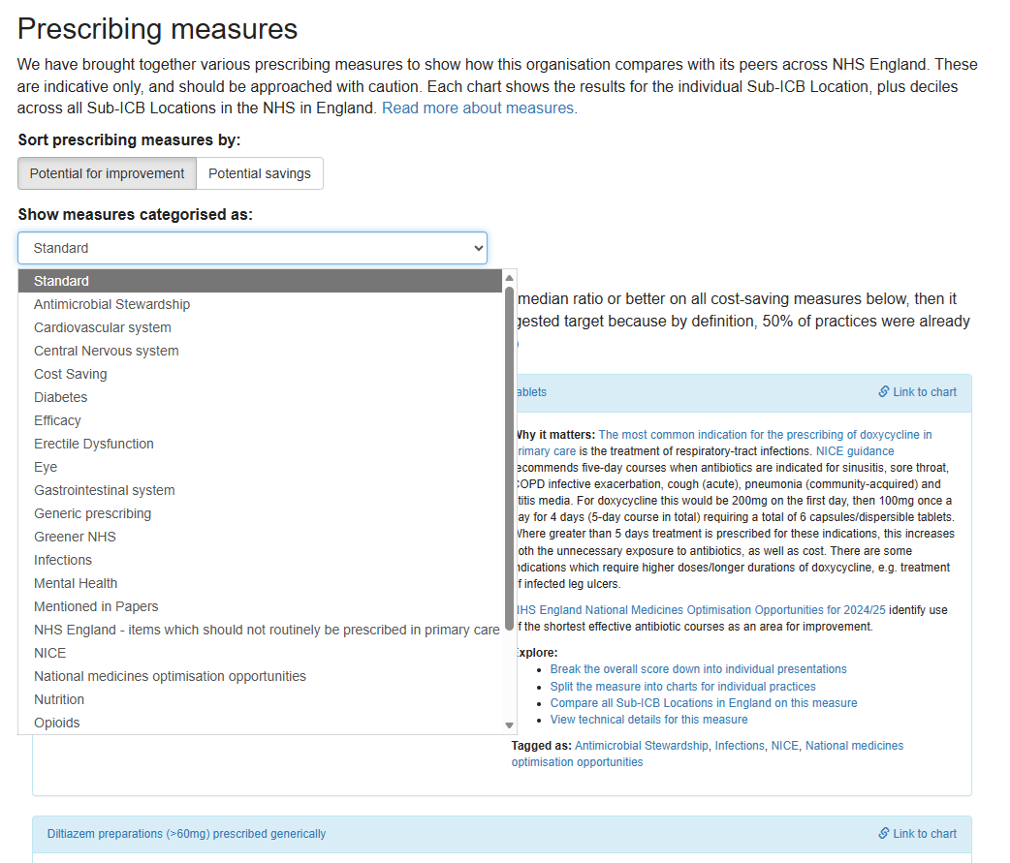
OpenPrescribing
OpenPrescribing uses English prescribing dataset from the NHS Business Services Authority (BSA) or ePACT2 data making it easier for GPs, managers and everyone to explore - supporting safer, more efficient prescribing. It is available on public domain and no registration required via https://openprescribing.net/
ARRS INDUCTION SLIDES

Slide 34
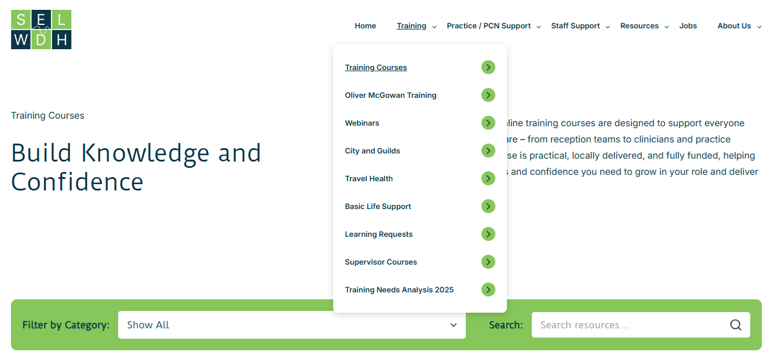
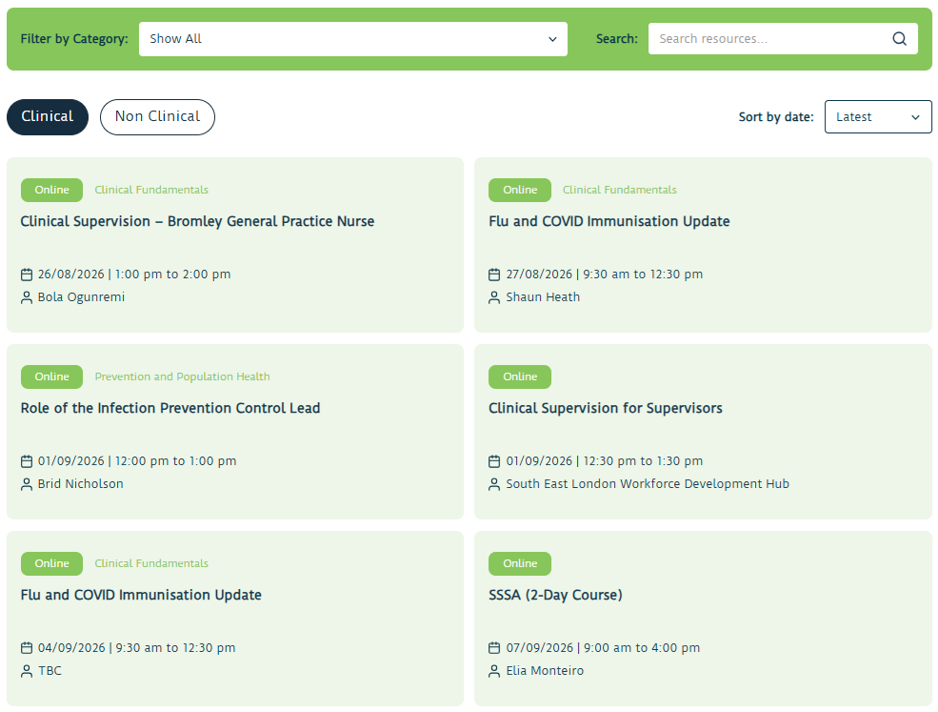
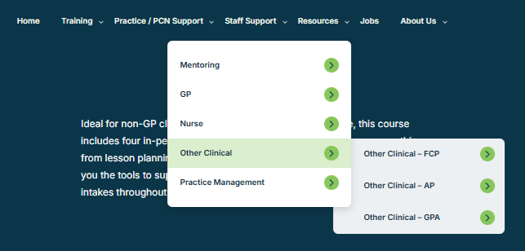
SELWDH
The SELWDH (South East London Workforce Development Hub) website is a key resource for ARRS providing access to training, professional development, career support, webinars, educational resources, workforce guidance, and networking opportunities to help ARRS staff develop their skills, meet role requirements, and deliver high-quality patient care. The hub also supports recruitment, retention, supervision, and ongoing workforce development across the six South East London boroughs.
ARRS INDUCTION SLIDES

Slide 35
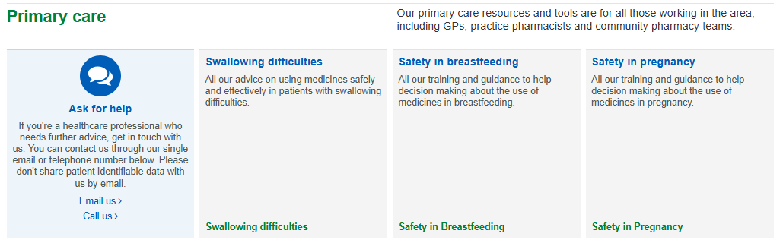
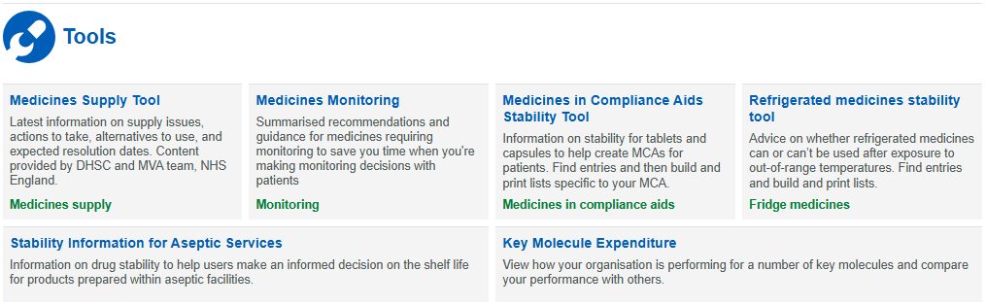
SPS - Specialist Pharmacy Service
The Specialist Pharmacy Service (SPS) website is an essential evidence-based resource for ARRS staff and primary care teams, providing expert medicines information to support safe and effective patient care. Key resources include medicines monitoring guidance, the Medicines Supply Tool for managing medication shortages and alternatives, the Medicines in Compliance Aids Stability Tool to support safe use of monitored dosage systems, advice on medicines safety in pregnancy and breastfeeding, and guidance for patients with swallowing difficulties, including information on alternative formulations and safe administration. SPS helps healthcare professionals make informed clinical decisions and optimise medicines management in everyday practice..
ARRS INDUCTION SLIDES
REMINDER:
You must register with email for a login to access some SPS services.

Slide 36
Other Useful Resources
NEWT Guidelines for administration of medication to patients with enteral feeding tubes or swallowing difficulties
Username: 3academy | candle
Oxleas Dietetic Service (Greenwich)
  Adults: oxl-tr.dieteticreferrals@nhs.net
  Children: oxl-tr.childrenstherapies@nhs.net Referral form Childrens-Therapy-Services-Referral-Form-amended-May-2022.docx
  Learning Disability and Autism team
    selicb.ldaprescribingteam@nhs.net
Specials Pharmacists Service
Helen.Cooper@gstt.nhs.uk / sheatha.abumehdi@gstt.nhs.uk
Formulary pharmacists
  GSTT: gst-tr.selondonformulary@nhs.net
  KCH: kch-tr.FormularyKCH@nhs.net
  LGT: lg.formulary@nhs.net
  Oxleas: oxl-tr.medicinesinfo@nhs.net Tel: 01322 625 002
  SLAM: pharmacy_staff_medicines_information@slam.nhs.uk
NHSE Dentisty, Optometry and Pharmacy Commissioning Hub
  Dental enquiries: England.Lon-dental@nhs.net
  Optometry enquiries: England.lon-optom@nhs.net
  Pharmacy enquiries: England.lon-pharmacy@nhs.net
Medicines Information
  Specialist Prescribing Services: www.sps.nhs.uk
  Local resources via medicines complete and Newt
ARRS INDUCTION SLIDES
MedicinesComplete — Dashboard is an online resource for drug and healthcare information. The subscription includes the following resources: BNF and BNF for Children Critical Illness Handbook of Drug Administration via Enteral Feeding Tubes Martindale: The Complete Drug Reference Palliative Care Formulary Stockley’s Drug Interactions
Username: medicines@selondonics.nhs.uk | SELMeds26

Slide 37
Resources to support medicine safety
Central Alert System (mhra.gov.uk)
  The Central Alerting System (CAS) is a web-based cascading system for issuing patient safety alerts, important public health messages and other safety critical information and guidance to the NHS and others, including independent providers of health and social care.
Drug Safety Update - GOV.UK (www.gov.uk)
  All past drug safety updates can be accessed here along with a sign up for email updated for new drug safety updates.
Medicines Supply Tool – SPS - Specialist Pharmacy Service – The first stop for professional medicines advice
  The tool provides latest information on supply issues, actions to take, alternatives to use, and expected resolution date.
DCIQ: NHS South East London ICS Quality Alerts reporting form (datixcloudiq.co.uk)
  ​A Quality Alert (QA) is a concern or a systemic issue generally affecting a service/ pathway that affects individual/group of patients and affects the ability to deliver a high-quality service within SEL. ​
  The QA process is an integral part of our local system to improve quality in SEL.
  The information provided is routinely reviewed and provides intelligence to allow the ICS to identify key themes and trends.
  Individual responses will only be provided to those that may have or had the potential to cause an individual significant harm and have been graded amber or red.
Learn-from-patient-safety-events.nhs.uk
  Record information about things that could have or did affect the safety of patients, or things that have gone well, in order to support learning and safety improvement
  Access, review and update event records they have permission to edit, and undertake governance activities to support local patient safety response and improvement
  View and download data about what patient safety events have been recorded within their own organisation, or by organisations within their Integrated Care Board (ICB) or region to the new Learn From Patient Safety Events service according to their level of access
Yellow Card | Making medicines and medical devices safer (mhra.gov.uk)
BI Dashboards
  To access the BI Prescribing Dashboards, request access via the following form: Primary Care Prescribing Access form
ARRS INDUCTION SLIDES

Slide 38
Resources to support medicine safety
Safe Management of Controlled Drugs
Here are some key links to assist with the safe management of controlled drugs in line with legislation and best practice:
Sign up to Controlled Drug Reporting Tool, via www.CDReporting.co.uk to:
  Report incidents and concerns (can be anonymous)
  Apply for authority to witness the destruction of controlled drugs
  Access the Resource Centre for
    Regional newsletters, bulletins, legislation and guidelines
CQC – Controlled Drug Prescribing Policy Template: gp-mythbuster-28-management CDs
NMPs Who can prescribe what? - PSNC within their competency and in line with legislation
For all other enquires email the London CDAO: england.londoncdaccountableoffice@nhs.net
ARRS INDUCTION SLIDES
Safe Prescribing of Controlled Drugs
Good opioid stewardship is essential to reduce harm from opioid medicines by reducing long term and high dose prescribing (>120mg oral Morphine equivalent) for chronic (non-cancer) pain.
Use Ardens Controlled Drug Risk Assessment template when initiating CDs to prompt and record discussions about treatment duration, dependence and expectations.
Live Well with Pain Website has self-management tools and patient leaflets
Opioids Aware - Faculty of Pain Medicine includes tools and resources for opioid prescribing
Controlled Drugs Enquiries
For all general enquires relating to Controlled Drugs please use the generic email: england.londoncdaccountableoffice@nhs.net
For Controlled Drugs destruction enquiries please email: england.londoncddestruction@nhs.net
For Controlled Drugs PIN enquiries please email: england.londoncdpins@nhs.net
For Controlled Drugs occurrence report enquiries please email: england.londoncdoccurrence@nhs.net

Slide 39
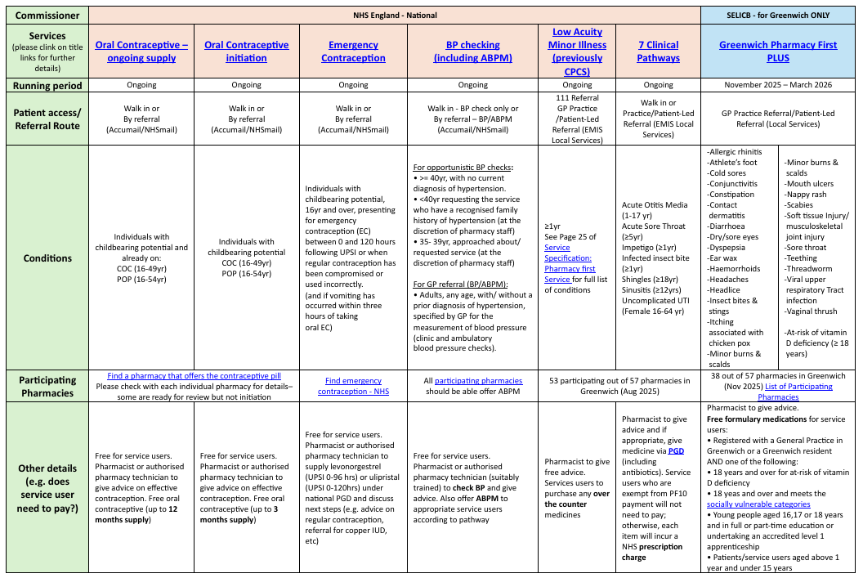
Pharmacy First
ARRS INDUCTION SLIDES
Community Pharmacy Services

Slide 40

7 Clinical Pathways
ARRS INDUCTION SLIDES

Slide 41
Greenwich Only – Pharmacy First Plus
Minor Ailments |  | Population Covered
ALLERGIC RHINITIS (HAY FEVER) | INSECT BITES AND STINGS | Registered with a General Practice in Greenwich or a Greenwich resident AND 18 years and over for at-risk of vitamin D deficiency 18 yeas and over and meet the following socially vulnerable categories: NHS Low Income Scheme and are in possession of a valid HC2 certificate Income Support (IS) or Income-related Employment and Support Allowance (ESA) Income-based Jobseeker’s Allowance (JSA) Tax Credit exemption certificate o Pension Credit Guarantee Credit Universal Credit and meets the criteria here Homeless & in possession of local authority ‘Letter of homelessness’ Young people aged 16,17 or 18 years and in full or part-time education or undertaking an accredited level 1 apprenticeship Patients/service users aged above 1 year and under 15 years Prescription charge exemption categories do not automatically give eligibility for the Greenwich Pharmacy First Plus unless patients/service users also fit into one of the socially vulnerable categories above.
ATHLETE’S FOOT | ITCHING ASSOCIATED WITH CHICKEN POX
COLD SORES | MINOR BURNS AND SCALDS
CONJUNCTIVITIS | MOUTH ULCERS
CONSTIPATION | NAPPY RASH
CONTACT DERMATITIS | SCABIES
DIARRHOEA | SOFT TISSUE INJURY/MUSCULOSKELETAL JOINT INJURY
DRY/SORE EYES | SORE THROAT
DYSPEPSIA | TEETHING
EAR WAX | THREADWORM
FEVER | VIRAL UPPER RESPIRATORY TRACT INFECTION
HAEMORRHOIDS | VAGINAL THRUSH
HEADACHES | At-Risk of Vitamin D Deficiency
HEADLICE
ARRS INDUCTION SLIDES

Slide 42






How to make referrals to Community Pharmacies
Low Acuity, Pharmacy Fist, Pharmacy First Plus
Referral (Via EMIS)
Contraception and BP
Referral (Via AccuRx)
ARRS INDUCTION SLIDES
It will help assessing patient and won’t allow referral for unsuitable patients
This bypass the assessment but much quicker way of referral

Slide 43

ARRS INDUCTION SLIDES
ou!
And once again …WELCOME TO GREENWICH
For more information, please visit:
Clinical ARRS Resources | Greenwich Health
Questions? You can either contact us on:
Training Resources | Healthcare Education & Training | Greenwich Health
or email Mark Shek (Training Hub ARRS Lead) m.shek@nhs.net

